Slide 1
Committee on Transportation System Operations (CTSO) 2020 Virtual Annual Meeting
Joint Subcommittee on System Mobility and Emerging Technologies
Friday, October 2, 2020
Daniela Bremmer, WSDOT, Chair (CTSO)

Slide 2
Overview of CTSO Joint Subcommittee on System Mobility and Emerging Technologies (SMET)
Daniela Bremmer, WSDOT, Chair (CTSO)
Jay Styles, VDOT, Vice-Chair (CPBM)

Slide 3
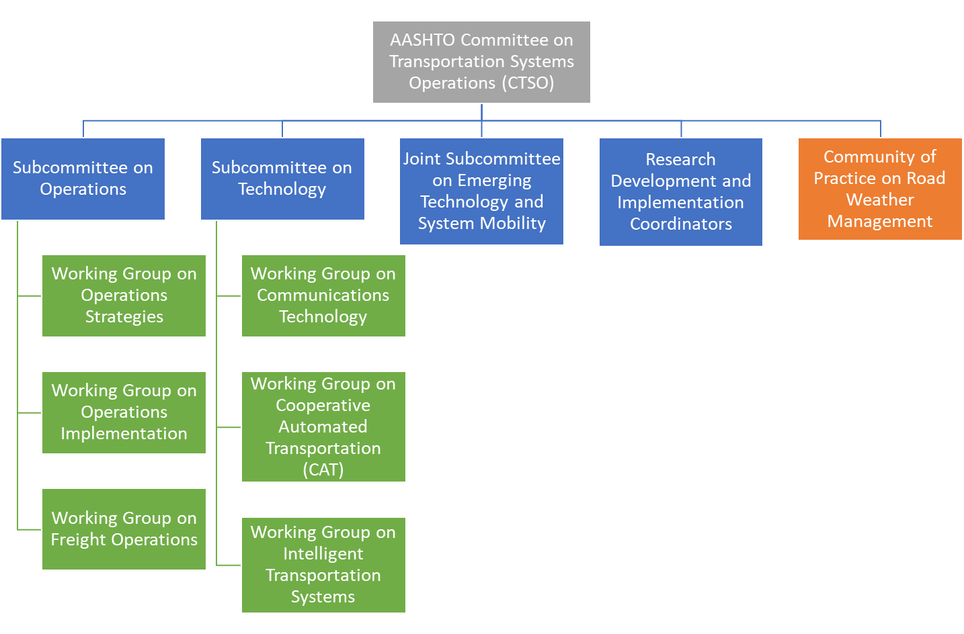
Joint Subcommittee on System Mobility and Emerging Technologies (SMET)
AASHTO Standing Committee on Performance Based Management (CPBM)
Notes:
.

Slide 4
System Mobility and Emerging Technologies
(SMET) Overview
Joint subcommittee formally fuses the related work of the Committee on Transportation System Operations (CTSO) and Committee on Performance-Based Management (CPBM). With an informal, collaborative relationship with the Committee on Data Management and Analytics (CDMA)
Serves as forum to share how state DOTs are managing system operation and system mobility and how performance is impacted due to current and emerging transportation technologies, operational strategies and connected environments
Explores system and mobility related performance, data and analytical tools, performance communication, reporting approaches, research and related, private sector partnerships
Examines the impacts of current and emerging system management approaches such as Connected and Automated Vehicle (CAV) technology, Cooperative Automated Transportation (CAT) and Mobility on Demand (MOD) programs.

Slide 5
Joint Subcommittee on System Mobility and Emerging Technologies (SMET)
New joint subcommittee – only five meetings thus far but key accomplishments
We are making a difference and gaining traction!
Mission in close alignment with the CTSO themes:
TSMO and CAT Alignment
Research
Input to NOCoE
Best Practices
ROLF and Operations Manual

Slide 6
System Mobility and Emerging Technologies
(SMET) Accomplishments: 2019-2020
Covid Activities #1 : AASHTO Survey on System Data for Covid-19
Survey requested feedback from each state agency on mobility performance data requests received to help answer “social distancing” and “shelter in place” policy effectiveness questions, including the following:
Social Distance Responses and Traffic Patterns
Shelter-in-place / Stay-at-home orders
Educational facilities being closed /Non-essential business being closed
Travel restrictions /Restaurant/Bar shutdowns
Number of people congregating
Fines/Enforcement
How do DOTs provide this data: use of dash boards or special reports? Has your agency begun to think about this type of analysis? What data would be required to do this analysis (count, employment, demographic)?
State DOT COVID-19 Response:
Use of Transportation Data and Information for Decision Makers
https://www.tpm-portal.com/resource/dot-covid19-data-survey/

Slide 7
System Mobility and Emerging Technologies
(SMET) Accomplishments: 2019-2020
Covid Activities #2 : Special Webinar Covid-19 Data Accessibility - Free Data Sources
The April 2020 webinar featured INRIX, University of Maryland, and Google and provided the following information on free data sources related to Covid19 analysis.
Webinar Recording: https://attendee.gotowebinar.com/recording/2019291993716040707
INRIX, Rick Schuman at rick@inrix.com
Blog posts: https://inrix.com/blog/
Volume Trends Dashboard information: https://inrix.com/covid-19-transportation-trends/
University of Maryland, Lei Zhang at lei@umd.edu
https://data.covid.umd.edu/
Google, Monali Shah at shahmonali@google.com
COVID-19 Community Mobility Reports: https://www.google.com/covid19/mobility/
COVID-19 public dataset program: Making data freely accessible for better public outcomes: https://cloud.google.com/blog/products/data-analytics/free-public-datasets-for-covid19

Slide 8
System Mobility and Emerging Technologies
(SMET) Accomplishments: 2019-2020
Other Partnerships:
AASHTO State AV Task Force Community of Practice
Identified 46 national CAV-AV-CAT Related Committees and Working Groups
Goal: how can the subcommittee fill gaps in our area of work and support relate efforts , leveraging resources
National, CAV-AV-CAT Related Committees and Working Groups – Inventory

Slide 9
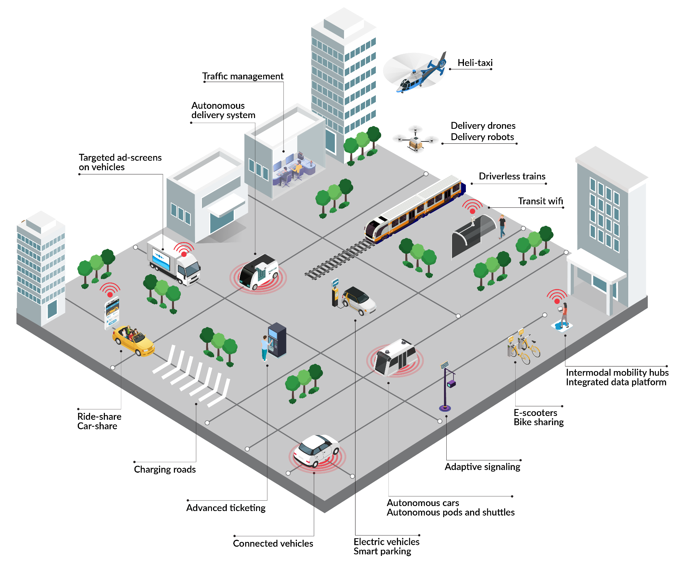
System Mobility and Emerging Technologies
(SMET) : 2020-2021 Action Plan Highlights
Theme 1: TSMO and CAT Alignment

Slide 10
System Mobility and Emerging Technologies
(SMET) : 2020-2021 Action Plan Highlights
Theme 1: TSMO and CAT Alignment
Considering to revisit the COVID-19 data survey – to include impacts on system analysis and technology budgets due to COVID-19 funding shortfalls
Engage with AASHTO Inter-Committee working groups for Emerging Technologies and volunteer to support alignments
Connected and Automated Vehicles (CAV)
Shared Mobility/ Mobility as a Service
Drones
Electric Vehicles

Slide 11
System Mobility and Emerging Technologies
(SMET) : 2020-2021 Action Plan Highlights (cont.)
Theme 2: Research
Developing a NCHRP 20-123 proposal to develop a strategic action plan and work plan roadmap for the subcommittee
Theme 3: NOCoE Support
Collaborate with NOCoE on developing case studies that exemplify the importance and use of system data for decision making beyond the traditional applications
Theme 4: Best Practices
Continue to hold bi-monthly subcommittee meetings that promote partnering sessions and the exchange of best practices
Reach out to the subcommittee and working groups of both standing committees to identify work plan priorities and opportunities for collaboration and identify partner TRB committees
.

Slide 12
Questions/Suggestions
Chair, Daniela Bremmer (WSDOT) - bremmed@wsdot.wa.gov;
Vice-chair, Jay Styles (VDOT), jay.styles@vdot.virginia.gov;
Patrick Zelinski, (AASHTO - CTSO - staff lead), PZelinski@aashto.org;
Matt Hardy (AASHTO – CPBM - staff lead), mhardy@aashto.org

