Slide 1
AMSIP
(Asset Management Strategic Implementation Plan)
TAMS Data Use Examples - What are we doing with all this asset management data?!
Dave Solsrud, PE
AMPO - Asset Management Program Office
Notes:
Questions:
is the return on data collection and maintenance worth the effort?
What level of obligation on districts to collect an maintain data?
What are the personnel implications?
Today is about showing what our people are doing with the data.
Will try to give a sense of analytical demands and “providers”
Presentation talks about Team Matrix, but also reflects guidance from Communications team: “Give examples of data use”
Also working to address Jay’s question: “What personnel and skillsets do we need in the districts to analyze the data?”

Slide 2

AMSIP Project
Major Decision Summary:
Do Not Pursue – Fence, Driveway Culverts, Storm Sewer*, Edge Drains
“Stay the Course” – Many Assets with Existing processes Ex: pavement, bridge, Culverts**
Low Hanging Fruit – AMPO, Other offices process existing data ex – Catch Basins, other Lidar data available
Process Improvements - Cyclical Lidar vs As-Builts
Substantial Investments - $$$’s, Staff Resource – ex: Sign Data, Sideroad culverts
*Storm Sewer to be collected on ad-hoc basis; via scoping inspections, district discretion ex: Metro
**Future analysis re level of detail needed for culverts
Notes:
More detail on next slide

Slide 3
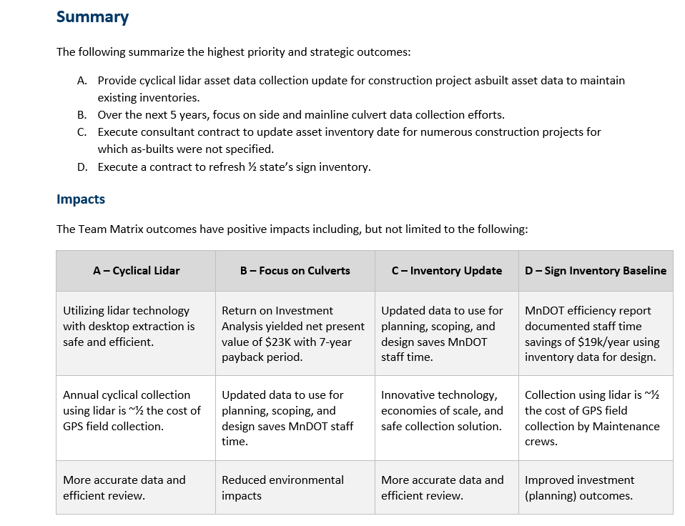
AMSIP Project
Notes:
See AMSIP Plan Document for more detailed information

Slide 4
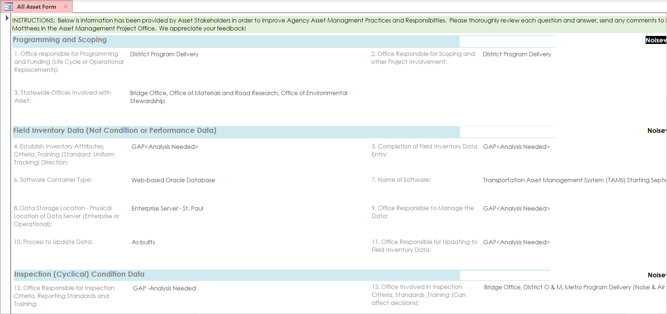
MnDOT Asset Responsibilities
Access Database
    Screenshot of Access DB (under development)
Notes:
An AMSIP goal (from 2019 TAMP workshop) = documenting roles and responsibilities
Access Database prepared by AMPO circa 2018
Much has been considered in AMSIP – some work left to do
Covers decision making, data collection, inspections, Could include additional questions? What is needed??????
Who:
Roles and Responsibilities – TAM guide?
Acquires data
Maintains data
Maintenance (TAMS work, Inspections)
Program delivery (As Builts, QA)
Lidar (Cyclical)
Uses the data
What would Operations like resolved/documented?
What format for presentation (see next two slides also)

Slide 5
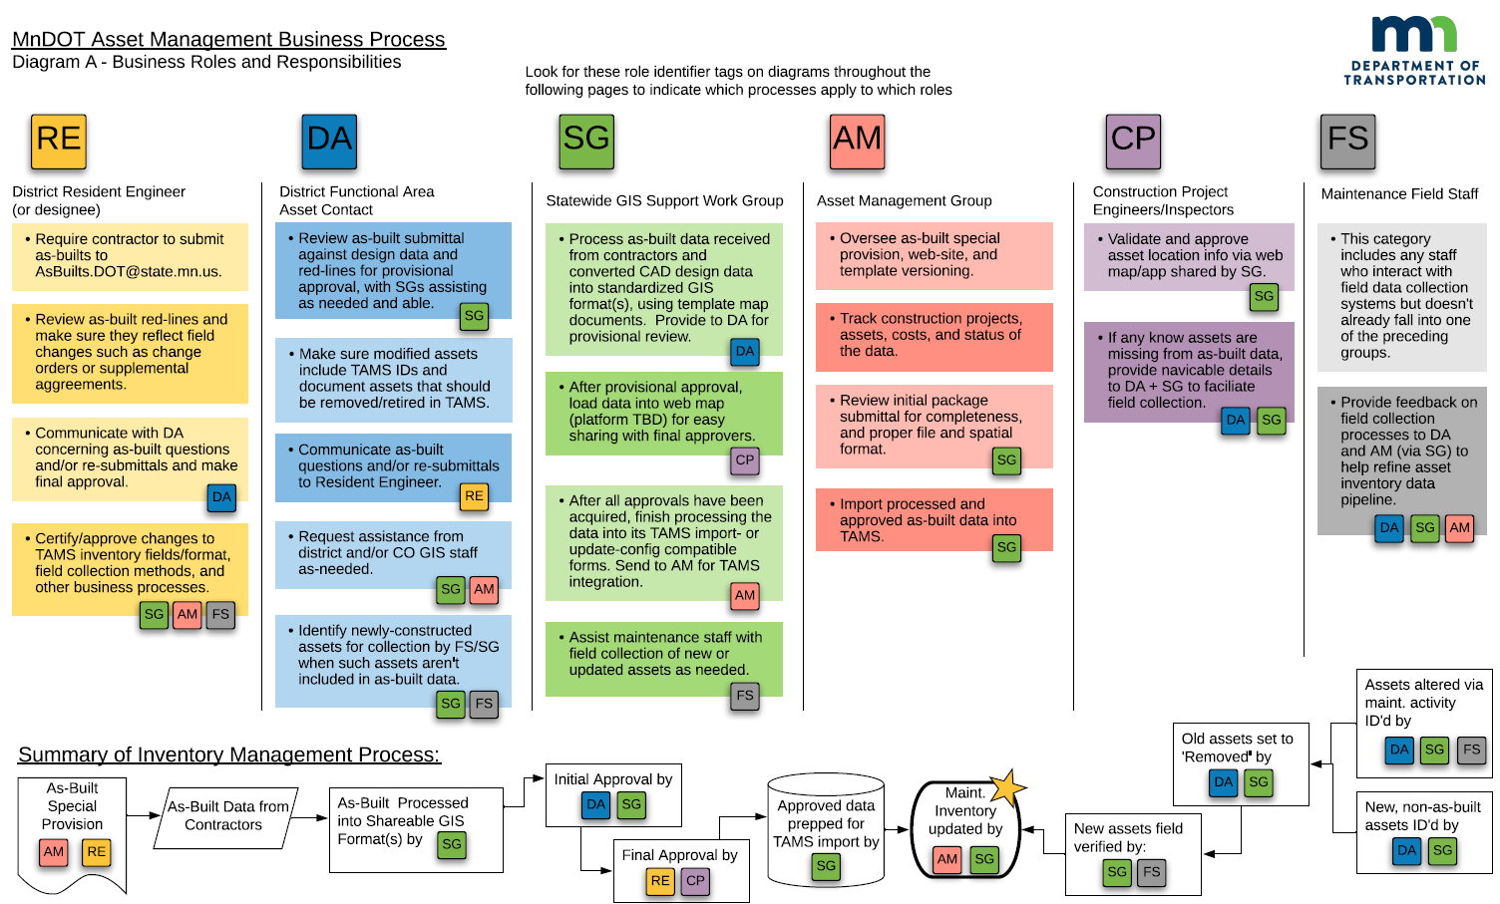
MnDOT Asset Responsibilities
As-Built Diagram

Slide 6
Asset Data Analytics
List of skills
Notes:
TAMS entry Skills: Work Orders – Maintenance leads
Asset Inventory
New – AMPO lead, Districts Validate – SME’s
As-Builts – (Spec) Construction lead – District SME’s validate, AMPO Support (uploads)
As-Builts – (cyclical Lidar) – AMPO lead, District SME’s validate, AMPO support (uploads)
Inventory mods by maintenance – Signs, Maintenance
What’s new (using the data)?
Georilla – (Viewer) continuously being updated
Assets, work histories, costs, drill downs, export
Universal internal access
AMPO stewardship (data connections
TAMS outputs
Many reports menu
Custom reports by AMPO/Embedded IT
Individual user created reports “Jasper”
Specialize Modules (Signs, Signals & ITS
HPMA – Pavement Investment Evaluator
District Evaluation of program proposals – Materials engineers
Asset Management Discipline
Planners – use output (reports)
Maintenance planners – use output (reports) Create work plans (TAMS)

Slide 7
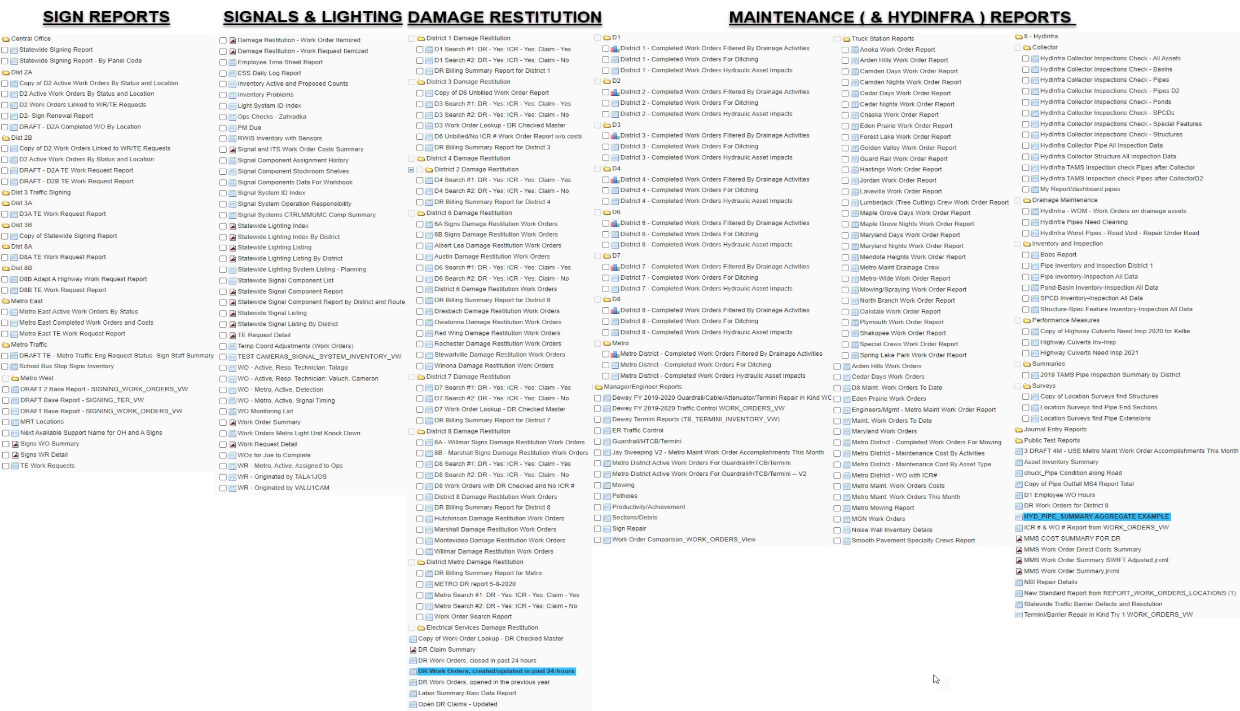
Who Uses Asset Data?
TAMS Reporting
    Suite of maintenance measures, LOS prioritization
Notes:
Some data can be pulled by specialists from TAMS
Some data can be pulled by GIS specialists from SDW
TAMS does have many “canned” reports – any user can pick from “public” reports
Created by any user or vendor
Users can also create their own personal reports
AMPO will create reports

Slide 8
Asset Data
List of Customers
Data Consumer Group
District Maintenance
District Bridge
District Traffic Ops
District Program/Planning
District Design
District Materials
District Construction
District Restitution Coord
District Communications
Maplewood
OCIC (Construction)
OPMTS (Project Mgmt Techn Support, ADA)
Bridge Office (Hydraulics included)
District Hydraulics
Office of Traffic
OTSM (Planning, Performance Measures)
Finance
CAV-X
Office of Environmental Stewardship
Office of Land Management
Transit and Bike
Freight
Electrical Services
Office of Maintenance (081)
Statewide Communication
AMSIP matrix has 25 groups of data consumers
Notes:
“Matrix” team – Data considerations
Dave Solsrud’s rule of Asset Data Use: “The “crowd” will double the number of uses of data you envisioned” People are creative!
Ex – we didn’t even consider Damage Restitution. MnDOT is a national model - $9M recovered last year.
Generic rule to keep in mind as leaders: “Personnel most responsible for collecting/recording data are the least benefitted.”

Slide 9
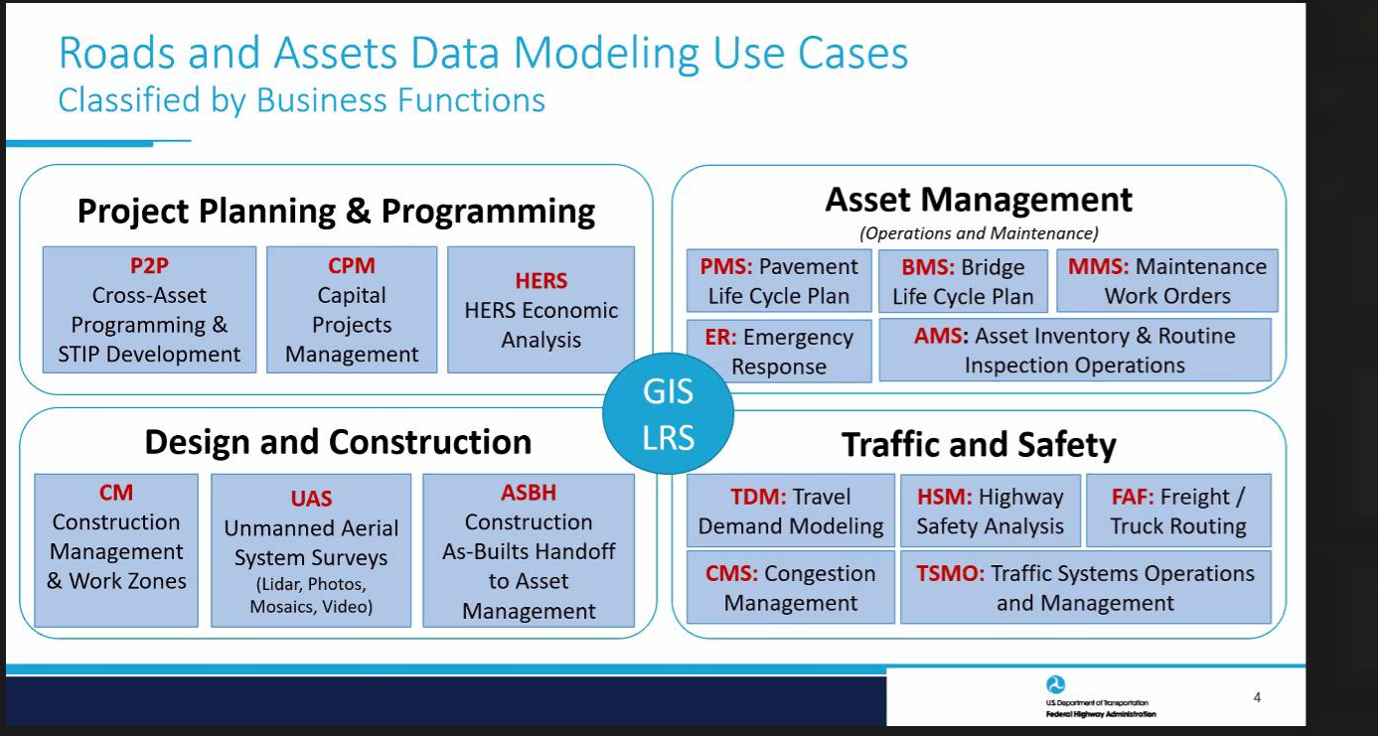
Asset Data
Business Functions
Notes:
FHWA presentation of data use cases
Takeaway – GIS and LRS link the data
Ex - Locs of signals, rumble strips, barrier, striping, driveways, sign quality etc. in crash analysis
Ex – Maintenance History for scoping, program decisions
Ex – asset data for planning – (more data, easier, earlier)
Ex – Upcoming capital projects for maintenance work planning
Ex - Pavement markings Retroreflectivity quality data for CAV
Ex - Maximized lifecycles via holistic data view for any asset class (i.e. continuous improvement in any stage is supported with data)
01: [Routes and Assets Data] from Road Inventory Systems → LRS, Road Inventory, Asset & Project Systems, Data Hub
02: [Asset Inventory, Condition and Work History, Plans Data] from TAMS → Data Hub & Vulnerability Analysis Systems
03: [Asset Damages Data] from Asset Inspection & Damage Assessment Apps → Asset Management System, GIS
04: [Survey, Inspection Data] from UAS → AMS, GIS, Design, Construction, Data Hub Systems
05: [Incident, Traffic & Asset Data] from Weather, Traffic and Asset Systems to Data Hub, Warehouse, GIS, BI
06: [Repair Projects and Work Plan/Requests Data] from Vulnerability Analysis & DDIR Apps → PPMS & AMS
07: [As-Built Asset Data] Design, Construction → LRS and Asset Management Systems
08: [Processed and Integrated Data for Analytics] from Data Hub → Data Warehouse & BI Systems
09: [Roads and Assets, Projects, Damages] from DOT Systems → FHWA HPMS, FMIS, DDIR Systems

Slide 10
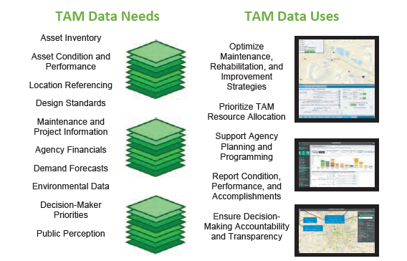
Asset Data
Business Functions

Slide 11
Who Uses Asset Data?
Maintenance Measures
    Suite of maintenance measures, LOS prioritization
Service Area | No. Measures
Bridges and Structures Inspection and Maintenance | 14
Bridge Inspection | 3
Bridge Preventive Maintenance | 4
Bridge Reactive Maintenance | 3
Non-bridge Structures | 4
Snow and Ice | 1
Snow and Ice | 1
System Roadway Structures Maintenance | 6
Drainage Systems Inspections and Maintenance | 2
Pavement and Surface Repair | 2
Vegetation Management | 2
Traffic Devices Operation and Maintenance | 20
High Mast Tower Lighting Inspection and Maintenance | 2
Highway Maintenance Safety Barrier Products | 10
Roadway Lighting Inspection and Maintenance | 2
Signal System Inspection and Maintenance | 3
Static Signs Inspection and Maintenance | 3
Grand Total | 41
Notes:
Current Maintenance Measures and Targets – many with LOS targets
Ex Barrier repair (next slide)
LOS can be prioritized within P/S or across P/S for letter grades A/B/C/D each
Analysts: AMPO, CO specialty office, Office of Maintenance
Analyst: District TPS + GIS person could create for district
Data sources: Vary by measure – additional examples to follow

Slide 12
Who Uses Asset Data?
Maintenance Measures
Traffic Barrier Performance Measures** | Level of Service Categorization A 100% -80.1%, B 80% – 60.1%, C 60% - 40%, D <40%
 | LOS Target | Non-Functional* | Functional Results*
High ADT Cable Barrier - % Completed On-Time | B | (10 days) 74% LOS B | (15 days) 90% LOS A
Low ADT Cable Barrier - % Completed On-Time | B | (15 days) 69% LOS B | (20 days) 76% LOS A
High ADT Attenuator/End Treatments - % Completed On-Time | C | (5 days) 49% LOS C | NA
Low ADT Attenuator/End Treatments - % Completed On-Time | C | (10 days) 45% LOS C | NA
High ADT Plate Beam Guardrail - % Completed On-time | B | (10 days) 54% LOS C | (25 days) 81% LOS A
Low ADT Plate Beam Guardrail - % Completed On-time | B | (15 days) 49% LOS C | (30 days) 61% LOS B
*Entire dataset calculated functional/non-functional as no means to know at this time.
**From July 1, 2020. Accident date to Finish date (day card). 767 Repairs.
Notes:
There were over 3100 repairs during this timeframe, WO start 7/1/20.
but found that using accident date is more accurate than WO start date when it comes to “notification or days to fix” so reduced number of records to get more accurate results on dataset. - Need some modifications to TAMS (coming in TAMS3)
Analyst = Traffic Office
Analyst = District TPS could easily run this data
Data Sources: TAMS, Measures data

Slide 13
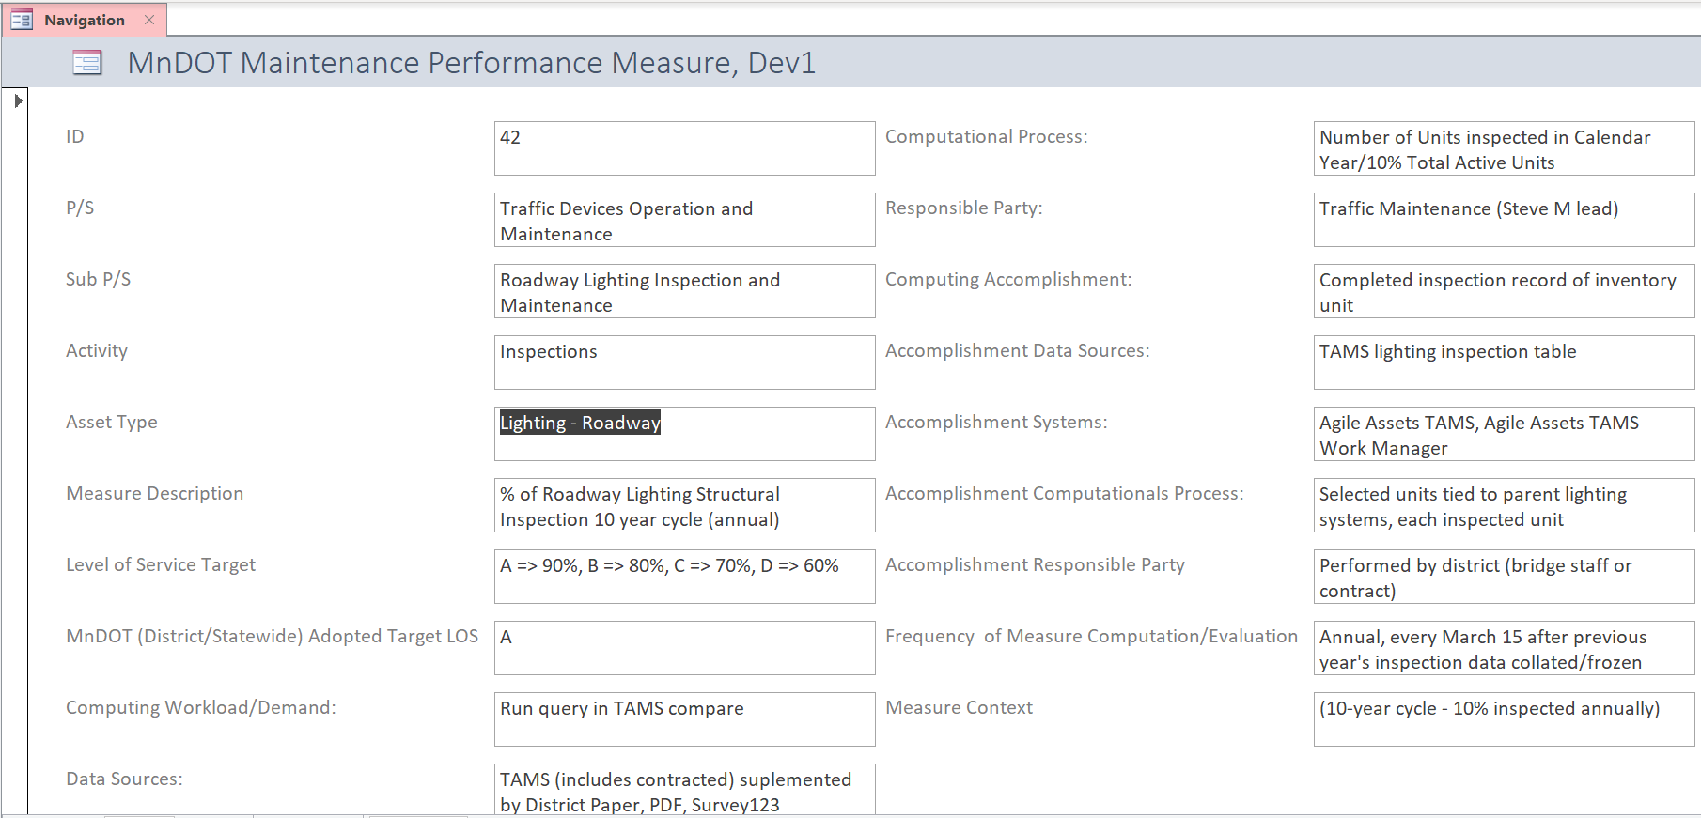
Who Uses Asset Data?
Maintenance Measures
Notes:
Documentation for maintenance measures – roles & responsibilities, computational methodologies, data sources, levels of service

Slide 14
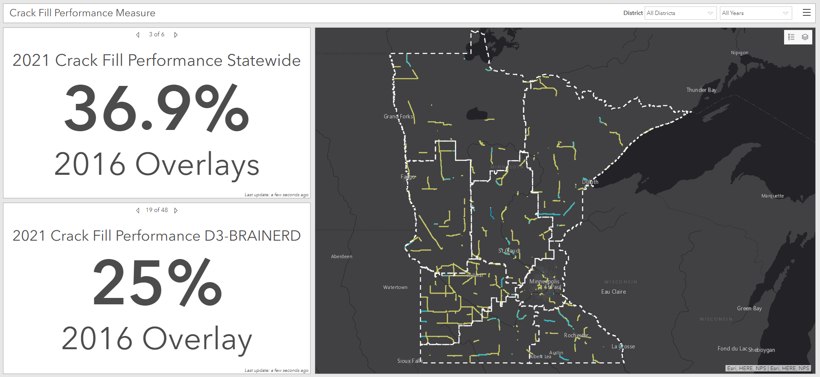
Who Uses Asset Data? Maintenance Measures
    Graphic showing one measure with levels of service Computations
    Josh Dashboard for crack filling or patching (whichever has the best dashboard)
Notes:
Example: Maintenance Measure tracking (80% target applicable at end of CY 21)
Analyst = AMPO – one-time dashboard creation (Rather than running reports, AMPO is building dashboards – real time performance)
Analyst = District GIS and TPS could drill down
Data Sources: CHIMES, TAMS, HPMA

Slide 15
Who Uses Asset Data? Spatial Analysis
Notes:
Example: Maintenance Work Planning – Ex culvert inspections vs performance measure
Analyst = CO Hydraulics
Analyst = District GIS + TPS could drill down (TAMS Data)
Data source: TAMS

Slide 16
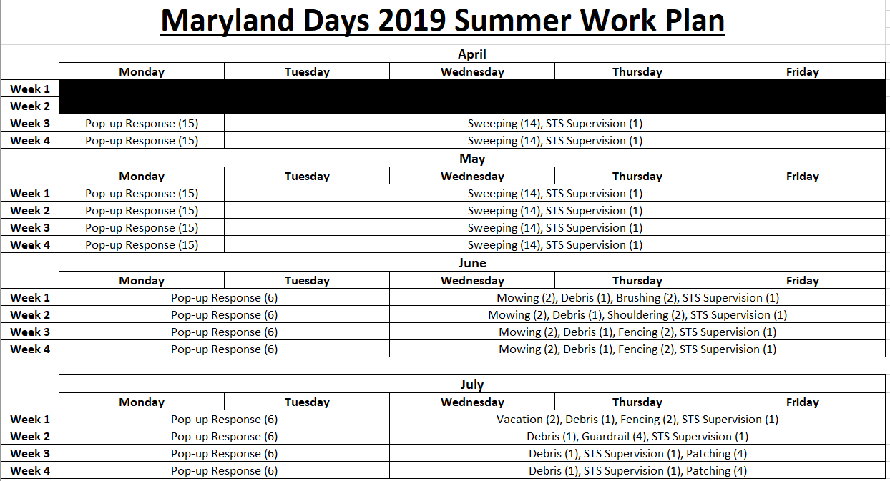
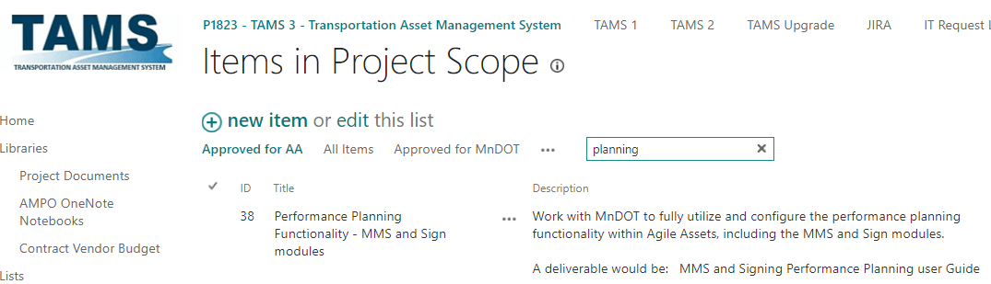
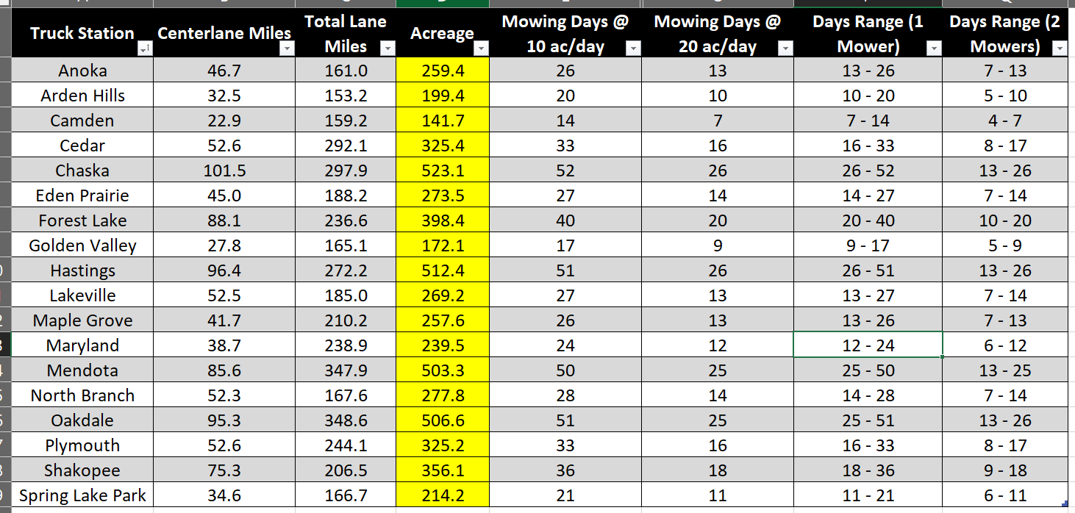
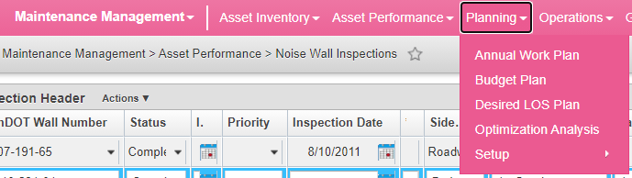
Who Uses Asset Data?
Maintenance Planning
Metro District
  Weekly Summer Planning
  Mowing Demand
  Mowing Planning
TAMS 3
Notes:
Example: Maintenance Work Planning – Metro
Analyst: TPS and or GIS
Data Sources: TAMS, SDW
(Note: TAMS3 will automate much of this)
Key Takeaway: Resource and Activity Planning (daily, annual, budget), TAMS 3
Background: Doug Maki met with supervisors in 2018 and 2019. Developed plans by week, activity, and number of employees. Planning module in TAMS will include resource projections by activity. $$
Historical TAMS data will provide demand and planning. In this example, acreage calc’s from lane miles and assumptions on acreage conversion. Got estimates on how much can be mowed in a day.

Slide 17
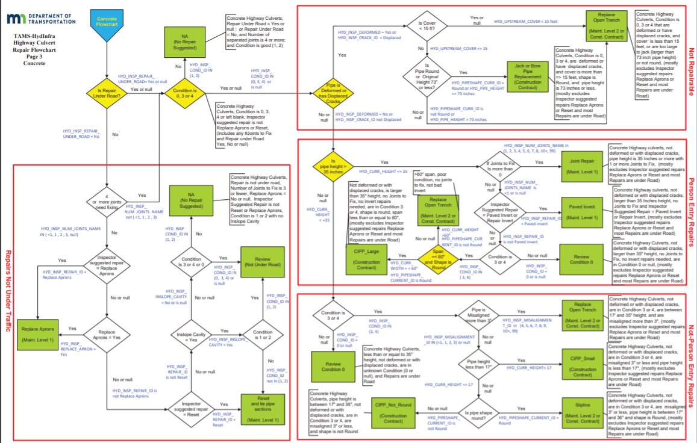
Who Uses Asset Data?
Maintenance Planning
TAMS-HydIfra Highway Culvert Repair Decision Tree
Notes:
Example – Hydraulics work needs
Analyst: CO Bridge Hydraulics
Analyst: District TPS + GIS could run this
Data Sources: Decision tree built in TAMS
Key Takeaway: Decision Tree in TAMS, types of culvert repairs based on inspections

Slide 18
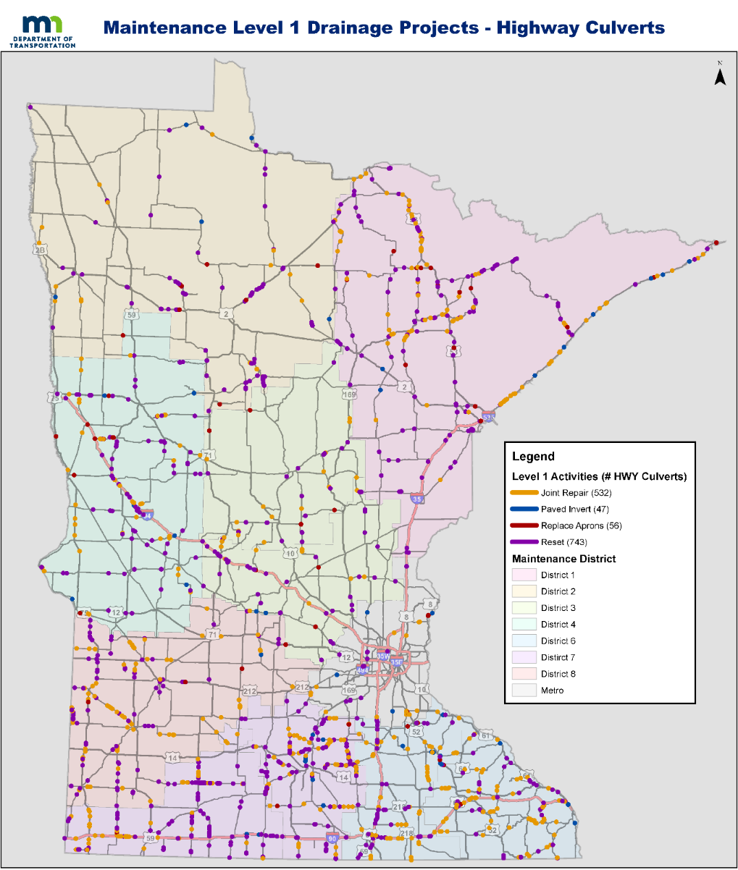
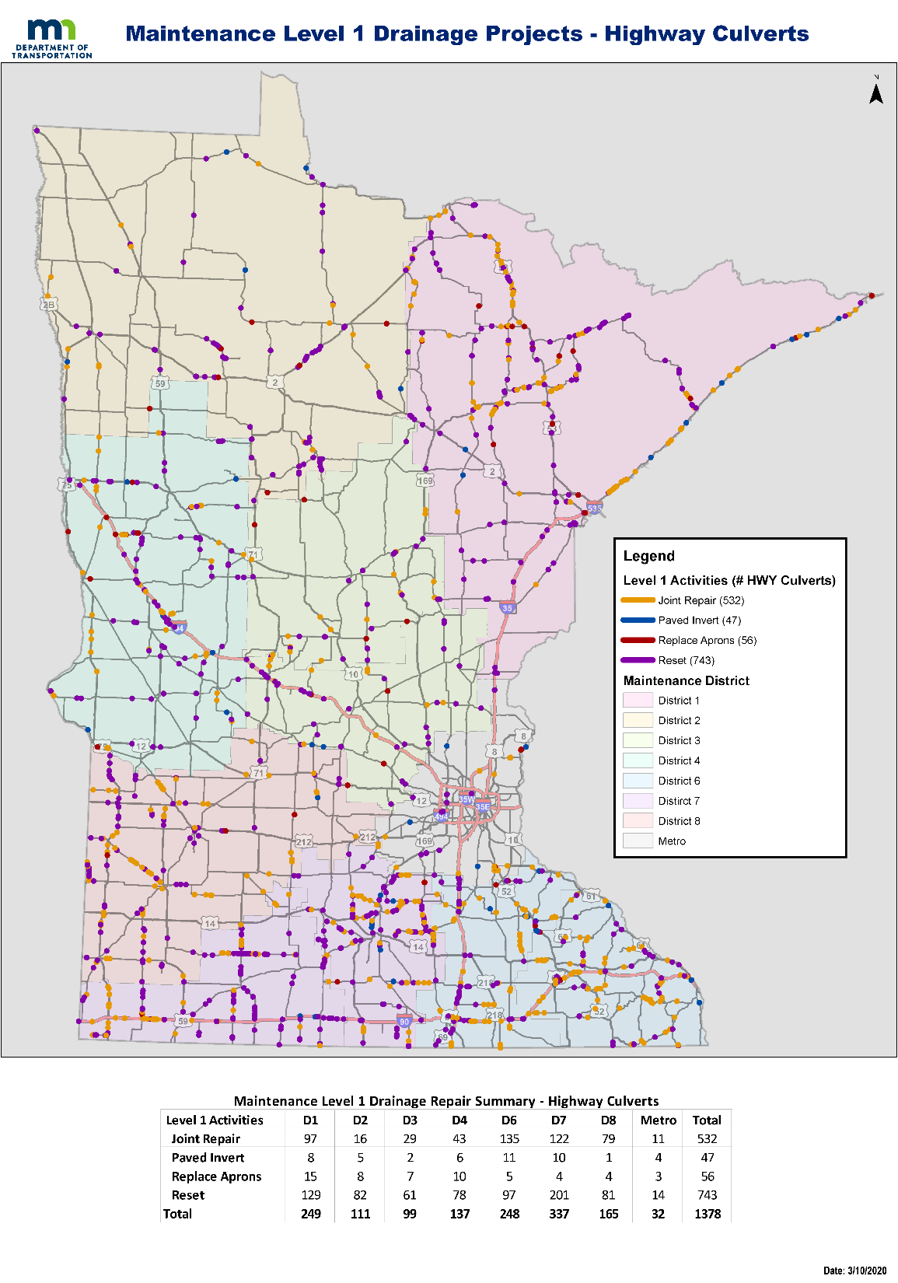

Who Uses Asset Data?
Maintenance Planning
Performance Measure-Flowchart Repairs-InplaceCulverts-Flowchart_21Feb.xlsx shows Flowchart Suggested Repairs and Priority 1 repairs for HydInfra Pipes from SDW 06FEB2020
Notes:
Example – Maintenance Performance Targets/Work Planning
Analyst: CO Bridge Hydraulics
Analyst: District TPS, Hydraulics Engineering Personnel, GIS could perform
Data Source: TAMS, Measures documentation
Key Takeaways: Results of decision tree helps plan for maintenance repairs (corridor, activity type, materials needed)

Slide 19
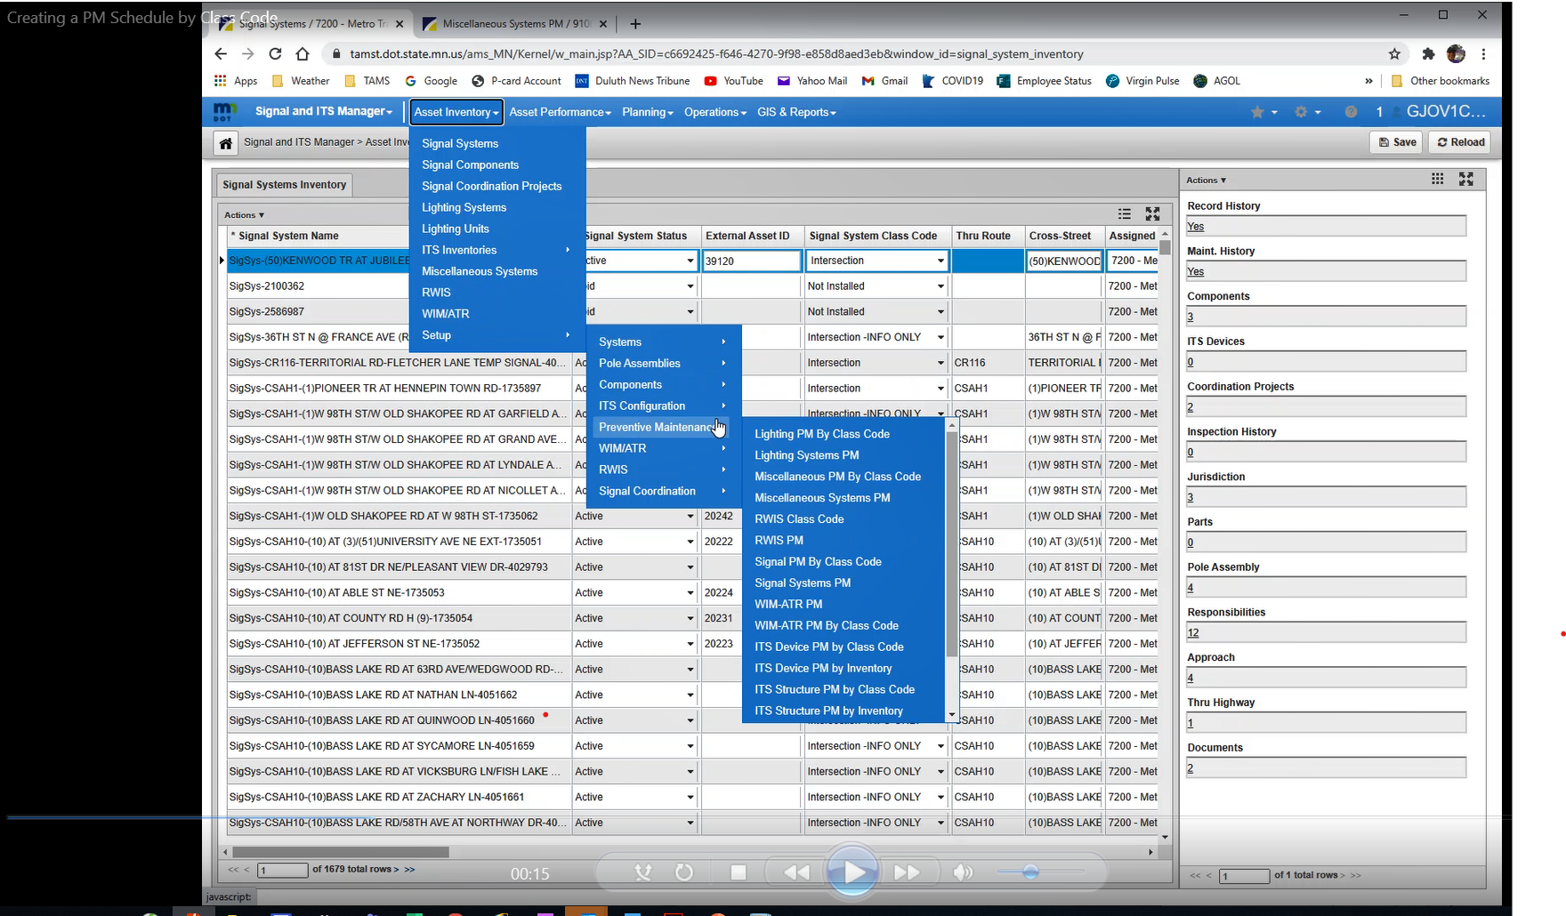
Who Uses Asset Data?
Preventive Maintenance Scheduling
Notes:
Example – Creating a Preventive Maintenance Schedule – Cameron’s training video 1:14 – can be used for any asset requiring repetitive action, culvert/pond inspections, structural inspections etc.
Analyst: Any CO Specialty office TAMS user (with appropriate profile settings)
Analyst: Any TAMS user (with appropriate profile settings)
Data Source: TAMS

Slide 20
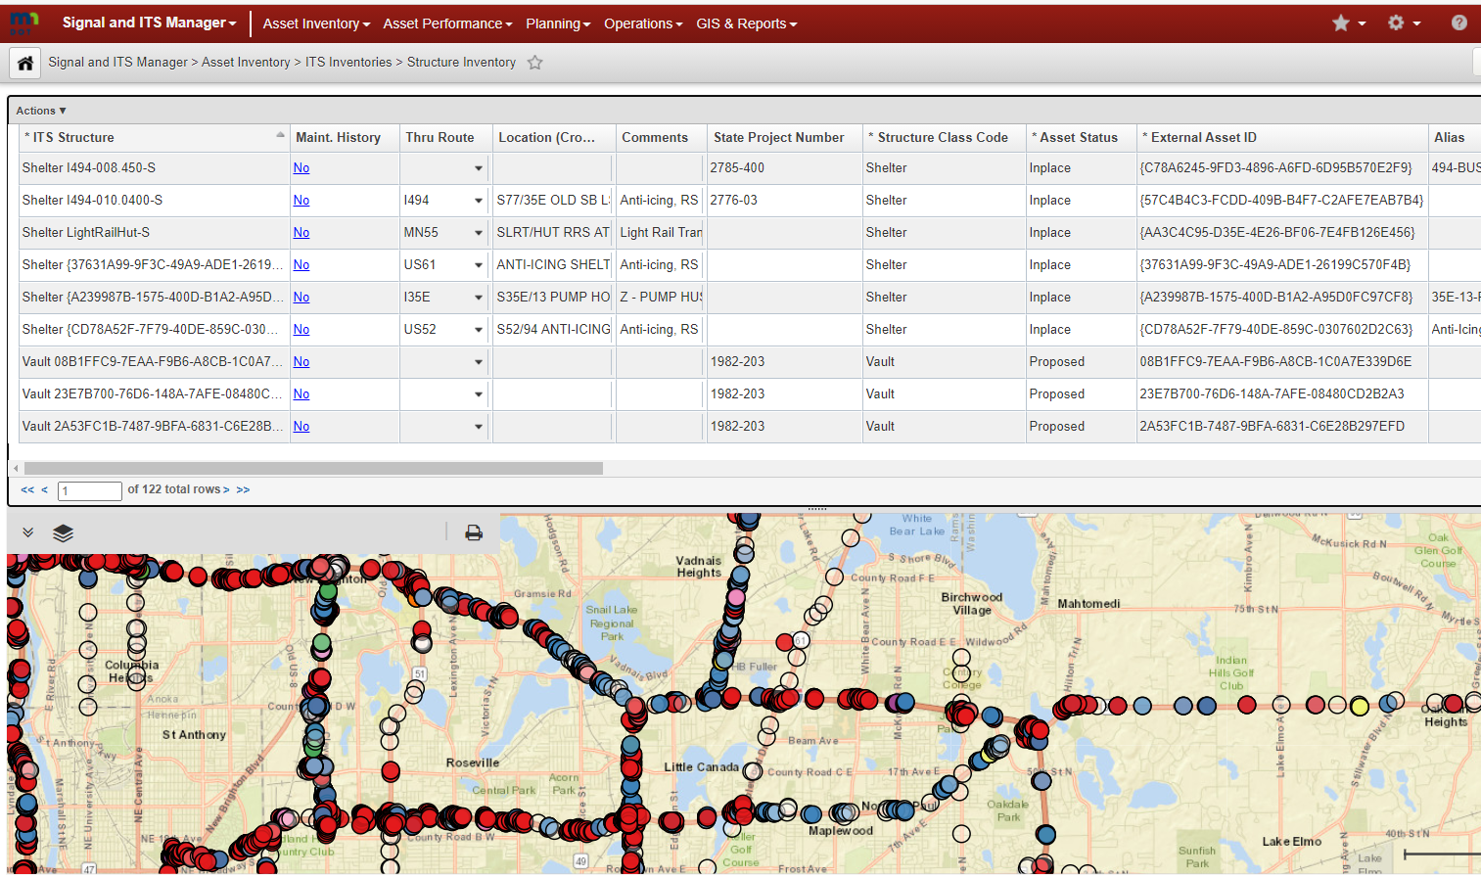
Who Uses Asset Data? System Size
Number of Assets Currently Residing in TAMS by Asset Category
Asset Category | Total Number of Assets
Hydraulics | 229,843
Hydraulic Structures | 79,458
Pipe | 148,794
Ponds | 1,366
Stormwater Tunnel Segments | 175
Stormwater Tunnel Structures | 50
Intellegent Trans. Systems | 71,019
ITS Cable | 5,180
ITS Device | 14,851
ITS Span | 33,625
ITS Structure | 17,363
Miscellaneous Systems | 1,664
Earth Retaining Systems | 860
Noise Walls | 447
RWIS | 168
WIM/ATR Systems | 189
Signals and Lighting | 74,577
Lighting Systems | 2,344
Lighting Units | 35,523
Signal Component | 33,924
Signal Systems | 2,786
Traffic Barriers | 51,402
Linear Barriers | 17,846
Termini | 33,556
Traffic Signs and Messages | 795,006
Panels | 456,755
Pavement Messages | 11,249
Supports | 327,002
Grand Total | 1,223,511
Notes:
Example – population of assets
Analyst: AMPO
Analyst: District TPS, GIS could run
Data source: TAMS (would need to supplement with HPMA, BRM depending on question)

Slide 21
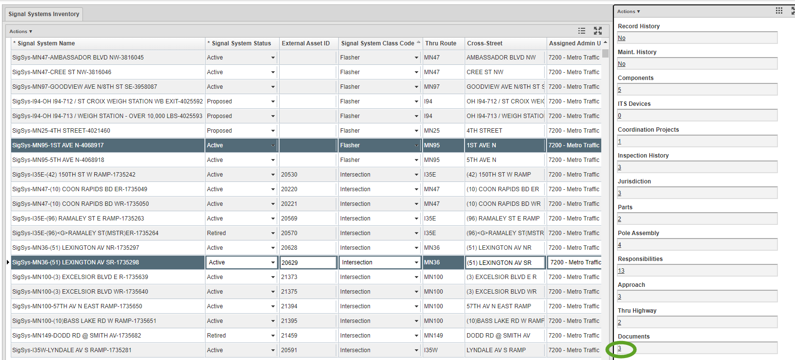
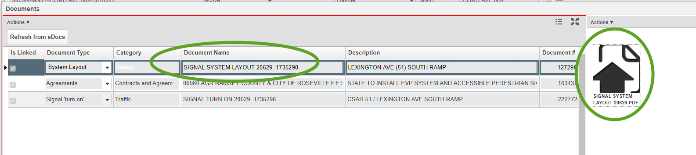
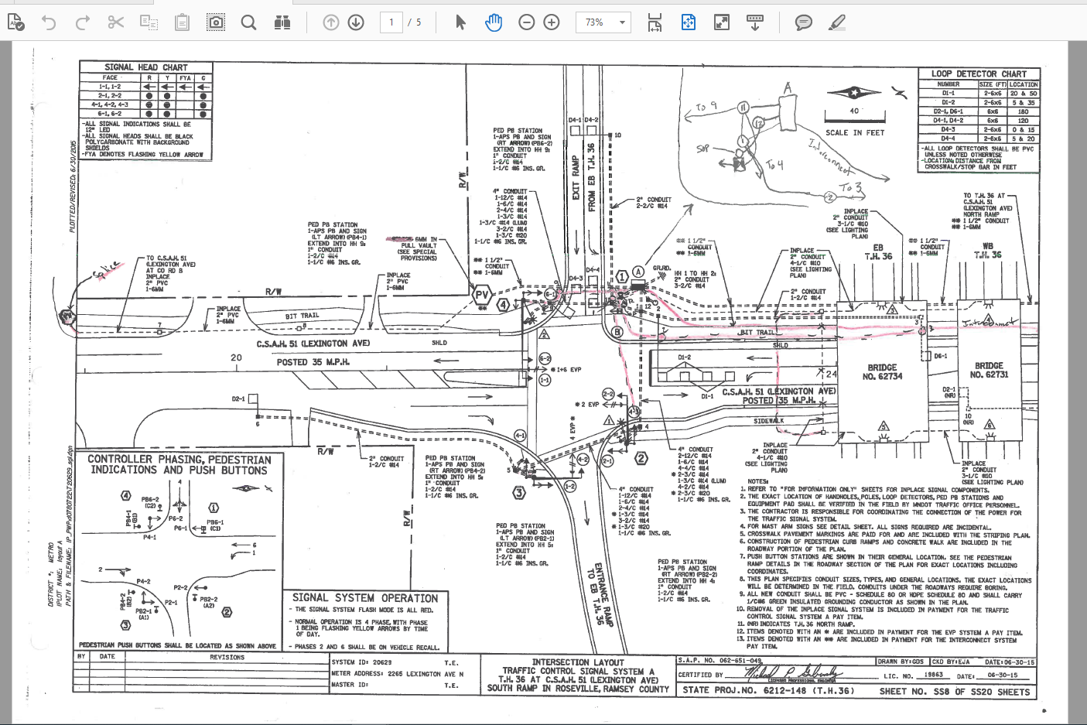
Who Uses Asset Data? Easy Access to Info
Notes:
Example – Access to plans, Agreements etc. via Edocs. Damage restitution attachments
Analyst: Any TAMS user
Data Source: EDOCS via TAMS

Slide 22
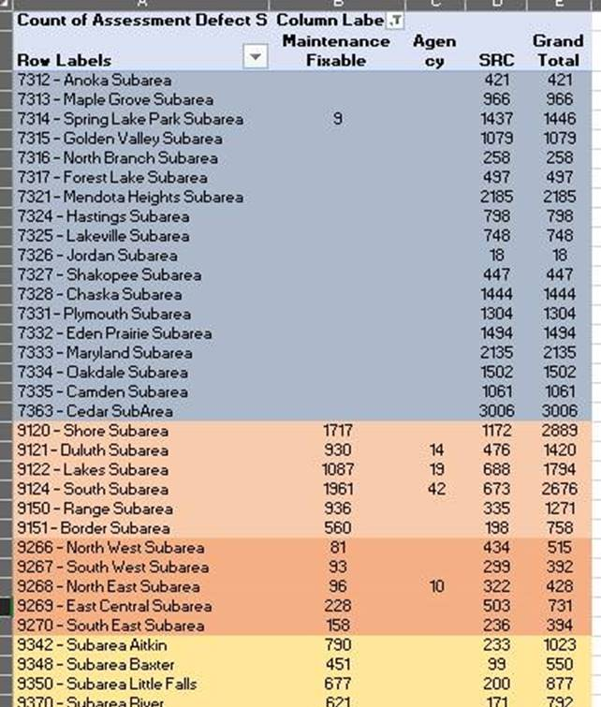
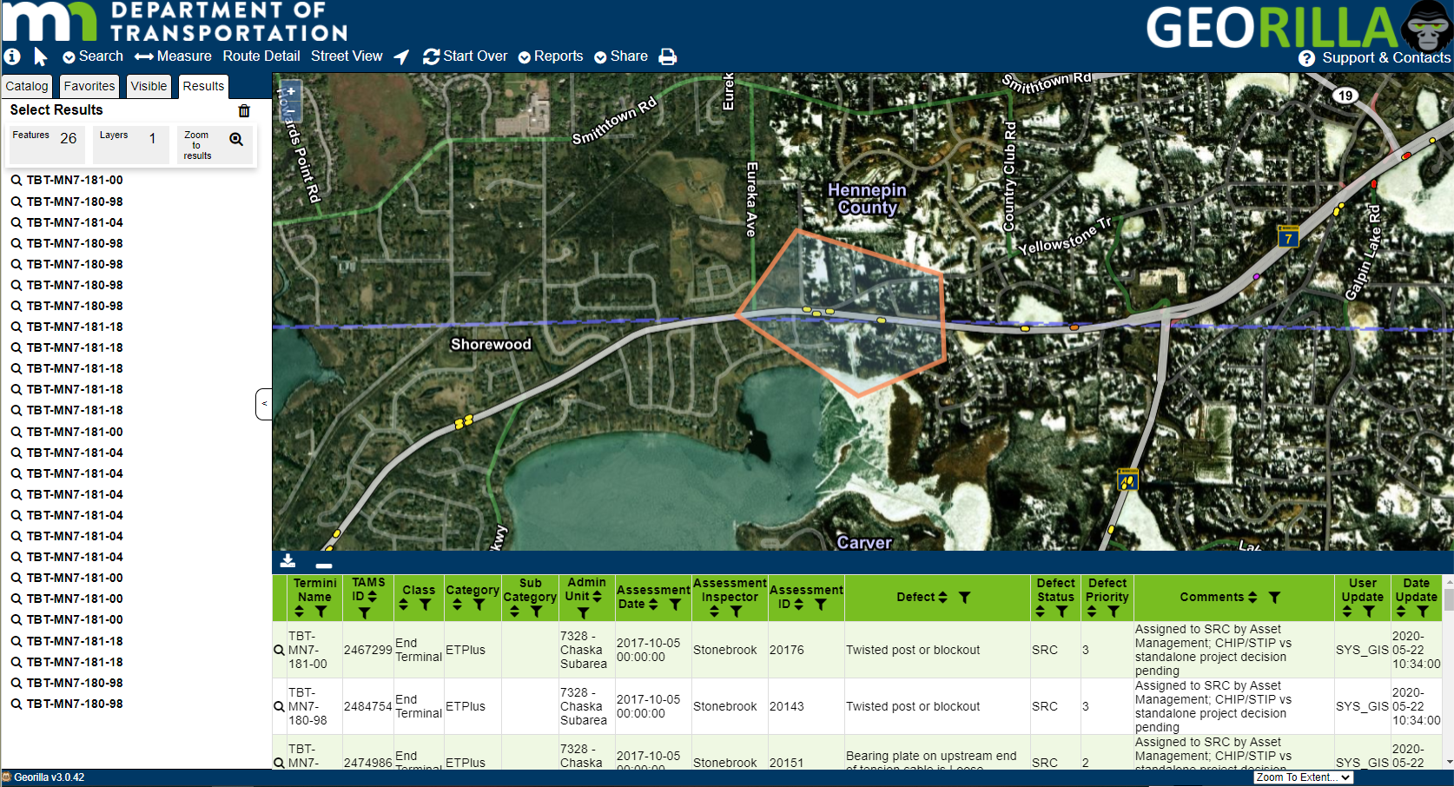
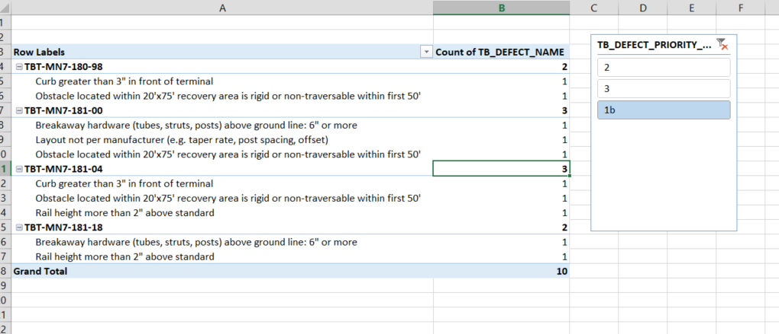


Who Uses Asset Data?
Maintenance/Capital Integration
Planning For and Addressing Traffic Barrier Defects
Notes:
Example – Maintenance and Capital Integration for Barriers
Analyst: AMPO
Analyst: District TPS, GIS (geofence in Georilla, export data) TAMS data easily exportable to XCEL
Data Source: TAMS
Key Takeaways: What work is maintenance and what is capital, ease of data availability, tracking what has been done
Background:
Driver of the project was to get a full inventory with several attributes include TB category and sub-category. For example, termini class code of crash cushion, bullnose category, and thrie beam sub-category as well as boots on the ground inspection of TB termini that included identifying over 70+ defects in 3 different priority groups.
Data uploaded into TAMS. Communication across the state about the results and putting a plan in place on how the defects would be addressed: Maintenance Fixable, SRC Fixable, other agency. Example of maintenance and capital coordination: Barrier

Slide 23
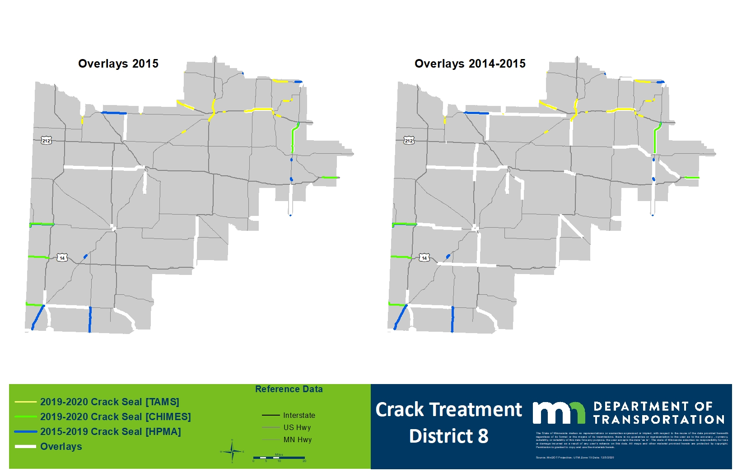
Who Uses Asset Data?
Maint/Capital Integration, Asset Management
Notes:
Example - Speaks to: Pavement Asset Management, PM Performance Measures, Maintenance and Capital Integration, Maintenance work planning
Analyst: AMPO
Analyst: District GIS (limited), TPS (TAMS historic work reporting)
Data Sources: HPMA, CHIMES, TAMS, SDW, PM Perf Measure Data
Speak to:
Measures established
Demand indicated
Accomplishment tracking for maintenance (TAMS)
Accomplishment tracking for capital (Chimes)

Slide 24
Who Uses Asset Data?
Maint/Capital (MnSHIP) Integration
Integrating Maintenance & Capital Ex: Pavement Mgt Forecast Condition * Performance/LOS * Cost Model@Cond
Notes:
Example – Patching demand as a result of pavement investment levels (modified revenue scenarios)
Analyst: AMPO
Analyst: District GIS (possibly)
Data Sources: TAMS (resource demand models), HPMA (pavement distress forecast), Performance Model data
Takeaways
If Poor Pavements go from 5% to 10% (sounds like a small thing?) that’s a doubling of mileage, but the model reflects both increased cost by poorer condition, AND increased number of mobilizations (every 1 year vs every 2 or 3 or 5)
Costs at least double!
(Non-NHS forecast for 16.2% or 18% poor in 2037)

Slide 25
Who Uses Asset Data?
Cost vs Productivity
Cost of the Crack Filling Activity as Recorded in TAMS
The data includes work done between Jan. 1, 2020 thru Dec. 31, 2020
Data reflects total cost of project broken down by reported length in miles.
Notes:
Example – Crack Filling Cost per mile
Analyst: District TPS, GIS
Data Source: TAMS (HPMA data is accessible via TAMS)
Takeaways: how do geographic or organizational units compare. Add further analysis to compare ADT, Lane configuration, travel time/distance, roadway condition

Slide 26
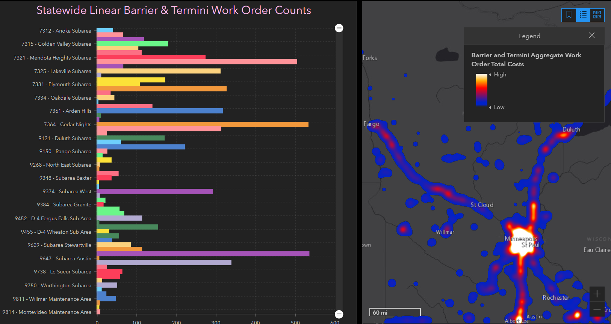
Who Uses Asset Data?
Spatial Analysis
TAMS Traffic Barrier Work Order Counts and Work Order Heat Map Highlighting Highest Cost Maintenance Repair Locations
Notes:
Example – “Heat Maps”
Analyst: District GIS
Data Source: TAMS
Key Takeaways: See Useful data by location on a map. Where’s the workload?
Background:
ArcGIS Online tool using TAMS data. Dashboard with interactive map on right. Work Order information that includes counts and total costs since TAMS inceptions.

Slide 27
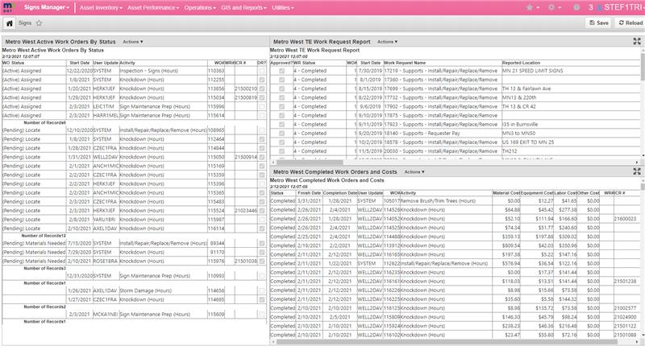
Who Uses Asset Data?
Dashboards
    What would be a good dashboard for a DE or Maintenance Engineer?
Notes:
Example: TAMS Dashboards: Active Work Orders, TE requests, Completed work orders – Individual User configurable, infinite combinations
Analyst: Individual user may configure
Data Source: TAMS
Key Takeaways: Quick Visual Table or Graph
Background: Sign module helping mainly with daily work planning, here I’m showing Work orders by status, TE requests coming/status, Pending locates

Slide 28
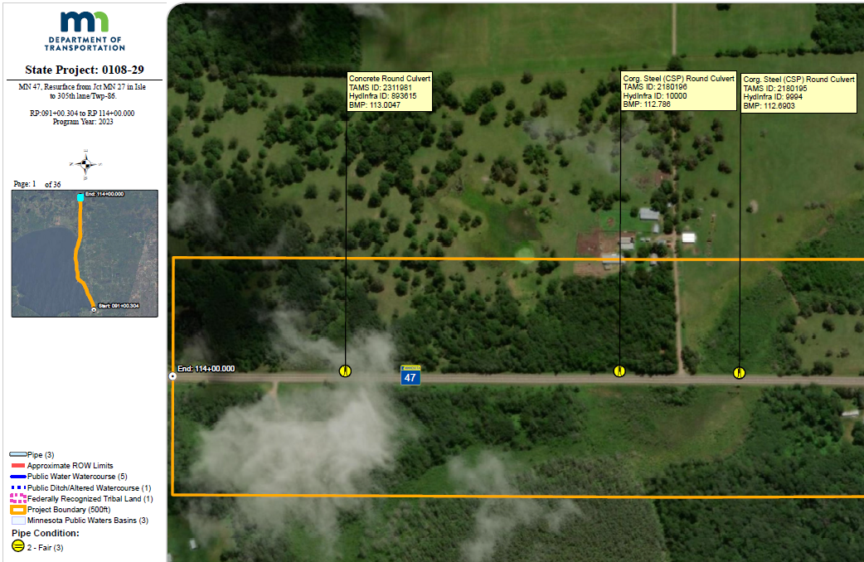
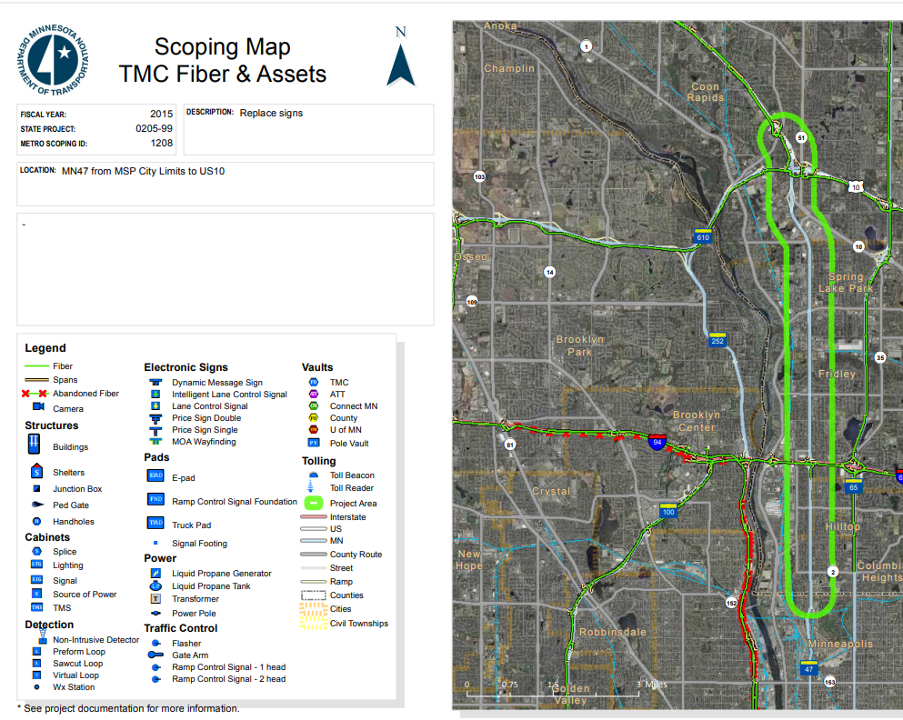
Who Uses Asset Data?
Scoping
Scoping Maps Containing Asset Information Within Future Project Limits (D3, D4, D6, Metro)
D1 “We are working on a standardized scoping product (likely map books similar to D6) but currently use the SDW layers of TAMS on a case-by-case/request basis to create maps, KMZs (Google Earth), or web apps for viewing asset data”.
Notes:
Example: Scoping = SDW or Georilla, Static Maps, or live drill down. Data easily available for planning & programming, shelf projects etc.
Analyst: District GIS
Analyst: Easy access by anyone
Key Takeaways: Assets Types and Locations Contained Within Project Limits
Background: Several Scoping map pages per project in Metro, D6, and D4. District 3 using corridor mpa’s.. Georilla and Google Earth being used.

Slide 29
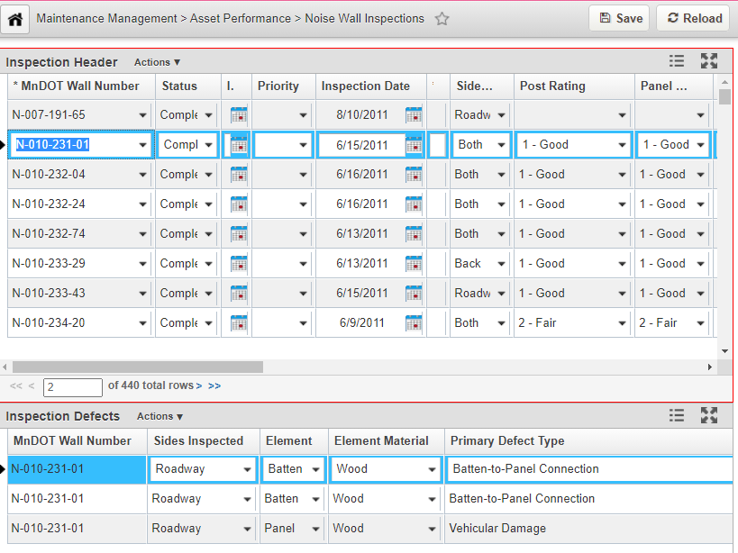
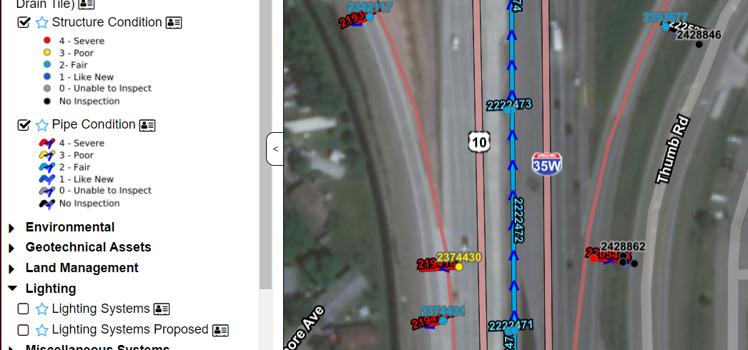
Who Uses Asset Data?
Scoping
Inspection Records Indicating Overall Condition, Defects, Detailed Checklists
Notes:
Example: Scoping Drill Down – Easy color coded ID, report summary or detailed defects, exported to spreadsheet/pivot table
Analyst: GIS or TPS
Key Takeaways: Asset Condition and Defects Scope Future Projects
Background: Shown here- Traffic Barrier defects exported out of Georilla (TAMS), view of drainage structure and pipe information,
TAMS look at noise wall inspection data including element ratings and defect types.

Slide 30
Who Uses Asset Data? Procurement
Example of how data can be extracted and viewed
Cost of guardrail repair by roadway type
Roll-up guardrail parts cost report by admin unit
Notes:
Example – TAMS interface with SWIFT – quantities of pieces and parts…. (also nice example of costs by roadway type)
Analyst – TPS
Data Source: TAMS

Slide 31
Who Uses Asset Data?
Procurement/BARC
Sign Management
Notes:
Example – Procurement/Budget/Capital Planning – Sign panel cost by geographic area by remaining service life – is there a wave?
Analyst: CO Traffic/signs
Analyst: TAMS Sign Module users
Data Source: TAMS

Slide 32
Who Uses Asset Data?
Consigned Inventory
TAMS has the ability to be able to keep track of our consigned inventory details:
Where and when it was used
What is our current quantity on hand
Used as a tool for cycle counting
Notes:
Example – Inventory charge outs by center – Goal is to use consigned inventory centers to better manage and secure materials – TAMS reports make reconciliation with SWIFT easier. Any number of permutations of this type of report possible.
Analyst: TPS
Data source: TAMS, SWIFT
TAKEAWAY – we are strongly encouraged to keep high value materials in consigned inventory centers managed by field personnel (culverts, guardrail, signs)

Slide 33
Who Uses Asset Data?
Damage Restitution
Damage Restitution Claim Numbers for the Calendar Year 2020
Notes:
Example – TAMS work orders customized for damage restitution, has cut many steps and redundancies, increased transparency, accuracy.
Analyst: Damage Restitution Coordinators
Data Source: TAMS
Takeaways: Many players involved (finance, legal, operations etc) overall a very successful implementation.
Some damage not captured by TAMS work orders (Bridge)

Slide 34
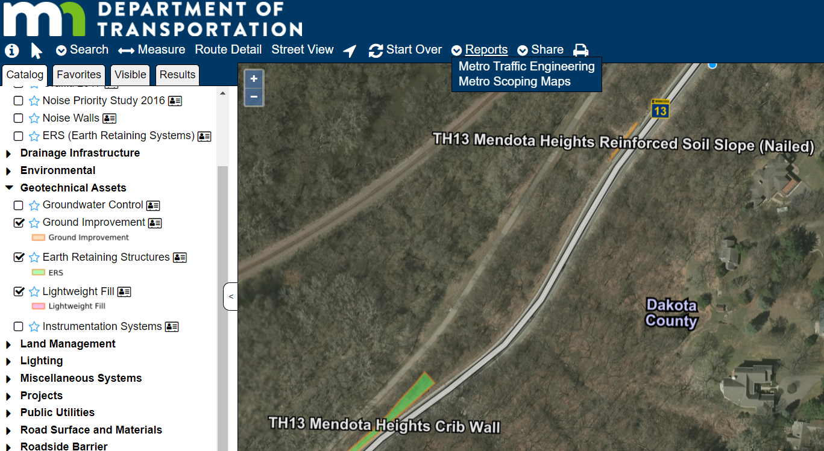
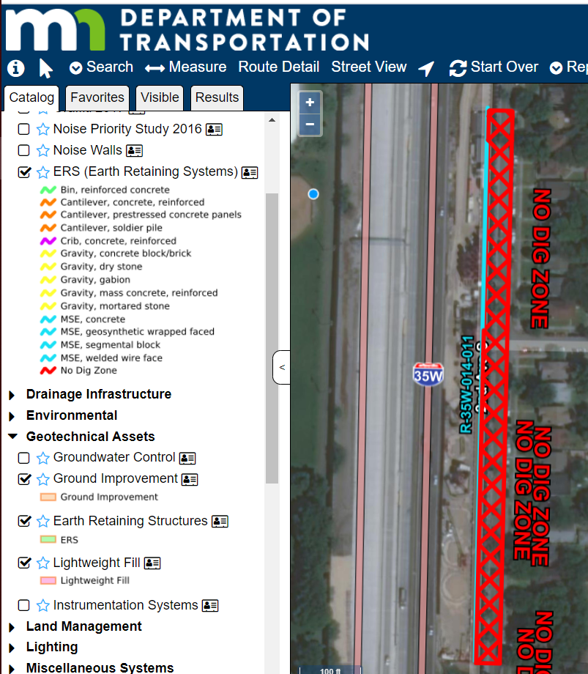
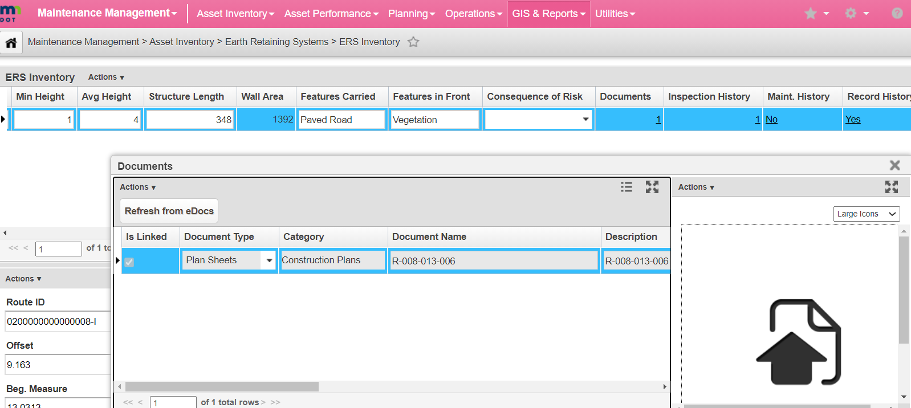
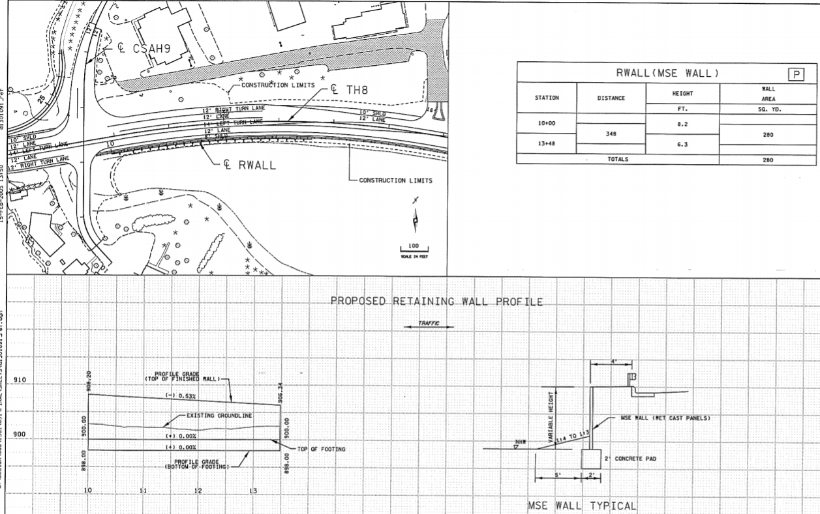
Who Uses Asset Data?
Risk Mitigation
Spatial GIS Documentation of Geotechnical Assets With Link To Plan Set Details
Notes:
Example – Risk - Awareness (underground soil nails example) ERS/Geotech Assets
Analyst: TAMS user – click on assets, drill down to associated plan sets
Key Takeaways: Underground geotechnical assets – GIS/TAMS
Background: Soil nail wall and special instrumentation on I35W, including link to plan set important for these underground assets.
Mini-plan sets have been created and included in TAMS for ERS.

Slide 35
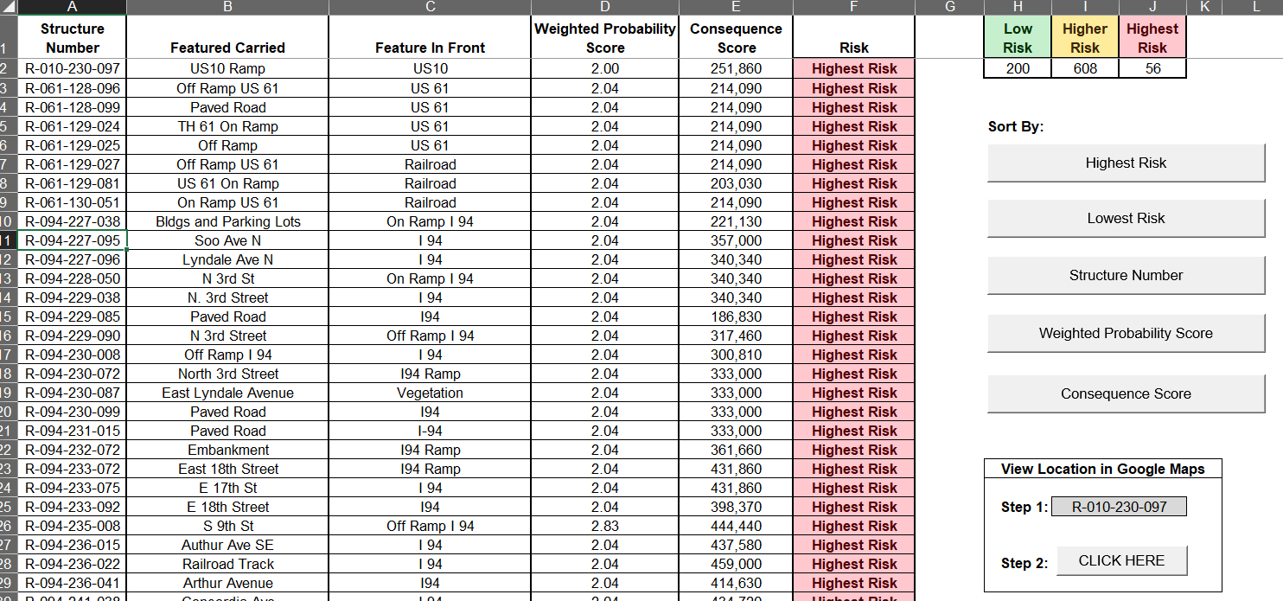
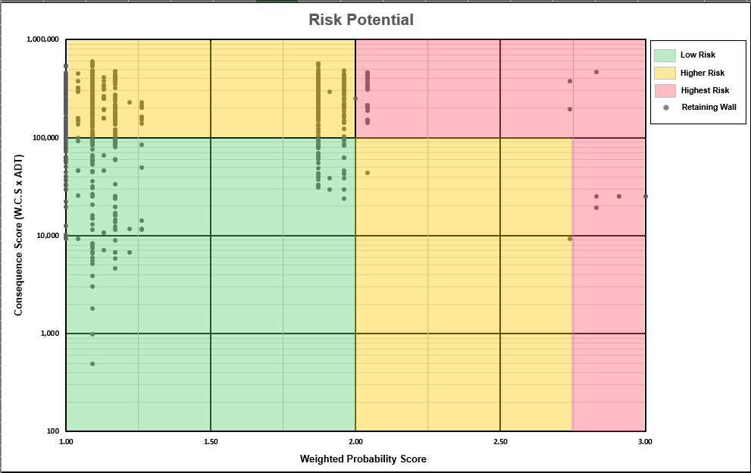
Who Uses Asset Data?
Risk Mitigation
Assigning Risk Scores To Metro Earth Retaining Systems (ERS) Based on Consequence and Probability
Notes:
Example – Metro ERS, Inventory, Assessment, Assignment
Analyst: TAMS User (data contained in TAMS)
Key Takeaways: Prioritize Assets by Risk Potential (consequence and probability)
Background: Metro District ERS project with Collins Engineering (probability and consequence analysis) output of risk potential 2017

Slide 36
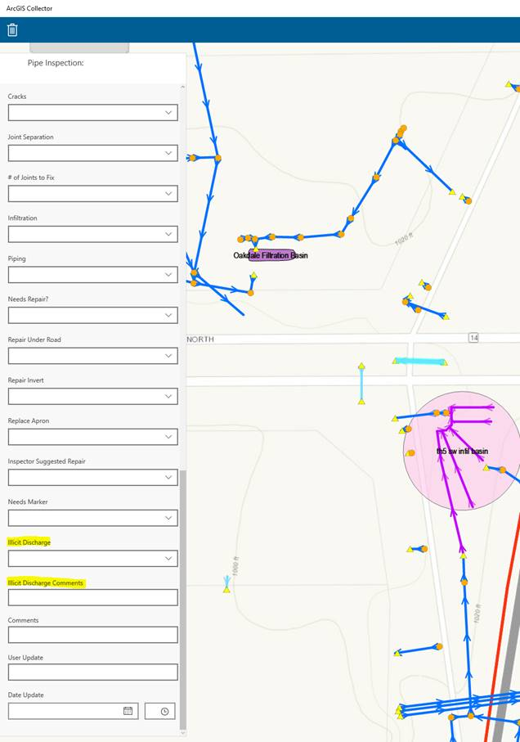
Who Uses Asset Data?
Regulatory
MS4 Illicit Discharge Tracking Reequipments met by TAMS inspections
GSOC Locate Data (M)
Notes:
Example – MS4 inspections, ilicit discharge tracking. Also to meet our GSOC mapping requirements; can save time vs field trips or digging out plans. Sometimes plans accessed through TAMS hotlinks
Analyst: CO Bridge Hydraulics
Analyst: District - any TAMS user (with appropriate profile) has access
Data Source: All contained in TAMS (except where districts have not entered storm sewer)

Slide 37
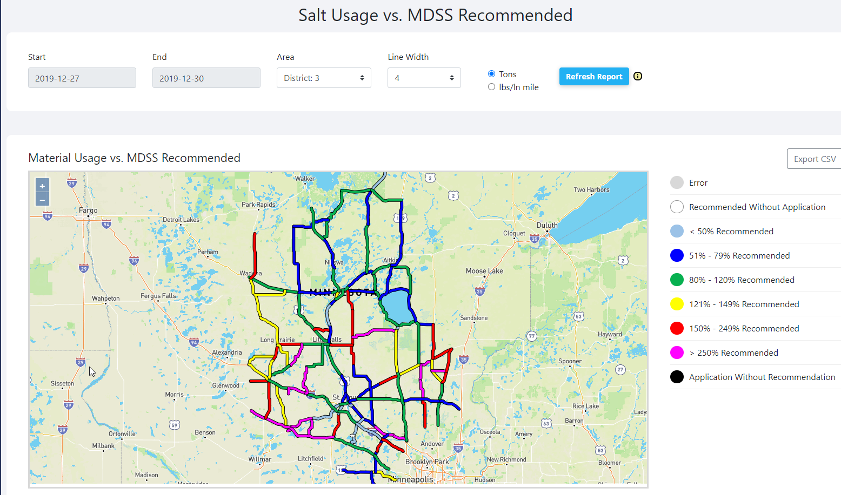
Who Uses Asset Data? Sustainability
Material Usage vs. MDSS Recommended
Notes:
Example – Salt Usage recording – Now operators estimate and assign to road SEGMENTS – consumption reported OUT of RCA data. TAMS will gather usage data, geospatially referenced, and be source of information for MDSS reporting, and automatic input to employee timesheets.
Analyst: Office of Maintenance
Analyst: District TPS/Maintenance TAMS user
Data Source: Ameritrak, DTN, MDSS, TAMS
Takeaway – Geographically Accurate application data. Reduced Employee effort and time

Slide 38
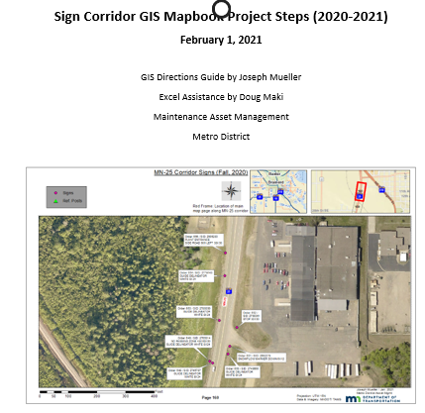
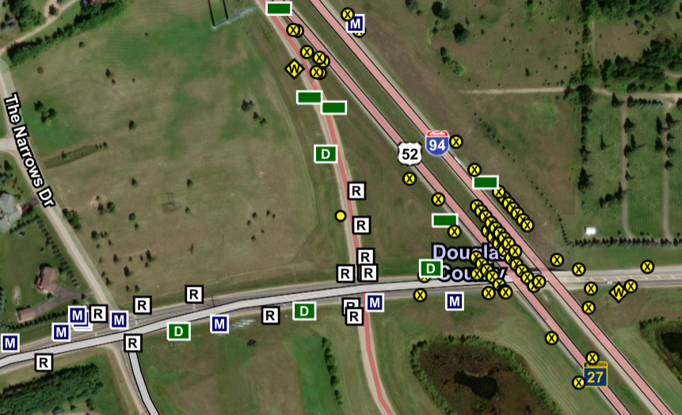
Who Uses Asset Data?
Design
D3 Utilization of TAMS Sign Inventory Data
  Attribution for Sign Plan Tabs
  GIS Mapbooks for Renewal Plans
D3 - “I am confident these maps and spreadsheets will be a game changer for the way we prepare sign renewal plans in the future.”
Notes:
Example – Design Plans – Inventory exported to create Sign Plan Tabs.
Analyst: District Traffic TAMS user
Data Source: TAMS
Clarify!! Michelle quote!!!!

Slide 39
Who Uses Asset Data?
081
TYPICAL PAVEMENT AGE (YEARS) | ACTIVITY TYPE | TYPICAL COST PER LANE MILE)
0 | New Construction | $469,272
8 | Crack Treatment | $2,705
12 | Chip Seal | $15,416
20 | Medium Mill and Overlay | $127,437
23 | Crack Treatment | $2,229
27 | Chip Seal | $12,700
37 | Medium Mill and Overlay | $102,314
40 | Crack Treatment | $1,790
44 | Chip Seal | $10,197
54 | Medium Mill and Overlay | $82,144
57 | Crack Treatment | $1,437
61 | Chip Seal | $8,186
70 | Medium Mill and Overlay | $66,807
70 | Residual Value (1/15 years used) | -$62,353
Total EUAC |  | $12,004
Preservation/Maintenance EUAC |  | $781
Methods/Inputs
Maintenance Lifecycle Cost/EUAC
LEM over the life of the asset
Reactive Maintenance and Operations Demand
Based on Performance Measures
Future Direction
Commit to Development EUAC and Reactive Maintenance Demand
Continue to work closely with AMPO To advance TAMS EUAC and Reactive Maintenance demand
What does the Black Box look like?
Notes:
Example – 081
Analyst: AMPO, Office of Maintenance, Mitch

