Slide 1
TAMS/Asset Management Reporting & Analytics products
AMPO

Slide 2
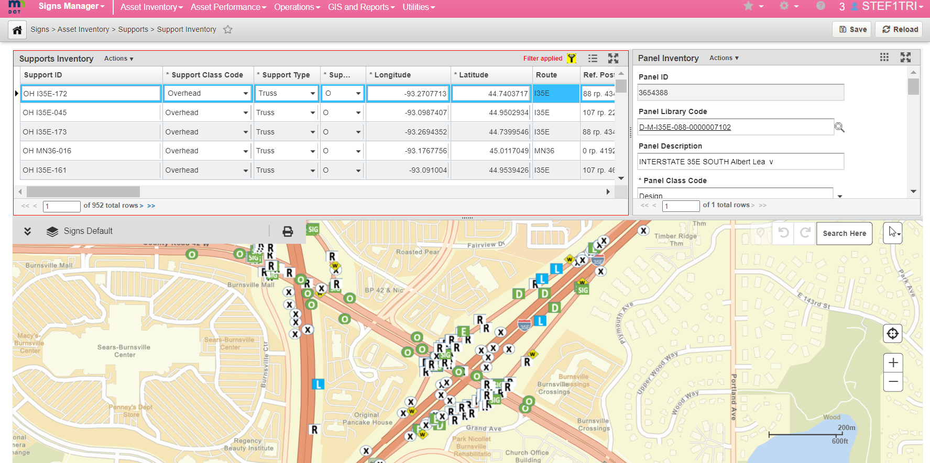
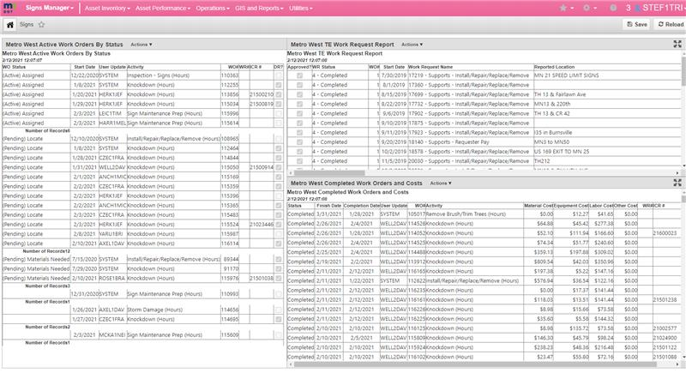
Introduction
TAMS/Asset Management Reporting & Analytics products
AMPO:
Trisha Stefanski, Tom Zimmerman, Michael Cremin, Josh Stearns
Reference: Samples presented at meeting
Outcome: AMSC Member info, reporting requests/wish list

Slide 3
Transportation Asset Management System Ancillary Assets
TAMS Release 1 (2016)
TAMS Release 2 (2019)
TAMS3 Assets (2022)
Traffic Signals and Components*
Roadway and Hi Mast Lighting*
Intelligent Transportation Systems
Ramp Meters
Cameras
Variable Message Signs
Detector Stations
Intelligent Lane Control Systems
Automated Traffic Recorders (ATRs)
Weigh-in-motion Systems (WIMs)
Road Weather Information System Devices (RWIS)
Hydraulics*
Pipes
Structures
Ponds
Storm Water Tunnels
Traffic Barrier (Guardrail)*
Noisewalls*
Earth Retaining Systems*
Pavement Markings (Turn Lanes, Arrows, etc.)
Pavement Sections For Maintenance Work Tracking
Sign Structures* and Panels
Entrance Monuments*
Geotechnical Assets (ERS, lightweight fill, ground improvement, geotechnical special drainage, and instrumentation system)
Pedestrian Infrastructure* (sidewalk and curb ramps)
Snow & Ice Assets Snow fence and snow traps
Pavement Striping
Weigh Station Scales
*Includes inspection data
Notes:
Roughly 20 asset classes included in TAMS, ~78 asset classes at MnDOT as a whole.

Slide 4
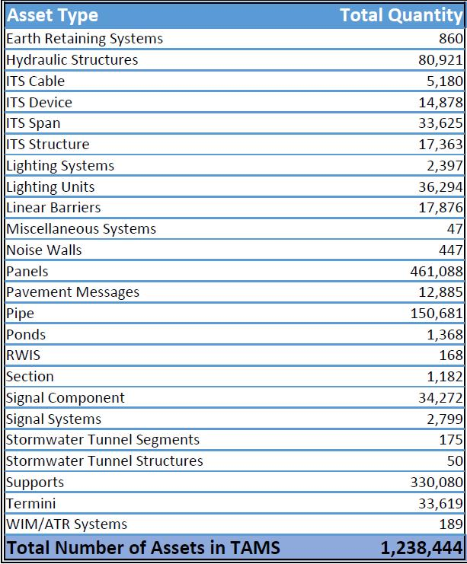
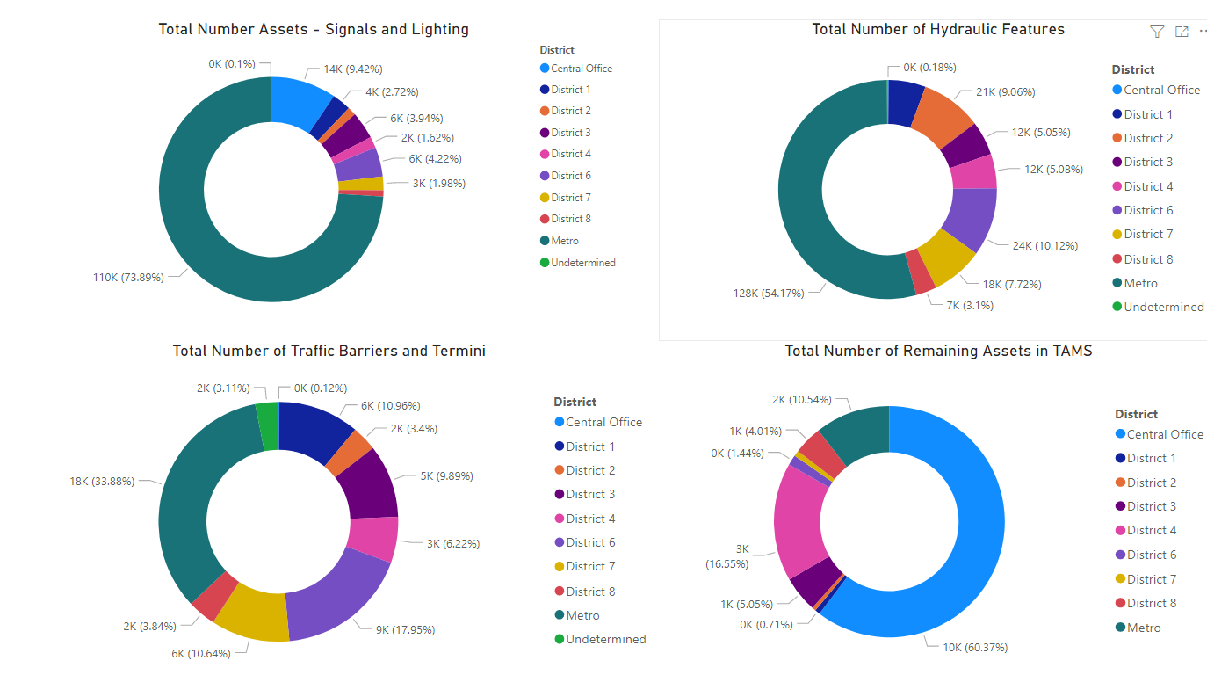
TAMS Asset Inventory Counts

Slide 5
Performance Measures, Patching Demand & Cost Analysis ArcGIS Model Builder
Notes:
This model utilizes forecast Surface Rating with Maintenance Performance measures and LOS to determine demand
Cost models with modified revenue scenarios to yield future work demands

Slide 6
Results of Patching Cost Analysis
Notes:
This model utilizes forecast Surface Rating with Performance measures and LOS to determine demand
Cost models and modified revenue scenarios to yield future maintenance work demands

Slide 7
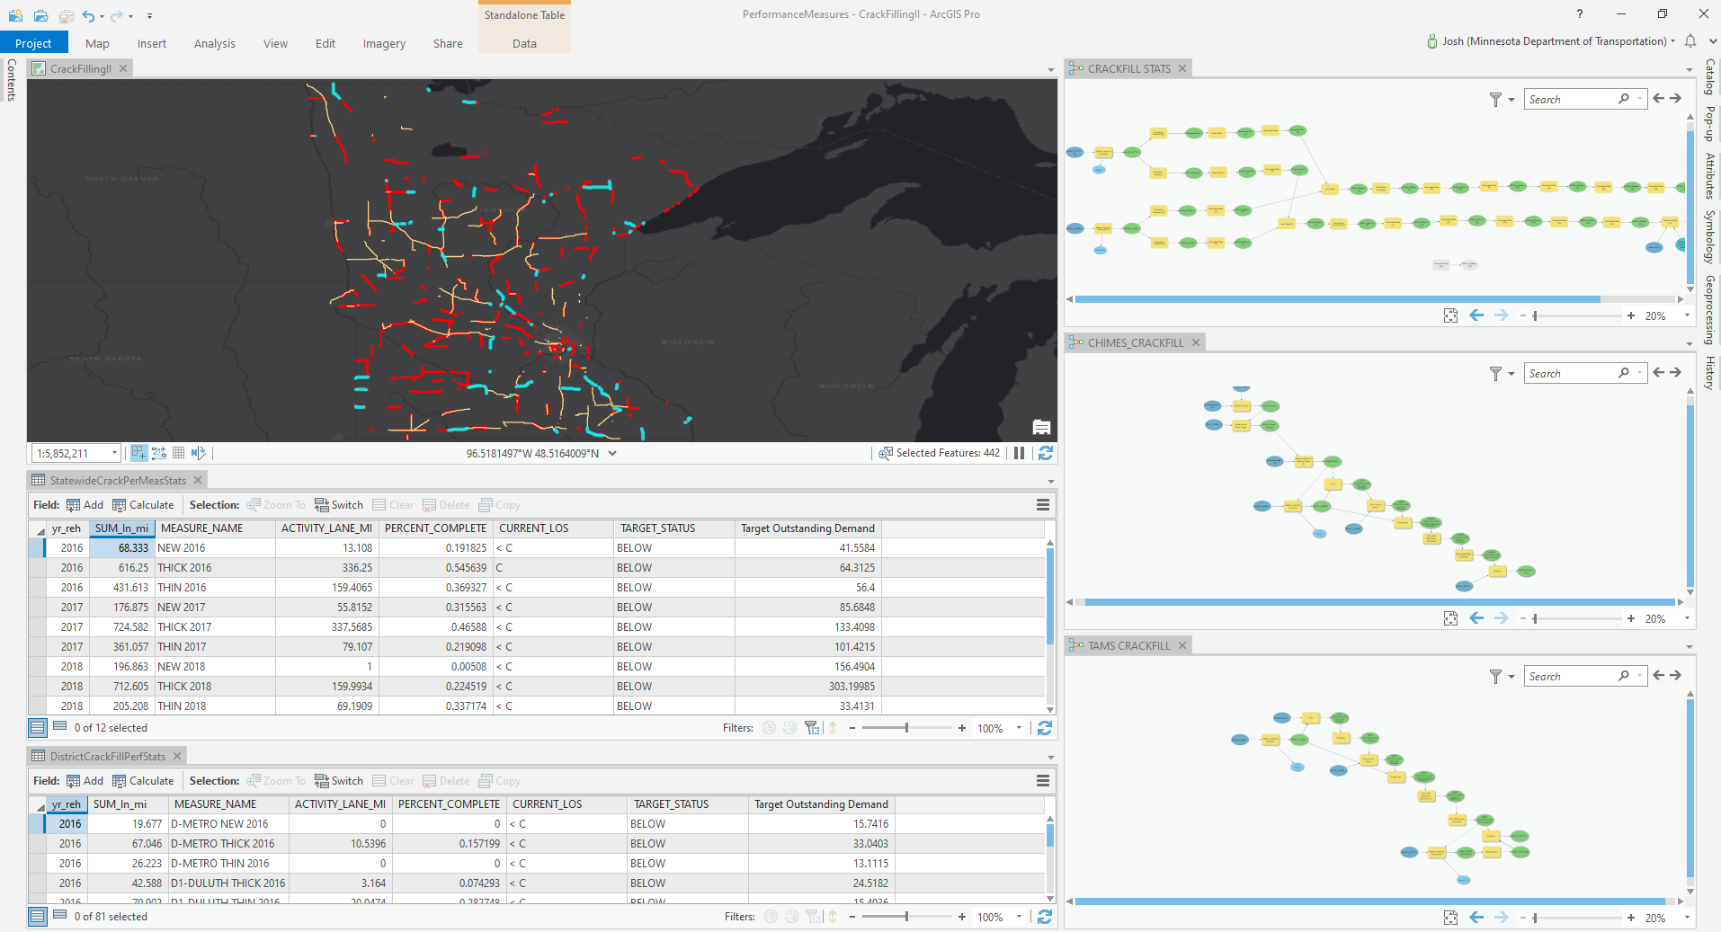
Performance Measures Crack Filling Work Demand ArcGIS Model Builder
Josh

Slide 8
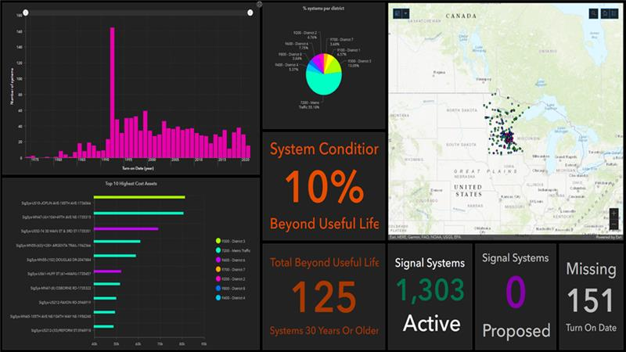
Dashboard Demo AGOL
Signals Dashboard in ArcGIS Online
Under Development: Lighting Dashboard and ITS Dashboard

Slide 9
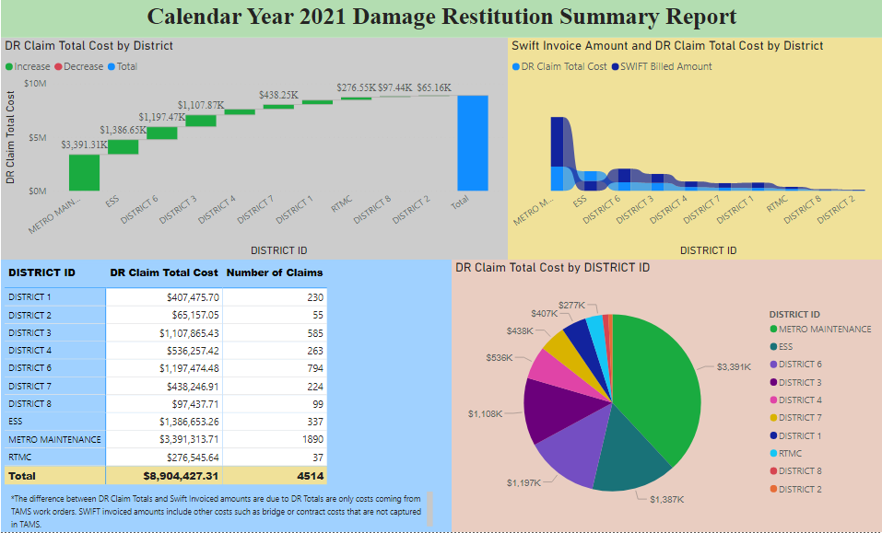
Damage Restitution Reporting
Notes:
Damage Restitution report: We’ve spent a lot of time moving people from the previous method of recording and reporting damage claims for finance and moved them into TAMS. This is a year to date report of the number of claims submitted to finance along with the dollar about coming off our TAMS work orders for damage restitution.

Slide 10
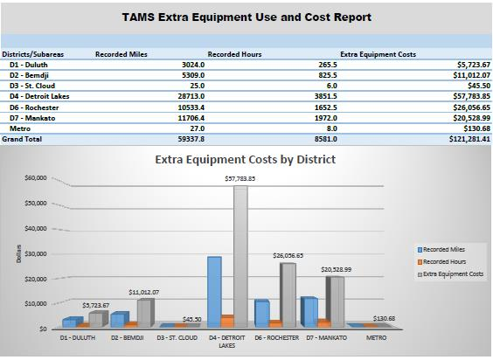
COVID Equipment Impact Report
Notes:
This chart is a result of a request that we received to see if we could develop some way to track and report on the extra pieces of equipment that was being used due to the Pandemic. Equipment in TAMS is recorded both by mileage and hours so you can see the utilizations regardless of the way vehicles are costed out.

Slide 11
Dashboard Demo TAMS
Notes:
This is an example of a new feature in TAMS. The Jasper Server reporting tool allow us to develop interactive dashboards. We are in the very early stages of learning how to use this tool. This is only one example of what we are hoping to provide TAMS users. The reports are only available to TAMS users at this time.

Slide 12
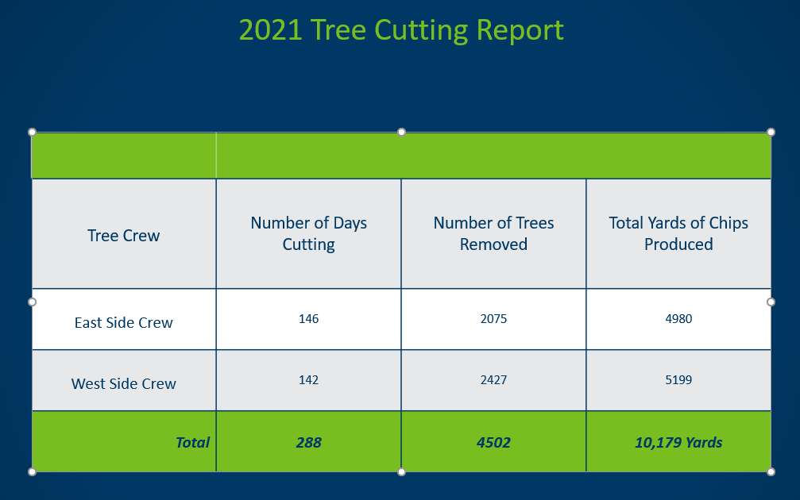
Metro District Superintendent Annual Report Out

Slide 13
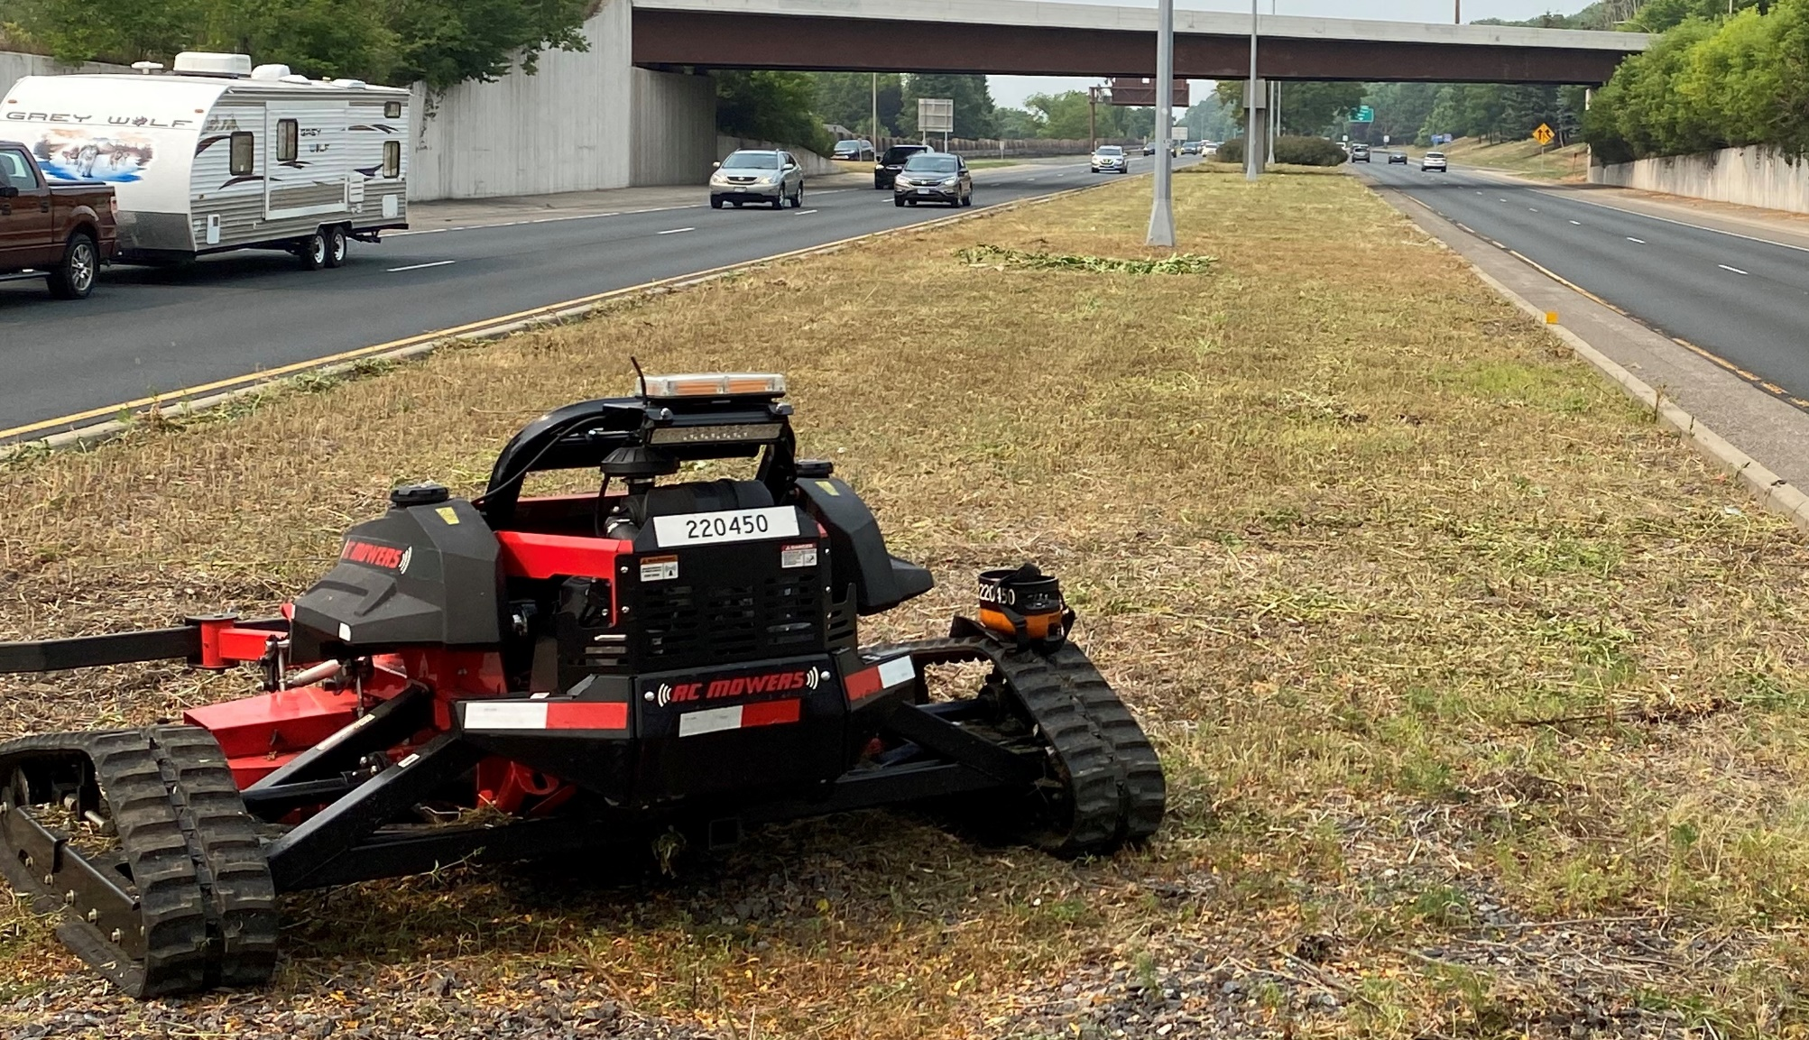
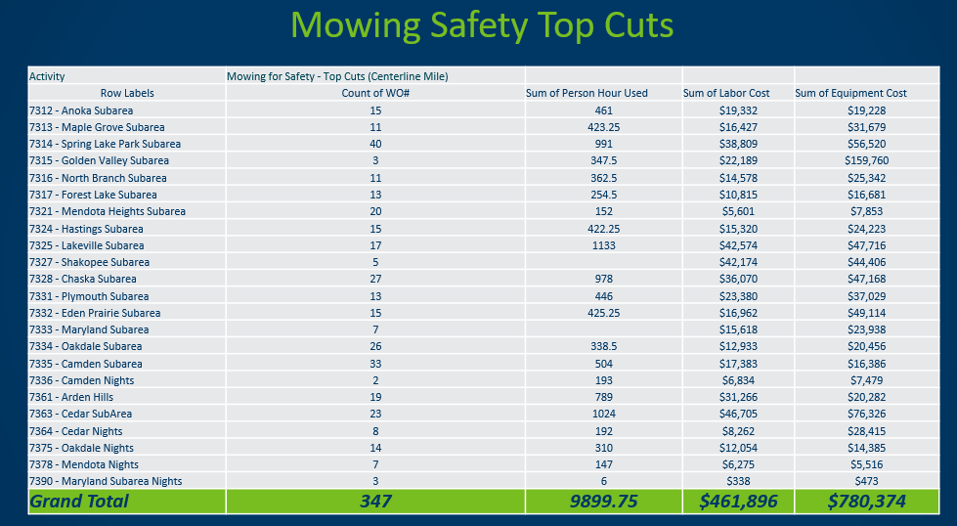
Metro District Superintendent Annual Report Out

Slide 14
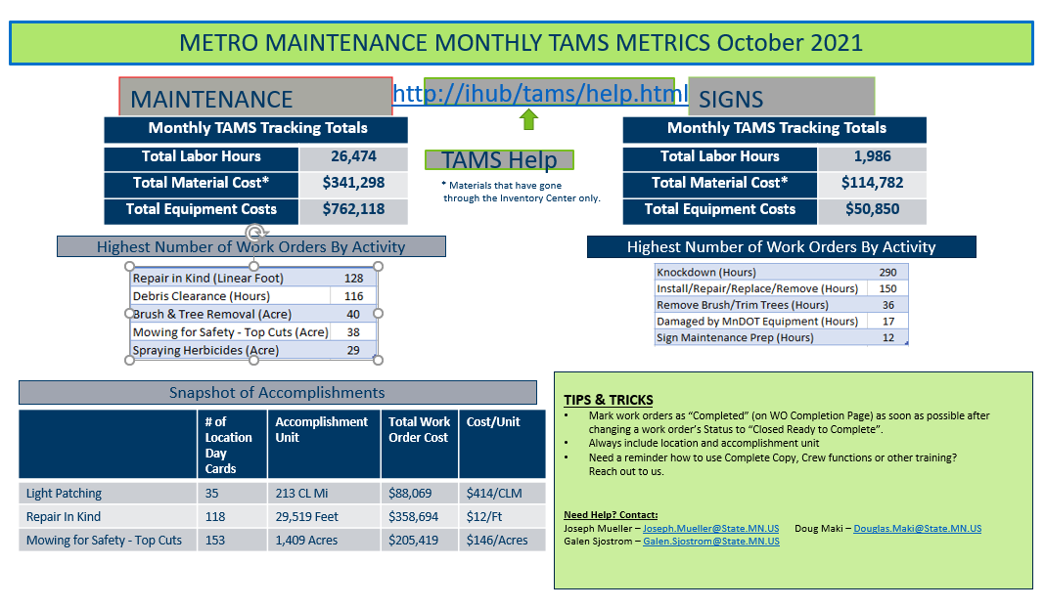
Metro District Maintenance Monthly Report Out

Slide 15
Utilization Trends Graphed – Patterns pop out

Slide 16
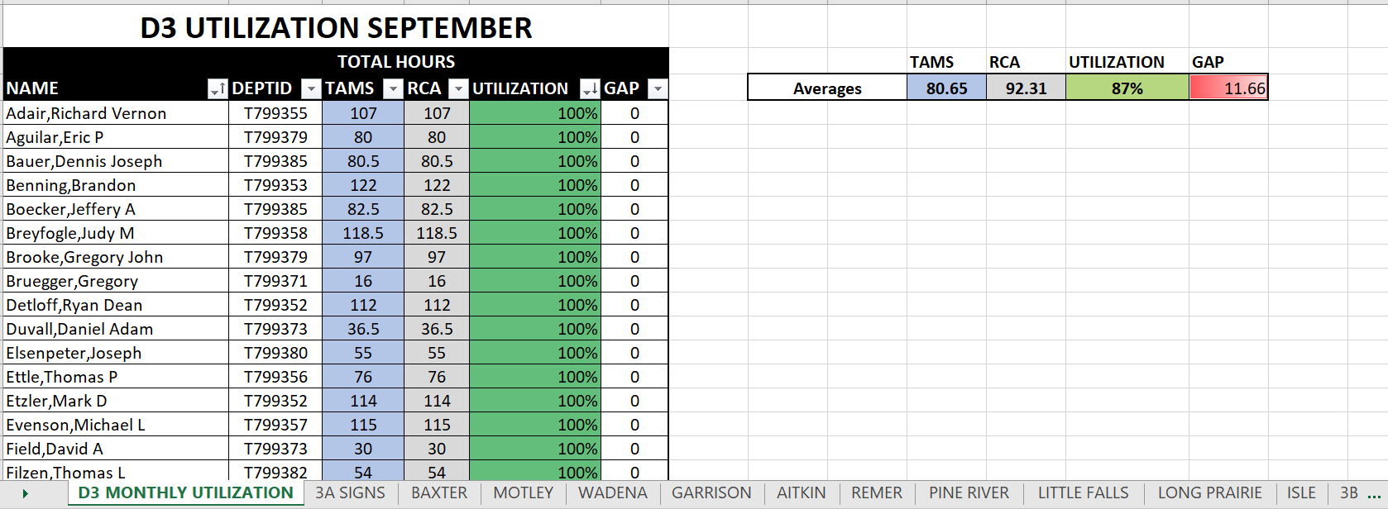
Utilization Trends – by Truck Station by Employee
In d3, Over half 100%ers; certain gaps understandable maybe firm up over time.

Slide 17
ESS Maintenance Needs TAMS Inspection Project
Inspection, Condition: how many Elements rated 4? Need maintenance timely action

Slide 18
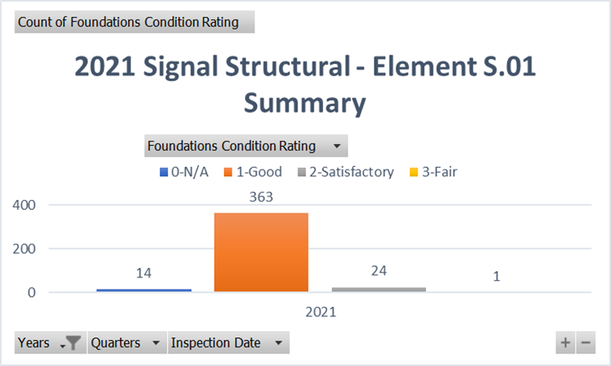
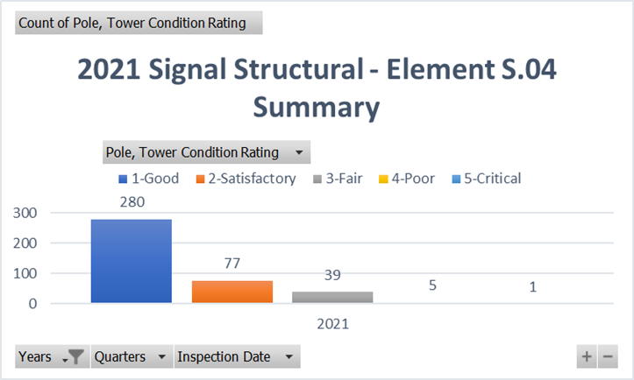
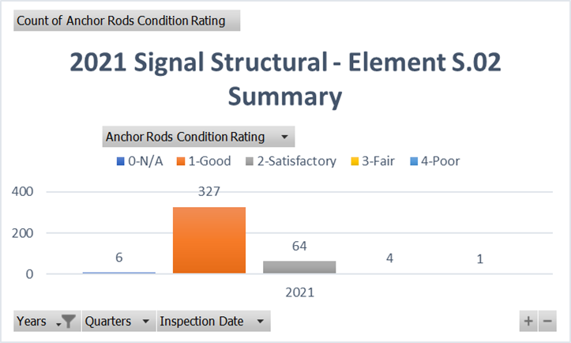
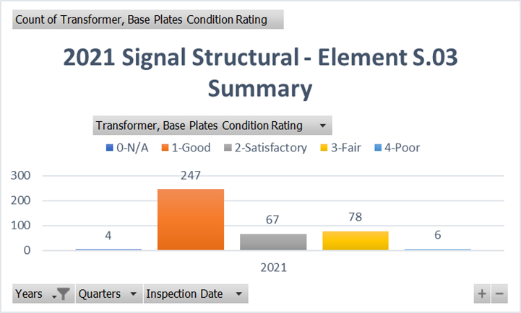
ESS Maintenance Needs TAMS Inspection Project
Notes:
Ad hoc reporting, Excel power pivot.

Slide 19
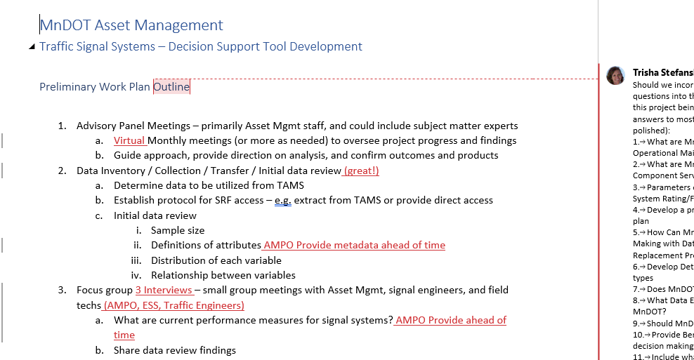
ESS TAMS Analysis Status of The Project
SRF Kick-off Call
Reviewed Scope of Work
AMPO Project Manager

Slide 20
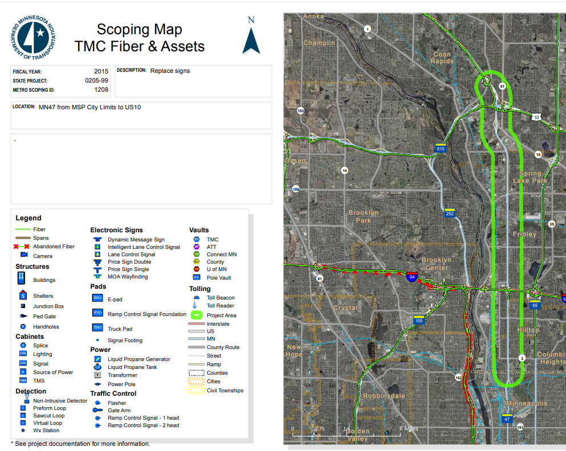
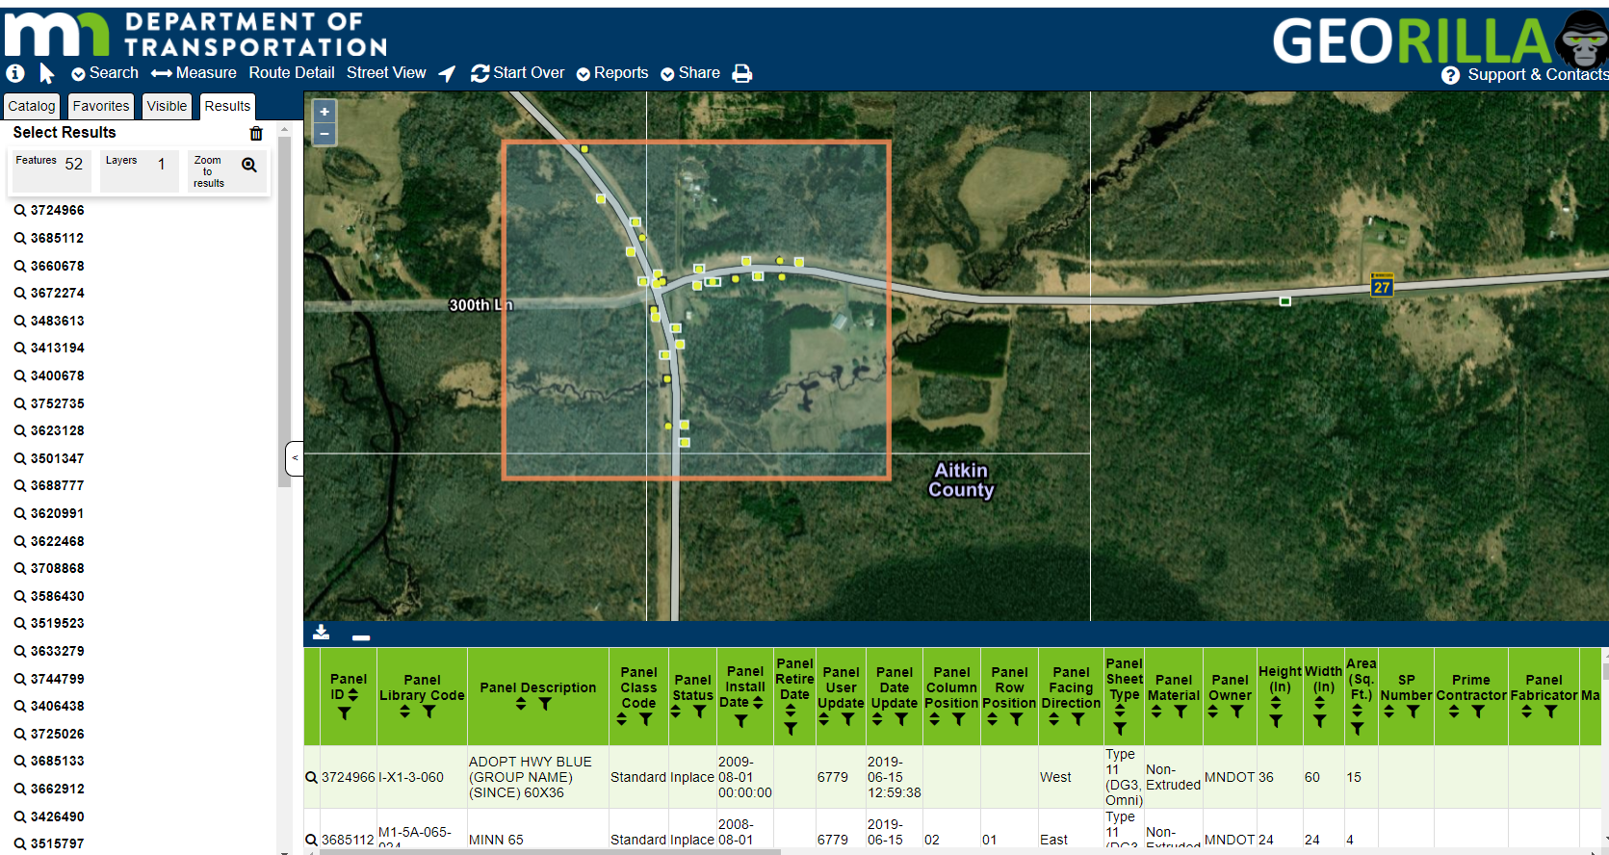
TAMS Asset Data Using Georilla as a Tool
Open-Source GIS Viewer
Over 200 layers, TAMS Work Orders
Export Function
Notes:
Georilla – open source software developed by U of Mn. Used in other agencies, our brand Georilla. City of St. Paul calls it GeoMoose.
Mash-up on several databases, over 200 layers for non-GIS users. Turn off-on. Search features, nice graphics and icons.
New export function from TAMS data, pull into spreadsheet for analytics, etc.
Utilizing construction project limits, scoping maps are generated from TAMS data to show asset types, condition, age. See TMC fiber map.

Slide 21
Page 1, The Assets
Quick Overview
Performance Measures
Asset Class | Typical PM Actions
Pavements | Crack seal, Patching
Bridges | Washing, crack sealing, deck sealing, painting steel members
Culverts | Cleaning/flushing, joint repair, resetting aprons, lining, invert paving
Signals and Lighting | Preventive Maint. and Operations Checks and Structural Inspection
Mowing | First Cut By Labor Day, July Safety Cut, Snow Control Cut
Signs | Maintenance Response time
Traffic Barrier | Maintenance Response time
Noise Walls & ERS | Structural Inspection
Maintenance Performance Measures
Several Asset Areas
First Cycle Reporting 2021
How Much Investment Will it Take to Move from LOS C to LOS D?
Implementing into TAMS
Notes:
In an effort to utilize maintenance and cost information to show level of service with targets and costs to increase LOS in Maintenance,
Performance measures have been created. Several asset areas.

Slide 22
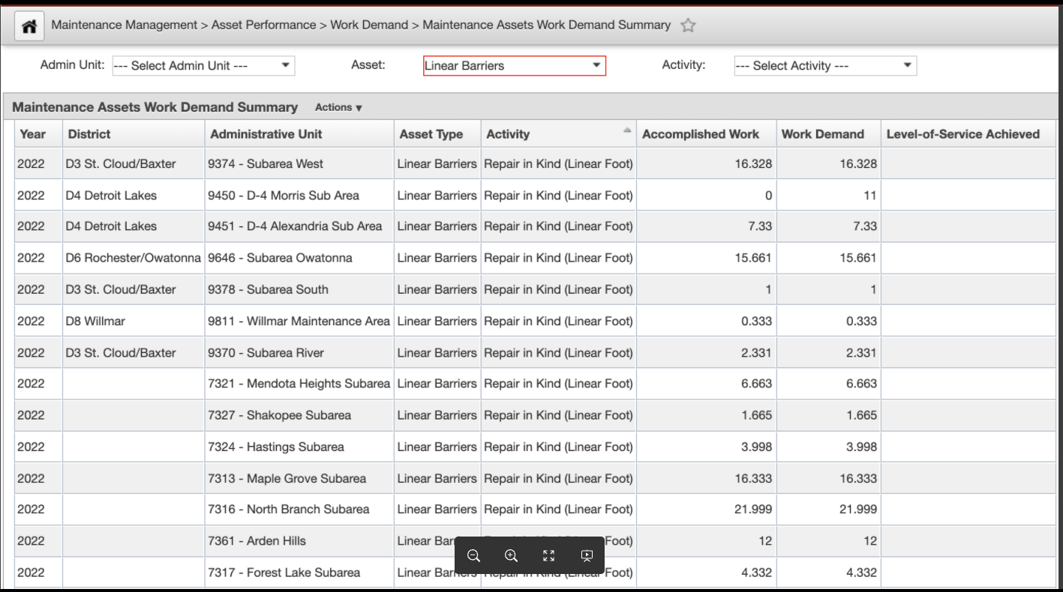
Utilizing TAMS Performance Measures
Crack Filling – Integration and Analytics on HPMA data
Heavy Patching – Integration and Analytics on HPMA data
Mowing – Input From Maintenance Safety Cut/Snow Control
Drainage – Suggested Repair Inspection Decision Tree
Noise Wall – Cyclical Inspections
Traffic Barrier – Assessment Defects Not Completed; historical repair numbers
Notes:
Take away – labor intensive complex ArcGIS model, programmed into TAMS. TAMS phase 3 includes development of Maintenance Planning.
Using condition data, like pavement cracking and surface rating to determine maintenance impacts-work demand.
Using input from Maintenance on what needs to be mowed to determine work demand.
More examples of work demand for drainage - Joint repair, Paved invert, replace apron, reset apron; noise wall inspection needs, and traffic barrier

Slide 23
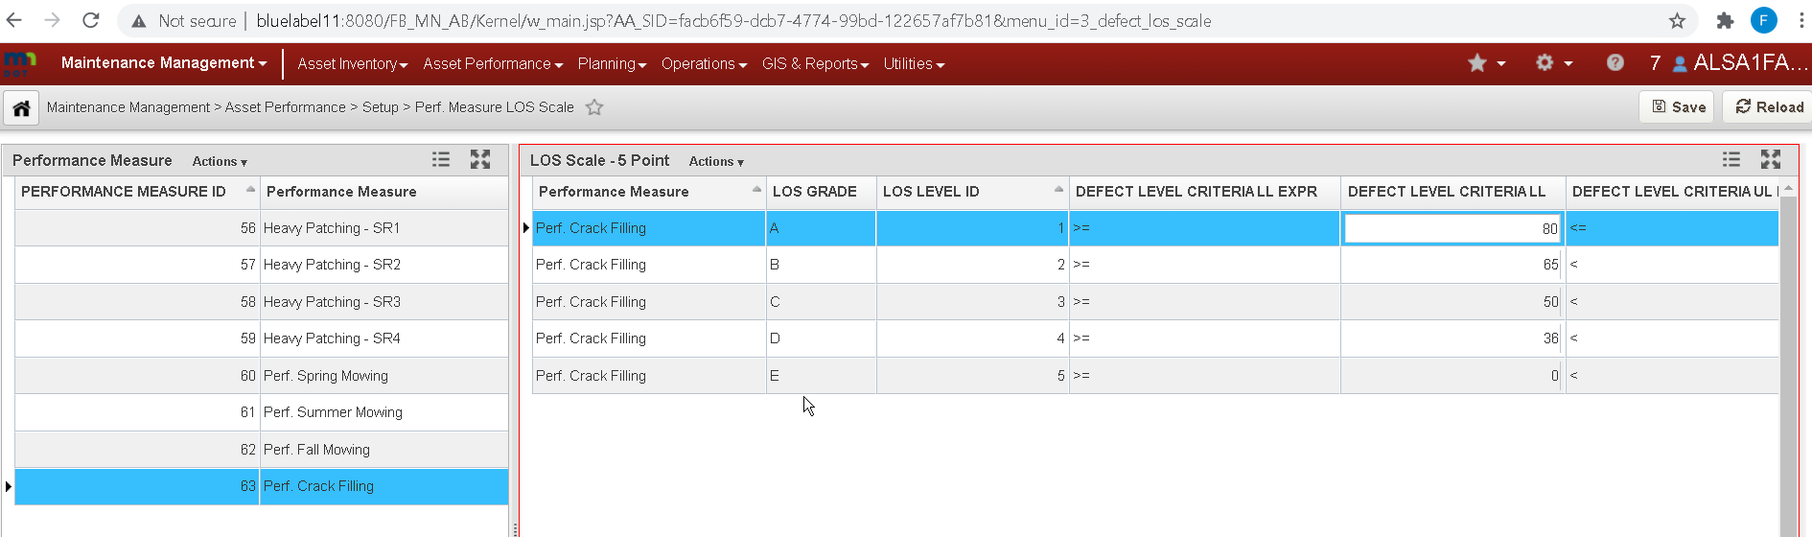
Maintenance Performance Measures LOS Results
Level of Service Results
Costs to Move to Higher LOS
Resulting Work Demand (GAP) Used in Next Season Work Plan
Notes:
Annual plan from gap of completed vs demand for next years plan

Slide 24
Outcomes
AMSC Member info, reporting requests/wish list

