Slide 1
Past Interaction Between TAMP and MnSHIP
Josh Pearson
Office of Transportation System Management
9/24/2020

Slide 2
Minnesota State Highway Investment Plan
Directs capital investment on state highway network
Fiscally constrained, 20-year plan
Due within one year of SMTP adoption – January 2023 at the latest
Not project specific
Update process to begin late 2020

Slide 3
MnSHIP update process

Slide 4
TAMP/MnSHIP History
2014 (Pilot) TAMP
2017 MnSHIP
2018 TAMP (draft)
2019 TAMP
TAMP/MnSHIP Update
2013 MnSHIP

Slide 5
2014 TAMP
Pilot TAMP completed in 2014
Revised the targets for pavement and bridge
Added new targets for other assets
Culverts/deep stormwater tunnels
Overhead sign structures
High mast light towers
Started to work on additional assets for inclusion in the 2019 TAMP (ITS, signals, lighting, pedestrian infrastructure, buildings, and noise walls)
System | 2013 MnSHIP | 2014 TAMP
Pavement – Interstate | 2% Poor 70% Good | 2% Poor 70% Good
Pavement – Other NHS | 2% Poor 70% Good | 4% Poor 65% Good
Pavement – Non-NHS | 3% Poor 65% Good | 10% Poor 60% Good
Bridge – NHS | 2% Poor 84% Good/ Satisfactory | 2% Poor 55% Good
Bridge – Non-NHS | 8% Poor 80% Good/ Satisfactory | 8% Poor 50% Good

Slide 6
2014 TAMP
Maintenance and operations strategies from 2013 MnSHIP and Highway System Operations Plan (HSOP) included in TAMP
Life-cycle planning scenarios and cost analysis compared strategies with and without maintenance
Future expected capital investment in preventive and reactive maintenance based on BARC and PM setasides in CHIP and in more high-level terms
TAMP used HSOP budget from 2012-2015 to discuss operation and maintenance budget needs

Slide 7
2017 MnSHIP
Incorporated revised pavement and bridge targets from 2014 TAMP to update 20-year investment needed to maintain targets through 2037
Roadside infrastructure performance levels used 2014 TAMP data and measures (if available) for performance level development and outcomes where
Performance level 0 & 1 – Expected outcomes based on investment level
Performance level 2 – Investment needed maintain current condition
Performance level 3 – Investment needed to reach draft targets
No discussion of prioritization of assets within Roadside Infrastructure

Slide 8
2017 MnSHIP
Split of state revenue sources between Capital and Operations/ Maintenance discussed during development of revenue projections
While Federal-Aid Highway Program is restricted to State Road Construction use, more discretion is permitted for revenues collected at the state level
Chose a split in growth rates so that the expected the loss of future purchasing power – defined as the gap between funding and inflationary increases – is the same for both budgets (same as split in 2013 MnSHIP)

Slide 9
2017 MnSHIP
Initial steps to consider pavement capital investment impact on ops and maintenance budgets
Discussed impact of investment direction on maintenance budget in “Unmet Need” section in Chapter 6
Performance Level Data | Performance Level 0 | Performance Level 1 | Performance Level 2 | Performance Level 3 | Performance Level 4
Outcomes | 2% (Interstate) 18% (Other NHS) 24% (Non-NHS) | 5% (Interstate) 11% (Other NHS) 14% (Non-NHS) | 2% (Interstate) 4% (Other NHS) 14% (Non-NHS) | 2% (Interstate) 4% (Other NHS) 10% (Non-NHS) | 2% (Interstate) 3% (Other NHS) 4% (Non-NHS)
Investment Need | $9.6 billion | $11.3 billion | $13.8 billion | $15.0 billion | $18.4 billion
Est. Maintenance Costs (per year average) | $27.8 million (18-27) $26.5 million (28-37) | $27.6 million (18-27) $24.7 million (28-37) | $27.5 million (18-27) $24.2 million (28-37) | $27.5 million (18-27) $23.8 million (28-37) | $27.3 million (18-27) $23.3 million (28-37)
Maintenance Cost in 2037 | $30.1 million | $29.2 million | $28.1 million | $27.7 million | $24.9 million

Slide 10
2018/2019 TAMP
Included new assets not in 2014 TAMP
Signals and lighting
Noise walls
Buildings
Pedestrian infrastructure
ITS infrastructure
All assets included discussion of capital and maintenance funding to maintain assets and life cycle planning scenarios
Initial data collection, condition ratings, and draft targets for some of the new assets were incorporated into Roadside Infrastructure investment category in MnSHIP but were not officially adopted
Performance measures and targets were later revised for some assets and officially adopted in the 2019 TAMP
Reference to HSOP was removed, as that plan has since been retired, removing connection to operations

Slide 11
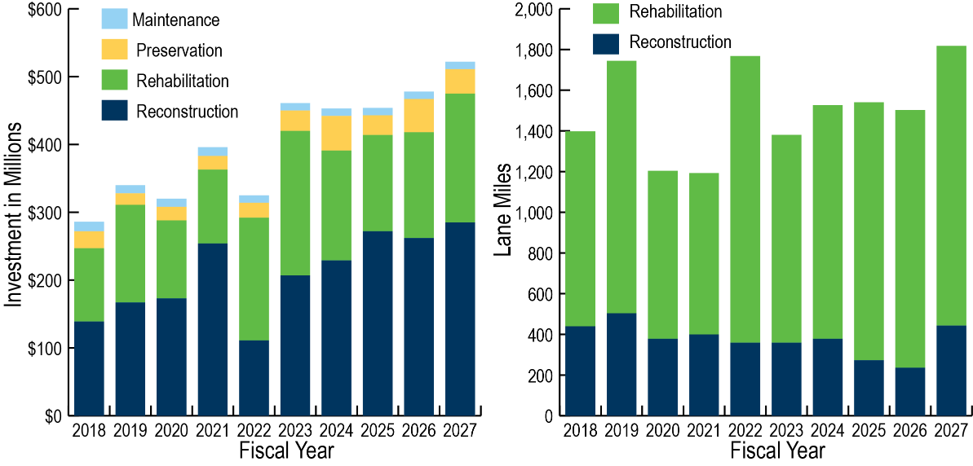
2018/2019 TAMP
Updated 10-year planned investment and additional need based on MnSHIP investment direction and CHIP projects
Yearly planned pavement and bridge investment and lanes miles/deck area to be completed included for annual consistency review
Pavement and bridge was shown by FHWA work type
Initial Construction
Maintenance
Preservation
Rehabilitation
Reconstruction

Slide 12
Ideas for TAMP/MnSHIP Updates
Discuss prioritization of assets in TAMP and incorporate prioritization in MnSHIP Roadside Infrastructure discussion
Review and evaluate 2023-2042 revenue projections to consider operation/maintenance and capital split and possibly adjust the split based on capital investments
Evaluate impact of underinvesting in capital improvements on maintenance budgets for pavement, bridge, and other assets
Evaluate impact on future capital and maintenance needs when investing in mobility/expansion using total cost of ownership data

Slide 13
What are other ways we can better integrate maintenance and operations into TAMP and MnSHIP?

Slide 14
Thank you!
Josh Pearson
Joshua.pearson@state.mn.us

