Slide 1
Asset Management Strategic Implementation Plan (AMSIP)

Slide 3
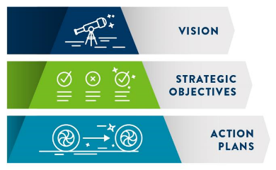
AMSIP Content
Overview
MnDOT’s Asset Management Vision & Objectives
Taking Steps to Achieve the Vision
Action Plans
Asset Data Action Plan
Life Cycle Strategy Action Plan
Communication Action Plan
TAMP Implementation Action Plan
Closing

Slide 4
Vision and Objectives
Vision: At MnDOT, transportation assets are managed effectively based on risk and return on investment, using the best available information and tools. (April 2020)
The three strategic objectives led to the development of the five work groups:
Use data effectively to strategically manage investments and assets, within available resources, in a proactive and wholistic way to reduce life-cycle costs and maintain the value of our most critical assets.
Improve the ability to evaluate trade-offs between investment options in a consistent and transparent way that maximizes system performance.
Integrate asset management into MnDOT’s culture through effective communication and a workforce with the skills needed to successfully fulfill their asset management duties and responsibilities.
Notes:
1. This involves:
Balancing the resources required to obtain and manage asset data with the associated risks and return on investment.
Providing tools that supply the information needed in a useful format to make well-informed decisions.
2. This involves:
Integrating operational and capital considerations to improve efficiency.
Evaluating trade-offs between asset classes and programs, recognizing that what is best for an individual asset may not be best for the system.
3. This involves:
Advancing the understanding of asset management at MnDOT.
Defining asset management roles and responsibilities.
Building individual and agency capabilities.
Establishing succession plans for key positions.

Slide 5
Fundamental Elements Addressed

Slide 6
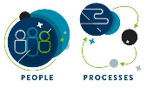
Work Group Assignments
Work Group 1: Asset Matrix Development
Work Group 2: Geotechnical Assets
Work Group 3: Pavement Preservation
Work Group 4: Communication
Work Group 5: TAMP

Slide 7
Asset Data Action Plan
Conduct LiDAR asset data collection activities on a cyclical basis to collect the information needed to update asset inventories for assets with as-built information available on construction projects.
Focus on completing the side and mainline culvert inventories.
Use consultants to update asset inventory data for construction projects without as-builts.
Refresh the state’s sign inventory using contract labor.

Slide 8
Life Cycle Action Plan
Establish performance measures and an accountability system for tracking annual preventive maintenance goals & accomplishments
Formalize preventive maintenance planning
Develop a common web-portal for preventive maintenance guidance

Slide 9
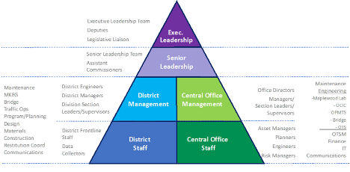
Communication Action Plan

Slide 10
Communication Recommendations
Communicate roles and develop internal resources (June 30, 2021)
Initiate District rollout (December 31, 2021)
Initiate Central office rollout (March 31, 2022)
Initiate the MnSHIP and TAMP rollout (December 31, 2022)

Slide 11
TAMP Implementation Action Plan
Implement a process for adding assets to the TAMP based on the asset tiers developed by Work Group 1
Identify & implement changes to the TAMP format that will improve its functionality within MnDOT
Evaluate the current method of incorporating pavement and bridge maintenance and operations costs in MnSHIP for suitability in the 2022 TAMP and make necessary adjustments. Refine the method of estimating maintenance and operations costs for other assets in the 2022 TAMP using TAMS

Slide 12
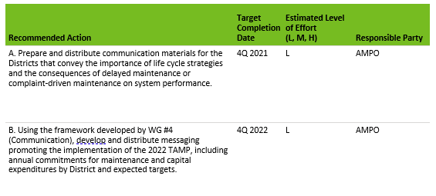
TAMP Implementation Action Plan (cont)
Develop & distribute messaging to promote TAMP implementation in accordance with the communication framework developed by Work Group #4
Implement efforts to guide the scoping process to help ensure that planned TAMP investment strategies are reflected in the STIP & CHIP

Slide 13
Closing
Notes:
The four pillars addressed in the AMSIP provide the foundation for MnDOT’s transportation asset management implementation. As MnDOT advances the implementation activities outlined in this Plan and extends the knowledge and understanding of asset management in the agency, it will deliver on the 5-year asset management vision and ultimately support the agency’s vision of delivering mobility, safety, public health, environmental sustainability, and a prosperous economy through a strong, effectively-managed transportation system.

