Slide 2
Welcome
David Solsrud

Slide 3
Introductions
Name
Office
Involvement With AMSIP or Asset Management
What Do You Want To Get Out of The Workshop?
You Get 30 Seconds!
Notes:
Make sure someone is recording these and bring them up throughout the workshop and at the end.

Slide 4
Workshop Team
Dave Solsrud, Manager - Asset Management Program Office
Trisha Stefanski, Asset Engineer – AMPO/Metro District
Michael Cremin, Project Engineer – AMPO
Mitch Webster, Planning– OTSM/Maintenance
Katie Zimmerman, AP Tech
Brad Allen, AP Tech
Bill Roberts, Spy Pond Partners

Slide 5
Today’s Objectives
Engaging, Interactive, & Fun Workshop
Learn About AMSIP and The Asset Matrix
Better Understand The Matrix Building Process
Walk The Walk-Through Results
AM Approaches
Tiers
Return on Investment Analysis
Asset Data and Costs
“Get Down To Brass Tacks”, Details of Immediate Practical Importance.
Set The Stage For AMSIP Roadmap
Notes:
Virtual format challenges
Leverage you precious time once… thanks for agreeing. Time is short, bandwidth is limited, and I promised this would be a collaborative process
Lots of work done behind the scenes – even matrix team unaware
My goals: make as many decisions as we can – minimize further study/research. These are management decisions rely on judgements in addition to data. We have tried to bring as much data as we can forward. Need to keep the momentum, bring to closure.
“Approaches, Tiers” to help categorically decide
Trish, Mike, Mitch. No one collectively knows more about what is going on with our data, and options, costs, uses. Rather than pose questions to this group – (70+ assets) I asked for recommendations
Talk about data uses, data costs ($, staff labor) concerns expressed re cost, also hard to quantify benefits.
We looked for reductions as well as add’s. Lot’s of “stay the course”, lots of adds, not so many reductions in data, but savings in process opportunities. Internal vs Consultant resources
My 3 nuances:
A lot is already being done both acquiring/maintaining data, but also use
Think future: Technology is advancing rapidly – Satellite imagery, Iphone surveys, Opensource data – it’s ok to stretch ourselves at this point
Crowd source data use – uses have greatly exceeded the initial intent of lots of our data collection (restitution, 081 funding, scoping, sign design plans) What else? TSMO? CAV?

Slide 6
Incedentally…
Asset Data Analytical Needs/Capabilities

Slide 7
Agenda
1:15 | Asset Management Strategic Implementation Plan
1:30 | Building The Matrix
2:00 | Return on Investment Analysis
2:15 | 15 Minute Break
2:30 | Results
3:30 | Recommendations
4:00 | Round Robin
4:15 | Wrap Up, Next Steps
*Trivia, Polling, and Q&A Chat Sprinkled Throughout The Workshop
Notes:
Katie

Slide 8
Asset Management Strategic Implementation Plan
Notes:
Overview of plan

Slide 9
Benefits of Asset Management
Improved asset condition, performance, resilience, and longevity.
Increased efficiency and effectiveness. Regular maintenance can be planned and scheduled, reducing disruption to service as little as possible.
More benefit for each dollar invested. TAM helps to ensure that the benefits delivered by the network are maximized, while the costs of providing, maintaining, and using it are minimized.
Reduced risk exposure. When assets are maintained and managed consistently and resilience is improved, the agency reduces the exposure to risk.
Improved coordination and communication. Asset management helps potential silos within an agency by improving resource allocation and improving coordination between staff on asset management related projects and maintenance
LIFE OF ASSET
Reactive
Maint.
Reactive
Maint.
Reactive
Maint.
PM
PM
Installation
Major Rehab
Notes:
Katie?

Slide 10
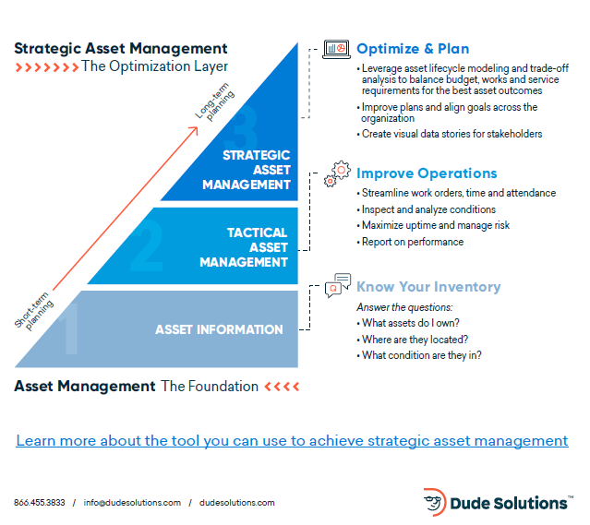
Strategic and Mature Asset Management
Notes:
Katie?

Slide 11
AMSIP Background
Map-21
Requires states to prepare Transportation Asset Management Plans (TAMP)
Also requires action “implementation”
TAMP Implementation Workshop
April 2019
Valuable Feedback
Mn State Statute 174.03
“The Commissioner must maintain an inventory of transportation asset, including but not limited to bridge, pavement, geotechnical, pedestrian, bicycle, and transit asset categories.”
Notes:
katie

Slide 12
TAMP Implementation Workshop Feedback
TAMP Assets
Asset Demands on District Staff
Data Roles, Responsibilities
Preventive Maintenance Barriers
Maintenance Funding
TAMP and MnSHIP Integration
Data Needs Beyond AM,
For example, 081, Restitution, Scoping, Design
Long Range Goals & Measures
Decision Making Constraints
Notes:
katie

Slide 13
AMSIP Planning Initiatives and Outcomes
Strategic – How Far Are We Going?
MnDOT Strategic Operating Plan → Tangible
Shared Vision → Documented
Implementation – People, Process, Data
Roles and Responsibilities
Process/Practices
Data Acquisition and Maintenance
Emphasis on Actionable and Tangible Outcomes
Maximize Number of Decision Made During Planning Effort
Emphasis On Collaborative Plan Development
Notes:
katie
Again – focus on maximizing decision making today

Slide 14
AMSIP “High 5” Technical Working Teams
Asset Matrix “Team Matrix” – Trisha Stefanski & Brad Allen
Geotechnical Assets – Brad Skow & Bill Roberts
Preventive Maintenance – Glenn Engstrom & Brad Allen
Communication Plans and Execution – J.T. Anderson & Katie Zimmerman
TAMP Topics – Shannon Foss & Katie Zimmerman
Notes:
katie

Slide 15
Building The Asset Matrix
Trisha Stefanski, PE - Mndot
Brad Allen, PE – Applied Pavement
Notes:
Brad and Trish

Slide 16
Team Matrix
Objective – Use National Best Practices To Categorize Assets Classes Into Priority Tiers and Clarify (1) How Assets and Asset Data Is Managed (2) The Data Needed To Support The Management, and (3) Roles and Responsibilities
Leadership Team – Brad Allen, Katie Zimmerman, Dave Solsrud, Trisha Stefanski, Michael Cremin, Mitch Webster
Team Members - Michael Barnes, Perry Collins, Paul Czech, Michael Ginnaty, Jay Hietpas, Susan Karnowski, William Pirkl, Mark Schoenfelder, Todd Stevens, Brad Utecht.
Notes:
brad

Slide 17
District Survey Asset Importance, Data Availability, Score
Notes:
Brad

Slide 18
Development Of The Asset Matrix
Asset Responsibilities Database
Asset Classes
Asset Data Needs
Asset Tiers
Asset Management Approaches
Asset Drivers
Data Collection Methodology
Partner w/Geotechnical TWT
Return on Investment
Partner w/TAMP TWT
Data Collection Plan
Working Matrix
Notes:
brad

Slide 19
Asset Management Approach
How Are We Currently Managing Our Assets?
What Is Our Desired Asset Management Approach?
Question | Minimum Maintenance | Reactive | Cycle Driven | Cycle Driven + | Condition Driven | Condition Driven +
Require Asset Inventory? |  | X | X | X | X | X
Require Asset Maintenance Cycle? |  |  | X | X | X | X
Require Asset Condition Data? |  |  |  | X | X | X
Require Long-Term Performance Mgmt? |  |  |  |  | X | X
Optimizing Life Cycle? |  |  |  |  |  | X
Notes:
Trish – this is a way of consolidating data related decisions

Slide 20
Asset Management Approach
Approach | Definition | Inventory Data | Condition Data | Management Demand
Condition Driven Plus | The condition of the asset is routinely monitored and modeled. Actions are taken proactively and reactively to optimize the asset lifecycle through minimum lifecycle cost, maximum benefit, maximum life-cycle length, or some similar approach | Yes | Yes | Highest
Condition driven | The condition of the asset is routinely monitored, and actions are taken to manage the long-term performance of the asset or the assets impact on system performance. | Yes | Yes | High
Cycle Driven Plus | The asset is inspected and maintained on a cyclical basis, where the inspection and maintenance activities are performed in simultaneously or in concert and condition data is collected and maintained for analysis | Yes | Yes | Med-high
Cycle Driven | The asset is maintained on a cyclical basis. Condition data may be collected on these assets to meet other business needs but the inspection cycle is managed separately from the maintenance cycle. | Yes | No | Med
Reactive | An inventory is maintained, but there is no regular condition data collection, and no maintenance performed to slow or address damage or deterioration until an asset is reported as having an unacceptable defect. Annual work is planned at the aggregate level, without concern for the specific locations of potential future defects. | Yes | No | Med-low
Min Maintenance | No inventory or condition data is collected or maintained. Maintenance is performed when assets are identified as having an unacceptable defect. | No | No | Low

Slide 21
Asset Drivers
Number of Assets
Value of Assets
Mandates, Regulation, Policies
Risk and Risk Mitigation
Number of Data Consumers
Portion of MnSHIP Investment Allocation
Portion of Ops Budget Allocation
TAMP Asset

Slide 22
Asset Tiers
Tier 1 assets represent a combination of the highest monetary valued assets along with assets that are critical to public safety, mobility, and the economy. Failure of a single asset could lead to an immediate safety risk or impact the transportation network for an entire region Poor performance by a group of similar assets could result in regional or even statewide impacts. As a result, these assets receive the greatest level of scrutiny and resources dedicated to inventory and condition data collection, investment decision making, maintenance, and capital investments to provide the highest practical level of service and reliability.
Notes:
See reference doc from michael
May need to clarify how tiers and approaches complement each other

Slide 23
Asset Tiers
Tier 2 assets are typically not as high-value as tier 1 assets, but still represent a significant consequence to public safety upon failure for a corridor or municipality. As a result, MnDOT dedicates resources to pro-actively monitoring and subsequent interventions to prevent unacceptable performance. The agency collects and uses inventory and condition data on these assets to identify, prioritize, and deliver maintenance and repair actions to cost-effectively manage the assets throughout their service lives.

Slide 24
Asset Tiers
Tier 3 assets support safety and system performance at their specific locations. Individual failures of these assets can have significant local impacts but are of limited consequence to overall network performance. These assets typically benefit from routine or cyclical replacements, of components or whole assets, to ensure proper performance. Inventory data is collected to support the efficient scheduling and delivery of appropriate cyclical work. Additionally, condition data may be collected for some assets to comply with mandates (e.g., municipal separate storm sewer systems), optimize the maintenance and replacement cycles (e.g. sign panels), or both.

Slide 25
Asset Tiers
Tier 4 assets represent limited risk to the transportation network. Failure of these assets generally impacts only the location served by that asset. To mitigate these risks, MnDOT has guidelines regarding maintenance response times to repair or replace assets within a certain period after being notified of the unacceptable condition to minimize the impact on safety and system performance. MnDOT collects and routinely updates inventory on these assets but doesn’t collect condition data, to ensure the agency has an accurate accounting of the current infrastructure and its needs. Work performed to maintain, improve, or replace these assets is tracked, specific to each individual asset or installation

Slide 26
Baseline Data Inventory
Specialty Office Meetings/AMPO Knowledge
Full/Partial/None
Collection Needs to Complete Baseline
Baseline Inventory Data
Current Resource Allocated
Desired Resource Add
How
Who
One-time Cost Estimate
Timeline
Baseline Method Description
Utilize Design Data
Field Walks
Mobile Imagery
Mobile LiDAR
Internal Knowledge (MnDOT Crowd Sourcing)
Satellite

Slide 27
Data Inventory Currency
Specialty Office Meetings/AMPO Knowledge
7 Methods
Current, Possible, Preferred, No
Current Resource Allocated
Desired Resource Add
Annual Cost Estimate
# of Asset
% Change upon life cycle
Applied Unit Cost
Currency Method ID | Currency Method Description
A | SRC As-Builts
B | Utilize Design Data & As-Builts
C | Utilize Design Data & Construction As-Builts & Annual LiDAR Survey
D | Annual Imagery*
E | MnDOT Forces During Construction projects
F | AVL and/or Data Logging System
G | Linear Referencing Systems
 | * Maplewood Van Option

Slide 28
Data Inspections Condition or Assessment Data
Specialty Office Meetings/AMPO Knowledge
Refer to AM Approach to Determine Desired Inspection Requirement
6 Methods
Current, Possible, Preferred, No
Current Resource Allocated
Desired Resource Add
Annual Cost Estimate
No. of Asset Units
No. of Inspections
Inspection Cost/Unit
Inspection Frequency
Total Cost
Inspection Method ID | Inspection Method Description
H | Visual Inspection (VT)
I | Physical Field Device Inspection
J | MnDOT Pavement Van Sensors
K | Satellite or Aerial Imagery
L | Drone Inspection
M | Mobile Lidar

Slide 29
Other Data Implementation Tasks
Task Descriptions
Software Upgrades or Enhancements
Training Opportunities
Level of Detail Within Asset Inventories
Current Research Projects
Business Process Changes or Documentation
Design
Inspection Guides
Inspection Frequency
Short-term or Long-term
Roles and Responsibilities TBD
Notes:
Some already happening
Will be part of roadmap

Slide 30
Return On Investment Analysis
Bill Robert, spy pond partners

Slide 31
Return On Investment (ROI) Analysis
Performed this analysis to better quantify the benefits of collecting additional data for selected asset types
Focused specifically on calculating the ROI of adding more culverts to the inventory (side and entrance culverts)
Used framework and tool from NCHRP Report 866
Performed calculations for a representative district
Reviewed the framework and tool in a web-based workshop, then followed up with District 2 staff for more data

Slide 32
NCHRP Report 866 Contents
Framework addressing evaluation of ROI and other financial metrics for asset management system/process investments
Set of case studies illustrating calculation of ROI and demonstrating potential benefits of asset management system/process investments
Guidance document and tool with step-by-step procedures agencies can follow to calculate ROI and other metrics for a proposed asset management system/process investment

Slide 33
ROI Calculation Steps
Plan
1. Define Purpose of Study and Scope of TAM Investment
2. Identify Likely Impacts
Collect
4. Establish Modeling Approach and Identify Tools
Analyze
6. Conduct Analysis
7. Estimate ROI and Summarize Results
3. Assess Available Data
5. Collect Necessary Data

Slide 34
MnDOT ROI Analysis Participants
Initial Workshop – 11/12
Ruth Betcher
Tara Carson
Andrea Hendrickson
Kris Langlie
Doug Maki
Greg Masteller
Bridget Miller
Rachel Miller
David Mohar
Scott Morgan
Beth Neuendorf
Lisa Sayler
Allen Schmitz
David Solsrud
Jason Swenson
Trisha Stefanski
Kellie Thom
Follow-Up Discussion – 12/9
Ruth Betcher
Michael Cremin
Andrea Hendrickson
Lisa Sayler
Josh Stearns
Kellie Thom
Mitch Webster

Slide 35
Culvert Analysis
Costs of Additional Culvert Data (per district)
Startup/Training – 80 intern hours
Plan Review – 600 intern hours
QA/QC – 40 MnDOT staff hours
Field Work – 2,160 MNDOT staff hours (27 weeks x 2 people)
Intern = $72,000/year
MnDOT Staff = $150,000/year

Slide 36
Culvert Analysis (continued)
Benefit of Additional Data (per district)
Reduced time for field review
120 intern hours per year
240 MnDOT staff hours per year
Reduced time to respond to issues/incidents
80 MnDOT staff hours per year (10 issues x 8 hours per issue)
Reduced downtime as a result of culvert failures
1 incident/year
Reduction in closure of 1 week
Assumed closure requires detour of 100 vehicles/day by 0.1 mile at 5 mph
$372 detour costs reduced/year
Other more difficult-to-quantify benefits include assisting in spill prevention, improving maintenance efficiency…

Slide 37
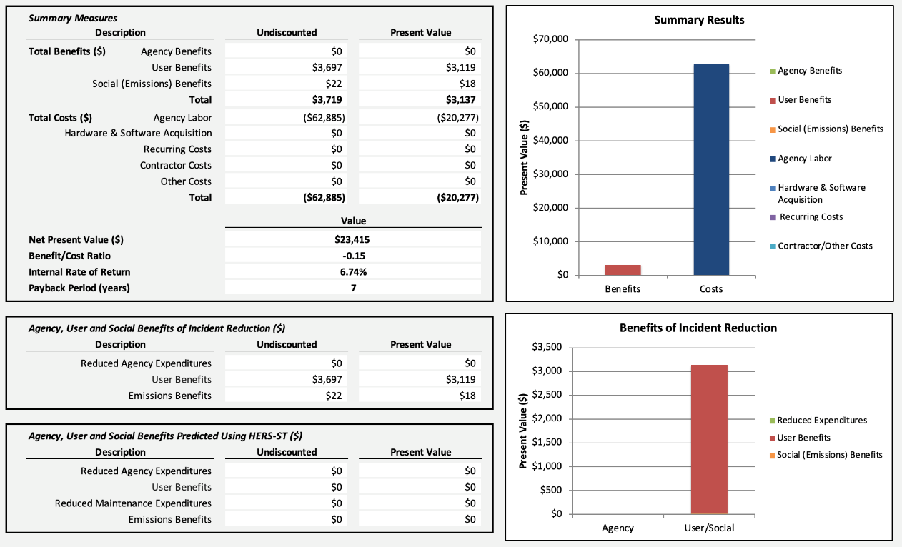
Culvert ROI Calculations
Net benefits
Agency: $20K
User/Social: $3K
ROI measures
NPV: $23K
IRR: 6.74%
Payback Period: 7 years

Slide 38
Conclusions
It is feasible to quantify an ROI for TAM data improvements
Return is positive for collecting additional culvert data
Many types of potential benefits from TAM improvements
Agency cost savings
Reduced impacts to users
Reduced environmental impacts
Improved investment outcomes (very large where applicable)
Some of the benefits are qualitative or difficult to quantify – a description of these should complement and ROI calculations

Slide 39
Trivia Time
Please go to menti.com CODE ZZZZ

Slide 40
Results
15-minute break
Start back at
Trisha Stefanski, pe

Slide 41
Asset Groups and Asset Classes
Bike and Ped | Accessible On-street ADA Parking
Bike and Ped | Pedestrian curb ramps, signals, and sidewalks
Bike and Ped | Bike Lane (not sep) and shared roadways
Bike and Ped | Shared use paths, side paths, separated bike lanes
Bridges | Vehicle Bridges >10' and Tunnels
Bridges | Bridge Pedestrian/Bicycle/Utility
Bridges | Bridge Clearance
Facilities | Class 1 Rest Areas, Class 1 Truck Stations, Office Buildings, Salt Sheds (S&I Operations)
Facilities | Class 2 and 3 rest areas, class 2 and 3 Truck Stations, Brine Buildings (S&I Operations), Weigh Stations
Facilities | Storage sheds, and misc. buildings (lift stations, hazmat, etc.)
Facilities | Class 4 rest areas
Geotechnical | Earth Retaining Systems (includes gravity, soil nail, soldier pile, sheet pile, reinforced concrete cantilever, MSE, crib, bin, timber, other types on the TAMS list)
Geotechnical | Reinforced Soil Slopes
Geotechnical | Improved Ground Supports (includes column-support embankments and transfer platforms)
Geotechnical | Instrumentation Systems (includes inclinometer, pressure cell, gauge, cabinet, and piezometer)
Geotechnical | Special Drainage Systems (includes chimney drain, perforated drain, herringbone drain, geomembrane cap and liner, and trench drain - does not include edge drains)
Geotechnical | Natural Hazard Locations (includes locations off of the ROW not otherwise addressed)
Geotechnical | Improved Subgrade Fills (includes lightweight fill such as: wood chip, tire-derived aggregate, geofoam, lightweight aggregate, cellular concrete, and grouted fill)
Geotechnical | Unimproved Subgrade
Geotechnical | Cut Slopes
Geotechnical | Embankments
Green Assets | Hazard - Noxious Weeds
Green Assets | Replacement Wetlands
Green Assets | Trees (Types: Historic, Notable, High-Risk, Land Bearing)
Green Assets | Native/Pollinator Plantings
Green Assets | Landscaping
Green Assets | Roadway Ditches
Hydraulic Infra | Highway Culverts
Hydraulic Infra | Deep Stormwater Tunnels
Hydraulic Infra | Ponds, Infiltration Basins, and Underground Storage
Hydraulic Infra | Storm Sewer Pipe and Structures
Hydraulic Infra | Structual Pollution Control Devices (SPCD's)
Hydraulic Infra | Local Road Culverts
Hydraulic Infra | Entrance Culverts
Maintenance | Snow and Ice Winter Plow Route
Maintenance | Stationary Anti-Icing Systems
Maintenance | Roadway Weather Information System (RWIS)
Maintenance | Snow Fence (Types: Living, Structural, Grading)
Maintenance | Mowing
Maintenance | Debris Removal
Notes:
Started with AM Responsibility effort from 3 years ago

Slide 42
Assets
Pavements | Highway Mainline
Pavements | High Volume Frontage Roadway
Pavements | Bus Shoulders
Pavements | Highway Ramps/loops
Pavements | Paved Shoulders
Pavements | Low Volume Frontage Roads
Pavements | Edge Drains
Pavements | Drain Tile
Pavements | Curb and Gutter
Pavements | Gravel Shoulders
Rail | Rail/Rail Crossings (non-MnDOT maintenance responsiblities)
Right of Way | Land, Boundary, Excess or Surplus Right of Way
Right of Way | Fence
Structures | ARMER System - radio towers, equipment shelters, radio transmission equipment, facilities
Structures | Wood Noisewalls
Structures | Entrance Monuments
Structures | Concrete Noise
Structures | Billboards (Permit Requirements only)
Traffic | Freeway Management Systems (TMS, RTMC operations, ITS)
Traffic | Signal Systems
Traffic | Lighting - High Mast Towers
Traffic | Sign Panels - Static
Traffic | Sign Structures - Static Panel Ground Mounted
Traffic | Sign Structures - Static Panel Overheads w/Foundations
Traffic | Sign Structures - I-beam w/Static Panel
Traffic | Lighting - Roadway
Traffic | Barrier - Attenuators (Crash Cushions)
Traffic | Barrier - Plate beam End treatments
Traffic | High Tension Cable Barrier
Traffic | Barrier - Plate beam
Traffic | Pavement Markings - Messages
Traffic | Pavement Markings - Striping
Traffic | Concrete Barrier
Traffic | Rumble Strips and Stripes
Notes:
78 Asset

Slide 43
Matrix Spreadsheet
Overview of Matrix Spreadsheet
Matrix Tier Drivers
Inventory Baseline Plan
Inventory Currency Plan
Inspection Plan
Implementation Tasks
Strategic Plans Summary
Demo Time

Slide 44
The “Didn’t Make the Tier” Assets
 | Matrix Drivers
Asset ID | Asset Group | Asset Class | Tier | Desired AM Approach | AM Maturity Step Gap
61 | Hydraulic Infra | Entrance Culverts | 5 | Reactive | 1
60 | Green Assets | Landscaping | 5 | Other | 0
62 | Maintenance | Mowing | 5 | Other | 0
63 | Maintenance | Debris Removal | 5 | Other | 0
73 | Rail | Rail/Rail Crossings (non-MnDOT maintenance responsiblities) | 5 | Other | 0
74 | Structures | Billboards (Permit Requirements only) | 5 | Other | 0
75 | Bridges | Bridge Clearance | 5 | None | 0
69 | Geotechnical | Unimproved Subgrade | 5 | Min. Maint. | 0
70 | Geotechnical | Cut Slopes | 5 | Min. Maint. | 0
72 | Geotechnical | Embankments | 5 | Min. Maint. | 0
66 | Green Assets | Roadway Ditches | 5 | Min. Maint. | 0
64 | Pavements | Edge Drains | 5 | Min. Maint. | 0
67 | Pavements | Drain Tile | 5 | Min. Maint. | 0
68 | Pavements | Curb and Gutter | 5 | Min. Maint. | 0
65 | Right of Way | Fence | 5 | Min. Maint. | 0
71 | Pavements | Gravel Shoulders | 5 | Min. Maint. | 0
Key Takeaways
No Inventory
No Inspection
Reduce Any Data Collection Efforts
Notes:
Entrance culverts reactive

Slide 45
Tier 1 Asset Results
 | Matrix Drivers
Asset ID | Asset Group | Asset Class | Tier | Desired AM Approach | AM Maturity Step Gap
1 | Bridges | Vehicle Bridges >10' and Tunnels | 1 | Condition+ | 0
4 | Facilities | Class 1 Rest Areas, Class 1 Truck Stations, Office Buildings, Salt Sheds (S&I Operations) | 1 | Condition+ | 0
2 | Pavements | Highway Mainline | 1 | Condition+ | 0
5 | Structures | ARMER System - radio towers, equipment shelters, radio transmission equipment, facilities | 1 | Cycle+ | 0
6 | Traffic | Freeway Management Systems (TMS, RTMC operations, ITS) | 1 | Cycle+ | 0
7 | Traffic | Signal Systems | 1 | Cycle+ | 0
3 | Maintenance | Snow and Ice Winter Plow Route | 1 | Other | 0
High Network Risk
Modeling
Condition +
Cycle +
High Maturity

Slide 46
Tier 1 Asset Results
 | Matrix Drivers |  |  |  |  |  |  |  | Plan summary |  | Baseline Inventory |  | Inv. Currency | Condition Inventory |  | System standup
Asset ID | Asset Group | Asset Class | Asset Class | Tier | Tier | Desired AM Approach | AM Maturity Step Gap | AM Maturity Step Gap | Short Description | 5 year Plan Sub-total ($10k resolution) | Timeline To Complete Inventory | Inventory Baseline Cost Estimate | Inventory Currency Annual Cost Estimate | Timeline To Complete Inspection Cycle | Inspection Plan - Annual Cost Estimate (Baseline incl.) | Other Imp. Tasks | Strategic Asset Unit | Statewide Count
1 | Bridges | Vehicle Bridges >10' and Tunnels | Vehicle Bridges >10' and Tunnels | 1 | 1 | Condition+ | 0 | 0 | Stay the course | Calc pending | NA | Calc pending | $10,000 | NA | $2,300,000 | 0 | Bridges | 4,599
4 | Facilities | Class 1 Rest Areas, Class 1 Truck Stations, Office Buildings, Salt Sheds (S&I Operations) | Class 1 Rest Areas, Class 1 Truck Stations, Office Buildings, Salt Sheds (S&I Operations) | 1 | 1 | Condition+ | 0 | 0 | Stay the course | Calc pending | NA | Calc pending | Calc pending | NA | $400,000 | 0 | Building Sites | 600
2 | Pavements | Highway Mainline | Highway Mainline | 1 | 1 | Condition+ | 0 | 0 | Stay the course | $6,810,000 | NA | $ - | $72,000 | NA | $2,150,000 | 1 | Centerline miles | 14,331
5 | Structures | ARMER System - radio towers, equipment shelters, radio transmission equipment, facilities | ARMER System - radio towers, equipment shelters, radio transmission equipment, facilities | 1 | 1 | Cycle+ | 0 | 0 | Stay the course | Calc pending | NA | Calc pending | Calc pending | NA | $70,000 | 0 | Systems | 350
6 | Traffic | Freeway Management Systems (TMS, RTMC operations, ITS) | Freeway Management Systems (TMS, RTMC operations, ITS) | 1 | 1 | Cycle+ | 0 | 0 | Stay the course | Calc pending | NA | Calc pending | Calc pending | NA | $572,000 | 0 | Systems | 14,310
7 | Traffic | Signal Systems | Signal Systems | 1 | 1 | Cycle+ | 0 | 0 | Stay the course | Calc pending | NA | $ 38,000 | Calc pending | NA | $750,000 | 6 | Systems | 1,500
3 | Maintenance | Snow and Ice Winter Plow Route | Snow and Ice Winter Plow Route | 1 | 1 | Other | 0 | 0 | Stay the course | $310,000 | NA | $ - | $1,000 | NA | $100,000 | 0 | TAMS Sections | 500
Total | Totals |  |  |  |  |  |  |  |  | $ 7,120,000 |  | $38,000 | $83,000 |  | $6,342,000 | 7
Notes:
Discuss Plan summary = total costs over 5 years – sticker shock
Baseline Inventory - Inventories Complete, Active: Signal Pole Locations From LiDAR
Inventory Currency - Design Plans/As-Builts
Inspection Processes – Robust, Active: Are Bridge Crews Inspecting Signals, Active: Perform ADA Site Assessments on rest areas and other MnDOT owned facilities.
Other Implementation Items
IT Project Request for HPMA Replacement
Transportation Research Synthesis On Preventive Maintenance/Inspection Signals (and OSS, lighting).
TAMS 3 Integration with S&I MDSS
Development of preventive maintenance standards, cycles, and Archibus triggers for select facilities equipment. This will include additional attribution within Archibus for the Districts

Slide 47
Tier 1 Asset Data Collection Plan
Stay The Course
“We started adding ITS cabinet equipment so we can automatically pull asset info like serial#, firmware, make, model etc. We are trying to leverage automation, so hand entry is needed less.”
“We are advancing deterioration modeling for all bridge and culvert elements”
“AMER inspections occur on 3-year cycle for guide wires and towers via TIA requirements, quarterly inspection required by FAA (remote alarm system but verify once per quarter). Five-year for fixed tower and look over the site as well”.
“The future integration of MDSS Data and TAMS for Snow and Ice recording will reduce data entry into RCA”.
Fun Fact: Tier 1 Assets are Managed in 6 Unique Enterprise Asset Management Systems
47

Slide 48
Tier 2 Asset Results
Tier 2
Not as High Value
Significant Consequence
Proactive Monitoring
Asset Groups
Bike and Ped
Geotechnical
Mainline Culverts
Geotechnical
Ancillary Pavements
High Mast
Condition, Cycle+
Maturity Gaps
 | Matrix Drivers
Asset ID | Asset Group | Asset Class | Tier | Desired AM Approach | AM Maturity Step Gap
11 | Bike and Ped | Pedestrian curb ramps, signals, and sidewalks | 2 | Condition | 4
10 | Bike and Ped | Accessible On-street ADA Parking | 2 | Condition | 4
12 | Bike and Ped | Bike Lane (not sep) and shared roadways | 2 | Condition | 4
9 | Bridges | Bridge Pedestrian/Bicycle/Utility | 2 | Condition | 0
19 | Geotechnical | Earth Retaining Systems (includes gravity, soil nail, soldier pile, sheet pile, reinforced concrete cantilever, MSE, crib, bin, timber, other types on the TAMS list) | 2 | Condition | 4
20 | Geotechnical | Reinforced Soil Slopes | 2 | Condition | 4
21 | Geotechnical | Improved Ground Supports (includes column-support embankments and transfer platforms) | 2 | Condition | 4
8 | Hydraulic Infra | Highway Culverts | 2 | Condition | 0
22 | Maintenance | Stationary Anti-Icing Systems | 2 | Cycle+ | 0
17 | Pavements | Bus Shoulders | 2 | Cycle+ | 2
16 | Pavements | High Volume Frontage Roadway | 2 | Cycle+ | 2
18 | Pavements | Highway Ramps/loops | 2 | Cycle+ | 2
23 | Traffic | Lighting - High Mast Towers | 2 | Cycle+ | 0

Slide 49
Tier 2 Asset Results
(Stay the Course Spreadsheet)
Notes:
Stay The Course

Slide 50
Tier 2 Asset Results
 | Matrix Drivers |  |  |  |  |  |  |  | Plan summary |  |  | Baseline Inventory |  |  | Inv. Currency | Condition Inventory |  |  | System standup
Asset ID | Asset Group | Asset Class | Asset Class | Tier | Tier | Desired AM Approach | AM Maturity Step Gap | AM Maturity Step Gap | Short Description | 5 year Plan Sub-total ($10k resolution) | 5-year Plan Sub-total ($10k resolution) | Timeline To Complete Inventory | Inventory Baseline Cost Estimate | Inventory Baseline Cost Estimate | Inventory Currency Annual Cost Estimate | Timeline To Complete Inspection Cycle | Inspection Plan - Annual Cost Estimate (Baseline incl.) | Inspection Plan - Annual Cost Estimate (Baseline incl.) | Other Imp. Tasks | Strategic Asset Unit | Strategic Asset Unit | Statewide Count | Statewide Count
10 | Bike and Ped | Accessible On-street ADA Parking | Accessible On-street ADA Parking | 2 | 2 | Condition | 4 | 4 | Add | $ 20,000 | $20,000 | <1 year | $ 3,000 | $3,000 | $1,000 | 3 to 5 years | $ 4,000 | $4,000 | 3 | Spots | Spots | 200 | 200
12 | Bike and Ped | Bike Lane (not sep) and shared roadways | Bike Lane (not sep) and shared roadways | 2 | 2 | Condition | 4 | 4 | Add | $ 60,000 | $60,000 | NA | $ - | $ - | $ - | 3 to 5 years | $ 20,000 | $20,000 | 0 | Miles | Miles | 200 | 200
19 | Geotechnical | Earth Retaining Systems (includes gravity, soil nail, soldier pile, sheet pile, reinforced concrete cantilever, MSE, crib, bin, timber, other types on the TAMS list) | Earth Retaining Systems (includes gravity, soil nail, soldier pile, sheet pile, reinforced concrete cantilever, MSE, crib, bin, timber, other types on the TAMS list) | 2 | 2 | Condition | 4 | 4 | Add | $ 800,000 | $800,000 | <1 year | $ 193,000 | $27,000 | $8,000 | 3 to 5 years | $ 188,000 | $188,000 | 2 | Walls | Walls | 2,500 | 2,500
20 | Geotechnical | Reinforced Soil Slopes | Reinforced Soil Slopes | 2 | 2 | Condition | 4 | 4 | Add | $ 150,000 | $150,000 | <1 year | $ 39,000 | $39,000 | $1,000 | 3 to 5 years | $ 36,000 | $36,000 | 1 | Slopes | Slopes | 500 | 500
21 | Geotechnical | Improved Ground Supports (includes column-support embankments and transfer platforms) | Improved Ground Supports (includes column-support embankments and transfer platforms) | 2 | 2 | Condition | 4 | 4 | Add | $ 30,000 | $30,000 | <1 year | $ 8,000 | $8,000 | $1,000 | 3 to 5 years | $ 5,000 | $5,000 | 1 | Support Areas | Support Areas | 100 | 100
16 | Pavements | High Volume Frontage Roadway | High Volume Frontage Roadway | 2 | 2 | Cycle+ | 2 | 2 | Add | $ - | $ - | <1 year | $ 2,000 | 2,000 | $ - | NA | $ - | $ - | 0 | Centerline miles | Centerline miles | 100 | 100
18 | Pavements | Highway Ramps/loops | Highway Ramps/loops | 2 | 2 | Cycle+ | 2 | 2 | Add | $ 60,000 | $60,000 | NA | $ - | $ - | $ - | 3 to 5 years | $ 20,000 | $20,000 | 0 | Centerline miles | Centerline miles | 200 | 200
Total | Totals |  |  |  |  |  |  |  |  | $ 1,120,000 | $1,120,000 |  | $ 245,000 | $79,000 | $11,000 |  | $ 273,000 | $273,000 | 7
Notes:
Baseline Inventory – 3 Gaps
Active: Current Collection efforts curb ramp and sidewalk, including inspections (greater MN complete)
Geotechnical Asset Funding allocated for MnDOT 0.5 FTE
Frontage Roads and ADA Parking Low-Cost Effort (AMPO)
Inventory Currency – No Gaps
Inspection Processes – 1 Gaps
Funding Allocated For Innovative Condition Data Collection Using NASA Sar Satellites
Other Implementation
Geotechnical Assets Funding Allocated for TAMS Phase 3 Enhancement

Slide 51
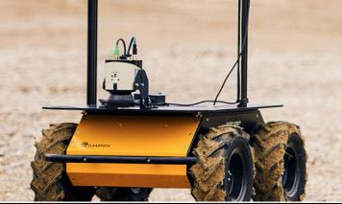
Tier 2 Asset Data Collection Planning Takeaways
Stay The Course
Baseline Inventory <1 year (MnDOT FTE, $80K)
Inspection of Geotechnical and Ancillary Pavements 3-5 years (?, $300K)
“To keep the pedestrian inventory data current, this winter there is an effort to move construction inspectors from using current electronic form completion (prior to construction close-out) to a user friendly MnDOT GIS web-application (Similar to survey123) with data sorting and analysis.”
Fun Fact: Maplewood Lab has a Robot named husky!

Slide 52
Tier 3 Asset Results Part 1
Tier 3
y
Asset Groups
Bike and Ped
Facilities
Geotechnical
Hydraulic Infra
Ancillary Pavements
Structures
Cycle+ and Cycle
Maturity Gaps
 | Matrix Drivers
Asset ID | Asset Group | Asset Class | Asset Class | Tier | Desired AM Approach | AM Maturity Step Gap
46 | Bike and Ped | Shared use paths, side paths, sep bike lanes | Shared use paths, side paths, sep bike lanes | 3 | Cycle | 2
13 | Facilities | Class 2 and 3 rest areas,Class 2 and 3 Truck Stations, Brine Buildings (S&I Operations), Weigh Stations | Class 2 and 3 rest areas,Class 2 and 3 Truck Stations, Brine Buildings (S&I Operations), Weigh Stations | 3 | Cycle+ | 0
36 | Geotechnical | Instrumentation Systems (includes inclinometer, pressure cell, gauge, cabinet, and piezometer) | Instrumentation Systems (includes inclinometer, pressure cell, gauge, cabinet, and piezometer) | 3 | Cycle+ | 3
48 | Geotechnical | Special Drainage Systems (includes chimney drain, perforated drain, herringbone drain, geomembrane cap and liner, and trench drain - does not include edge drains) | Special Drainage Systems (includes chimney drain, perforated drain, herringbone drain, geomembrane cap and liner, and trench drain - does not include edge drains) | 3 | Cycle | 2
49 | Green Assets | Hazard - Noxious Weeds | Hazard - Noxious Weeds | 3 | Other | 0
26 | Hydraulic Infra | Ponds, Infiltration Basins, and Underground Storage | Ponds, Infiltration Basins, and Underground Storage | 3 | Cycle+ | 3
25 | Hydraulic Infra | Deep Stormwater Tunnels | Deep Stormwater Tunnels | 3 | Cycle+ | 0
28 | Hydraulic Infra | Structual Pollution Control Devices (SPCD's) | Structual Pollution Control Devices (SPCD's) | 3 | Cycle+ | 2
47 | Hydraulic Infra | Local Road Culverts | Local Road Culverts | 3 | Cycle | 2
27 | Hydraulic Infra | Storm Sewer Pipe and Structures | Storm Sewer Pipe and Structures | 3 | Cycle+ | 3
34 | Maintenance | Roadway Weather Information System (RWIS) | Roadway Weather Information System (RWIS) | 3 | Cycle+ | 1
41 | Pavements | Paved Shoulders | Paved Shoulders | 3 | Cycle+ | 2
43 | Pavements | Low Volume Frontage Roads | Low Volume Frontage Roads | 3 | Cycle+ | 2
37 | Structures | Entrance Monuments | Entrance Monuments | 3 | Cycle+ | 0
24 | Structures | Wood Noisewalls | Wood Noisewalls | 3 | Cycle+ | 0

Slide 53
Tier 3 Asset Results Part 2
 | Matrix Drivers
Asset ID | Asset Group | Asset Class | Tier | Desired AM Approach | AM Maturity Step Gap
29 | Traffic | Sign Panels - Static | 3 | Cycle+ | 1
32 | Traffic | Sign Structures - I-beam w/Static Panel | 3 | Cycle+ | 1
33 | Traffic | Lighting - Roadway | 3 | Cycle+ | 0
30 | Traffic | Sign Structures - Static Panel Ground Mounted | 3 | Cycle+ | 1
31 | Traffic | Sign Structures - Static Panel Overheads w/Foundations | 3 | Cycle+ | 1
44 | Traffic | Pavement Markings - Messages | 3 | Cycle | 2
42 | Traffic | Barrier - Plate beam | 3 | Cycle+ | 0
38 | Traffic | Barrier - Attenuators (Crash Cushions) | 3 | Cycle+ | 0
39 | Traffic | Barrier - Plate beam End treatments | 3 | Cycle+ | 0
40 | Traffic | High Tension Cable Barrier | 3 | Cycle+ | 0
45 | Traffic | Pavement Markings - Striping | 3 | Cycle | 1
Asset Groups
Traffic
Maturity Gaps
Signs
Pavement Messages
Pavement Striping

Slide 54
Tier 3 Asset Methodology Analysis (One-Time Collect)
Gap in Asset Inventory Data Analysis
HDR Project in 2018 3,000/Project
$250K Effort
Alternative Method to Use MnDOT Resources
*These costs use historical data from one project and do not include conflation
Notes:
Access Database
Gaps where we didn’t get as-builts
HDR project 3,000/project

Slide 55
Tier 3 Methodology Analysis (Annual Collect)
MnDOT Signs are replaced by 3 methods
1. Maintenance Damage Repairs
2. Maintenance and Contractor Annual Sign Replacement Projects
Lower Cost For Comparison Purposes (5 min/sign)
25,000 signs (15-year life cycle)
1.0 FTE or $150,000
3. Construction Project Impacts
Annual 2-5% of Sign Modifications
As-built $13/sign cost in 2019
$150-$200,000
District 3 Pilot Project Mobile Lidar & Conflation $3.50/sign.
Mobile Lidar Cyclical Collect $150K/Year
Reduced MnDOT Staff Time

Slide 56
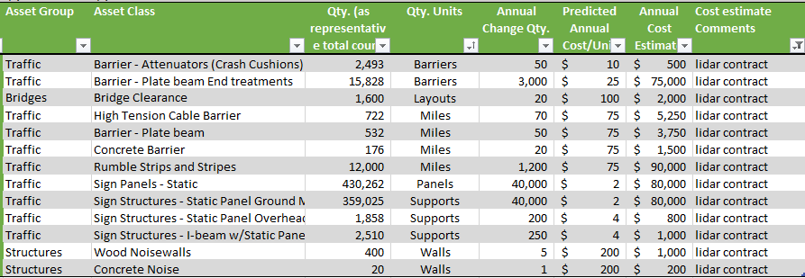
Tier 3 Methodology Analysis (Annual Collect)
Above Ground Assets
Traffic Barrier
Concrete Barrier
Rumbles
Signs
Noisewalls
Economies of Scale
High-level Cost Exercise
Concrete Barrier $65 each Versus $13/Pt As-Builts

Slide 57
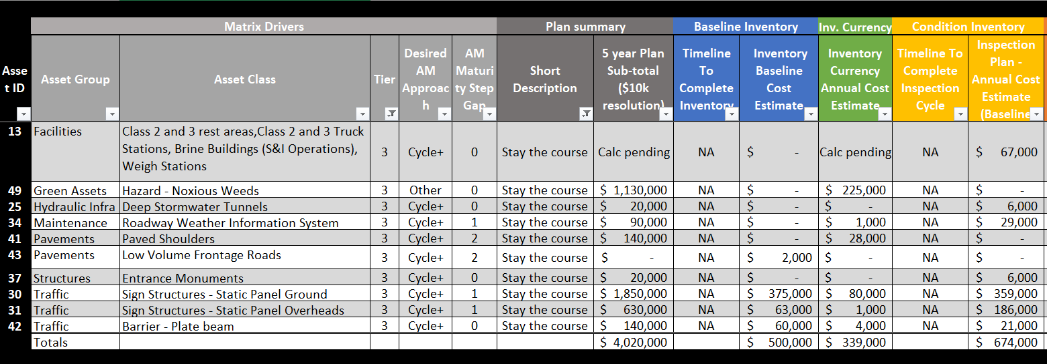
Tier 3 Asset Results – Stay The Course

Slide 58
Tier 3 Asset Data Collection Planning - Add
 | Matrix Drivers |  |  |  |  |  | Plan summary |  | Baseline Inventory |  | Inv. Currency | Condition Inventory |  | System standup
Asset ID | Asset Group | Asset Class | Asset Class | Tier | Desired AM Approach | AM Maturity Step Gap | Short Description | 5 year Plan Sub-total ($10k resolution) | Timeline To Complete Inventory | Inventory Baseline Cost Estimate | Inventory Currency Annual Cost Estimate | Timeline To Complete Inspection Cycle | Inspection Plan - Annual Cost Estimate (Baseline incl.) | Other Imp. Tasks | Strategic Asset Unit | Statewide Count
46 | Bike and Ped | Shared use paths, side paths, sep bike lanes | Shared use paths, side paths, sep bike lanes | 3 | Cycle | 2 | Add | $ 160,000 | NA | $ - | $ 20,000 | 3 to 5 years | $ 20,000 | 2 | Miles | 200
36 | Geotechnical | Instrumentation Systems (includes inclinometer, pressure cell, gauge, cabinet, and piezometer) | Instrumentation Systems (includes inclinometer, pressure cell, gauge, cabinet, and piezometer) | 3 | Cycle+ | 3 | Add | $ 50,000 | <1 year | $ - | $ 1,000 | 3 to 5 years | $ 15,000 | 1 | Systems | 30
48 | Geotechnical | Special Drainage Systems (includes chimney drain, perforated drain, herringbone drain, geomembrane cap and liner, and trench drain - does not include edge drains) | Special Drainage Systems (includes chimney drain, perforated drain, herringbone drain, geomembrane cap and liner, and trench drain - does not include edge drains) | 3 | Cycle | 2 | Add | $ 10,000 | <1 year | $ 3,000 | $ 1,000 | 3 to 5 years | $ - | 2 | Pipes | 250
26 | Hydraulic Infra | Ponds, Infiltration Basins, and Underground Storage | Ponds, Infiltration Basins, and Underground Storage | 3 | Cycle+ | 3 | Add | $ 370,000 | 1 to 3 years | $ 50,000 | $ 25,000 | 1 to 3 years | $ 65,000 | 0 | Ponds | 1,300
28 | Hydraulic Infra | Structual Pollution Control Devices (SPCD's) | Structual Pollution Control Devices (SPCD's) | 3 | Cycle+ | 2 | Add | $ 50,000 | 1 to 3 years | $ 25,000 | $ - | 1 to 3 years | $ 9,000 | 0 | Structures | 86
47 | Hydraulic Infra | Local Road Culverts | Local Road Culverts | 3 | Cycle | 2 | Add | $1,140,000 | 3 to 5 years | $ 720,000 | $ 12,000 | 3 to 5 years | $ 121,000 | 0 | Pipes | 12,093
27 | Hydraulic Infra | Storm Sewer Pipe and Structures | Storm Sewer Pipe and Structures | 3 | Cycle+ | 3 | Add | $11,010,000 | <1 year | $ 75,000 | $ 168,000 | > 5 years | $ 3,366,000 | 0 | Pipe/Structures | 168,285
Notes:
Baseline Inventory – X Gaps
Active:
Inventory Currency – Y Gaps
Inspection Processes – Z Gaps
f
Other Implementation
EE
Clarify storm sewer plans – what are we actually adding

Slide 59
Tier 3 Asset Data Collection Planning - Add
 | Matrix Drivers |  |  |  |  | Plan summary |  | Baseline Inventory |  | Inv. Currency | Condition Inventory |  | System standup
Asset ID | Asset Group | Asset Class | Tier | Desired AM Approach | AM Maturity Step Gap | Short Description | 5 year Plan Sub-total ($10k resolution) | Timeline To Complete Inventory | Inventory Baseline Cost Estimate | Inventory Currency Annual Cost Estimate | Timeline To Complete Inspection Cycle | Inspection Plan - Annual Cost Estimate (Baseline incl.) | Other Imp. Tasks | Strategic Asset Unit | Statewide Count
29 | Traffic | Sign Panels - Static | 3 | Cycle+ | 1 | Add | $ 2,230,000 | 1 to 3 years | $ 750,000 | $ 80,000 | 3 to 5 years | $ 359,000 | 0 | Panels | 430,262
32 | Traffic | Sign Structures - I-beam w/Static Panel | 3 | Cycle+ | 1 | Add | $ 220,000 | 1 to 3 years | $ 63,000 | $ 1,000 | 3 to 3 years | $ 50,000 | 0 | Supports | 2,510
33 | Traffic | Lighting - Roadway | 3 | Cycle+ | 0 | Add | $ 2,200,000 | 3 to 5 years | $ 150,000 | $ 85,000 | 3 to 5 years | $ 543,000 | 2 | Lighting units | 27,147
44 | Traffic | Pavement Markings - Messages | 3 | Cycle | 2 | Add | $ 1,100,000 | 3 to 5 years | $ 350,000 | $ 150,000 | NA | $ - | 1 | Markings | 100,000
38 | Traffic | Barrier - Attenuators (Crash Cushions) | 3 | Cycle+ | 0 | Add | $ 340,000 | <1 year | $ 30,000 | $ 1,000 | NA | $ 100,000 | 1 | Barriers | 2,493
39 | Traffic | Barrier - Plate beam End treatments | 3 | Cycle+ | 0 | Add | $ 2,300,000 | <1 year | $ 30,000 | $ 75,000 | NA | $ 633,000 | 0 | Barriers | 15,828
40 | Traffic | High Tension Cable Barrier | 3 | Cycle+ | 0 | Add | $ 170,000 | <1 year | $ 60,000 | $ 5,000 | NA | $ 29,000 | 0 | Miles | 722
45 | Traffic | Pavement Markings - Striping | 3 | Cycle | 1 | Add | $ 520,000 | <1 year | $ 20,000 | $ 100,000 | NA | $ - | 0 | Miles | 45,224
Total | Totals |  |  |  |  |  | $22,040,000 |  | $ 2,326,000 | $ 725,000 |  | $ 5,366,000 | 10
Notes:
Baseline Inventory – X Gaps
Active:
Inventory Currency – Y Gaps
Inspection Processes – Z Gaps
f
Other Implementation
EE
Big add is total sign collect remaining districts if done

Slide 60
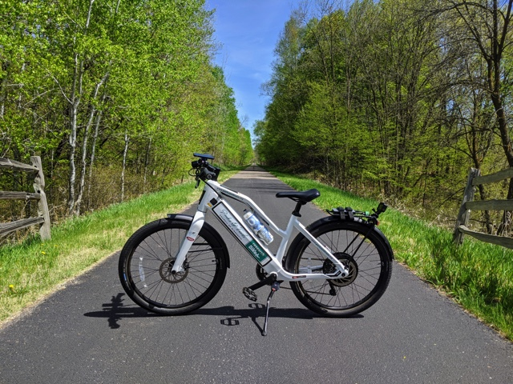
Tier 3 Asset Data Collection Planning Key Takeaways
Geotechnical Inventory (MnDOT, $75K)
Hydraulic Inventories (MnDOT, $XK)
Sign Inventory Baseline Need in Four Districts (Consultant, $1.2M)
Multiple Asset Inventory One-Time Project (Consultant, $250K)
Inspections on Multiple Assets ($5M Annual, 3 to 5 Years)
Fun Facts:
Research Bike From Park & Trails Council Collects
Data Used To Rate Trail Conditions.

Slide 61
Tier 4 Asset Results
Tier 4
Inventory
Only Inspection of Snow Fence
Asset Groups
Maintenance
Green
Facilities
Geotechnical
ROW
Traffic
Cycle+, Reactive
Maturity Gaps
 | Matrix Drivers
Asset ID | Asset Group | Asset Class | Tier | Desired AM Approach | AM Maturity Step Gap
58 | Maintenance | Snow Fence (Types: Living, Structural, Grading) | 4 | Cycle+ | 2
59 | Green Assets | Native/Pollinator Plantings | 4 | Other | 0
14 | Facilities | Storage sheds, and misc. buildings (lift stations, hazmat, etc.) | 4 | Reactive | 0
51 | Geotechnical | Natural Hazard Locations (includes locations off of the ROW not otherwise addressed) | 4 | Reactive | 1
52 | Geotechnical | Improved Subgrade Fills (includes lightweight fill such as: wood chip, tire-derived aggregate, geofoam, lightweight aggregate, cellular concrete, and grouted fill) | 4 | Reactive | 1
53 | Green Assets | Replacement Wetlands | 4 | Reactive | 1
54 | Green Assets | Trees (Types: Historic, Notable, High-Risk, Land Bearing) | 4 | Reactive | 1
55 | Right of Way | Land, Boundary, Excess or Surplus Right of Way | 4 | Reactive | 0
50 | Structures | Concrete Noise | 4 | Reactive | 0
56 | Traffic | Concrete Barrier | 4 | Reactive | 0
57 | Traffic | Rumble Strips and Stripes | 4 | Reactive | 1

Slide 62
Tier 4 Asset Results Data Collection Planning – Stay the Course
Notes:
Baseline Inventory – 5 Gaps, Active:
Inventory Currency – No Gaps, Adding Snow Fence to As-builts or get data from Design
Inspection Processes – 1 Gap, future Snow Fence Inspection
Other Implementation Tasks, 4 -

Slide 63
Tier 4 Asset Results Data Collection Planning - Add
 | Matrix Drivers |  |  |  |  |  | Plan summary |  | Baseline Inventory |  | Inv. Currency | Condition Inventory |  | System standup
Asset ID | Asset Group | Asset Class | Asset Class | Tier | Desired AM Approach | AM Maturity Step Gap | Short Description | 5-year Plan Sub-total ($10k resolution) | Timeline To Complete Inventory | Inventory Baseline Cost Estimate | Inventory Currency Annual Cost Estimate | Timeline To Complete Inspection Cycle | Inspection Plan - Annual Cost Estimate (Baseline incl.) | Other Imp. Tasks | Strategic Asset Unit | Statewide Count
58 | Maintenance | Snow Fence (Types: Living, Structural, Grading) | Snow Fence (Types: Living, Structural, Grading) | 4 | Cycle+ | 2 | Add | $180,000 | <1 year | $5,000 | $10,000 | 3 to 5 years | $40,000 | 2 | Fences/Traps | 200
51 | Geotechnical | Natural Hazard Locations (includes locations off of the ROW not otherwise addressed) | Natural Hazard Locations (includes locations off the ROW not otherwise addressed) | 4 | Reactive | 1 | Add | $70,000 | 1 to 3 years | $67,000 | $1,000 | NA | $ - | 1 | Centroids | 1,000
52 | Geotechnical | Improved Subgrade Fills (includes lightweight fill such as: wood chip, tire-derived aggregate, geofoam, lightweight aggregate, cellular concrete, and grouted fill) | Improved Subgrade Fills (includes lightweight fill such as: wood chip, tire-derived aggregate, geofoam, lightweight aggregate, cellular concrete, and grouted fill) | 4 | Reactive | 1 | Add | $20,000 | 1 to 3 years | $13,000 | $1,000 | NA | $ - | 1 | Fill Areas | 200
53 | Green Assets | Replacement Wetlands | Replacement Wetlands | 4 | Reactive | 1 | Add | $10,000 | 1 to 3 years | $7,000 | $ - | NA | $ - | 0 | Wetland areas | 15
57 | Traffic | Rumble Strips and Stripes | Rumble Strips and Stripes | 4 | Reactive | 1 | Add | $460,000 | 1 to 3 years | $8,000 | $90,000 | NA | $ - | 0 | Miles | 12,000
Total | Totals |  |  |  |  |  |  | $740,000 |  | $100,000 | $102,000 |  | $ 40,000 | 4
Notes:
Baseline Inventory – 5 Gaps, Active:
Inventory Currency – No Gaps, Adding Snow Fence to As-builts or get data from Design
Inspection Processes – 1 Gap, future Snow Fence Inspection
Other Implementation Tasks, 4 -

Slide 64
Tier 4 Asset Data Collection Planning Key Takeaways
Snow Fence Inventory Updates From 2016-2020 (MnDOT, 1-3 Years)
Geotechnical Assets (MnDOT, <1 Year)
Updates from Paper to GIS Wetland Replacement (MnDOT, 3-5 years)
Future Inspection of Snow Fence (?, 3-5 years)
Fun Facts:
Snow Fence Collector Application Will be the Foundation for the “Farmer to Farmer Snow Fence Networking web-site.

Slide 65
Pivot Graphs
Notes:
Maturity Gaps
Baseline Inventory – X Gaps
Active:
Inventory Currency – Y Gaps
Inspection Processes – Z Gaps
f
Other Implementation
EE

Slide 66
Trivia Time Please Type Your Answer In The Chat Box
Be The First To Answer….
How

Slide 67
Recommendations
DAVE Solsrud

Slide 68
Recommendation A
Move Forward with MnDOT Resource Low-Cost Efforts
GIS Frontage Road Inventory (Metro AM)
Metro District Concrete Barrier Conflation (Metro AM)
Catch Basin Lidar Conflation (AMPO/Districts)
Light Pole and Signal Pole Lidar Conflation (AMPO/ESS/Districts)
Replacement Wetland GIS Inventory (OLM)
Mowing Inventory For Performance Measures (AMPO)
Accessible ADA Parking Inventory
Snow Fence Inventory
Each Effort Estimated to Cost Less Than $25,000

Slide 69
Recommendation B
Obtain full District inventory of structural pollution control devices (SPCD), ponds and basins using MnDOT resources and with input/review from Districts.
Estimated Time Commitment of 6 months GIS Analyst and 4 Weeks of District Review.
Definitions
Highway Culverts: In place culverts with a roadway type of centerline, collector/distributor, mainline, media, ramp/loop or roundabout
Local Road Culverts: In place culverts with a roadway type of city, county, frontage
Entrance Culverts: In place culverts with a roadway type of entrance, farm entrance, field entrance, commercial entrance
Flume: Pipe that conveys water down a steep slope, energy may be dissipated in the pipe flume itself and/or at the outlet
Notes:
Comments:
Current practice in some Districts already
Advance 081 efforts
Legal and Operational Risks

Slide 70
Recommendation C
Program One-Time Consultant Project To Conflate Asset Traffic Barrier, Rumbles, and Striping Inventories Impacted By 2019 and 2020 Construction Seasons.
Existing HDR project yielded $3,000/project
Notes:
HDR 3,000 per project yield cost of roughly $250,000

Slide 71
Recommendation D
Not Inventorying
Fence
Edge Drains
Ditches
Curb and Gutter
Unimproved Subgrade
Cut Slopes
Gravel Shoulders
Embankments
These Asset Were Recognized as Minimum Maintenance Assets & Asset Inventories Not Required

Slide 72
Recommendation E
We recommend including all below ground assets in SRC as-builts 2011.601.
Electrical Systems (For Example, Lights, Signals, ITS, Weigh Stations)
All culvert types (highway, local road and entrance).
Storm drainpipes and catch basins.
Definitions
Highway Culverts: In place culverts with a roadway type of centerline, collector/distributor, mainline, media, ramp/loop or roundabout
Local Road Culverts: In place culverts with a roadway type of city, county, frontage
Entrance Culverts: In place culverts with a roadway type of entrance, farm entrance, field entrance, commercial entrance
Flume: Pipe that conveys water down a steep slope, energy may be dissipated in the pipe flume itself and/or at the outlet
Notes:
Comments:
Law requirement for Gopher State One Call
Streamlining review and import methodology through AMPO/District staff

Slide 73
Recommendation F
Upgrade Automated Vehicle Location Data Logging Systems on Central Office Stripers and Integrate Data with TAMS
Estimate From The Vendor of $70,000 For Equipment and Estimate of IT Time ~$30K
Notes:
Comments:
Means to Document Material Type
Current System is Desperate
Efficient
New System Designed For TAMS Integration

Slide 74
Recommendation G
Program A Statewide Annual Mobile Lidar Collection Project Each Fall To Update Construction Project Data (Signs and Several Other Above Ground Assets).

Slide 75
Recommendation H
Inspections
Storm sewer inspection will take place during the scoping process and added throughout time.
Structural pollution control devices (SPCD), ponds and basins Inspection cycle to be determined by current requirements from permits, MS4 SWPPP or District needs.
Definitions
Highway Culverts: In place culverts with a roadway type of centerline, collector/distributor, mainline, media, ramp/loop or roundabout
Local Road Culverts: In place culverts with a roadway type of city, county, frontage
Entrance Culverts: In place culverts with a roadway type of entrance, farm entrance, field entrance, commercial entrance
Flume: Pipe that conveys water down a steep slope, energy may be dissipated in the pipe flume itself and/or at the outlet
Notes:
Comments:
Building asset inventory for Gopher State One Call
One-time storm sewer inventory would be expensive and time consuming
Strategy becomes building the inventory over-time
Right time for inspection data

Slide 76
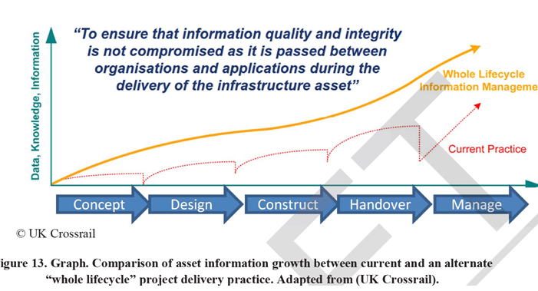
Recommendation I
Interoperable Design, Construction, and Asset Management Software Systems (data) Forming a Whole Lifecycle Approach
For Example, Provide Training and Support on The New Transportation Asset Management Based Sign Inventory Design Plan Data Table Template.

Slide 77
Recommendation J
Conduct Data Inter-relationship and Data Value Pilot
Pick 1 or 2 Assets
Understand Current Efforts
What Data Collected When
How Much Attribution
Are Districts Using The Data
Streamline Future Efforts
Maximize Data Sharing From Concept – Plan – Scope – Design – Construction - Manage
Set Expectations For Level of Attribution At Each Phase
Communicate Results

Slide 78
Recommendation K
Reduce MnDOT Data Collection Efforts
Maintenance Snow and Ice Labor, Equipment, Material (LEM) Data Entry into RCA. TAMS and MDSS Integration Project.
Sign Maintenance Data Entry for Sign Replacement Projects
As-built Processing For Signs, Noise Walls, and Traffic Barrier (annual LiDAR)
Sign Design Plan Development (New Template)
“
When employed correctly, four ounces can move a
thousand pounds
“
-Mulan
Notes:
When employed correctly, four ounces can move a thousand pounds. - Mulan

Slide 80
Attractive Roadsides
Mowing Maps
Snow & Ice
Analysis & Reporting
Smooth Pavement Pavement Van Analysis
Drainage
TAMS Development & Support
Roadside Safety
Traffic Barrier Mapbooks
Fleet
AVL Analysis
Structures
Inspections and Reporting
ADA Data Collection
Damage Restitution Contract Updates
District
As-Built Experts
Maintenance
GIS Mapping
Summer Work Plan
Work Planning

Slide 81
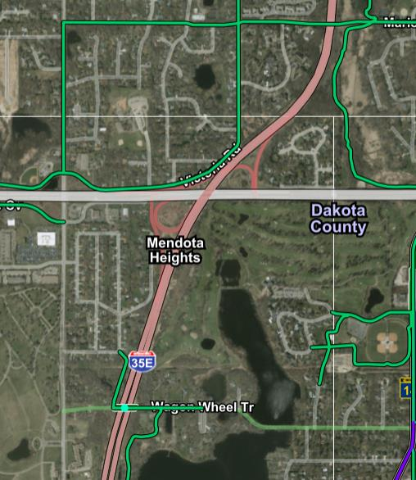
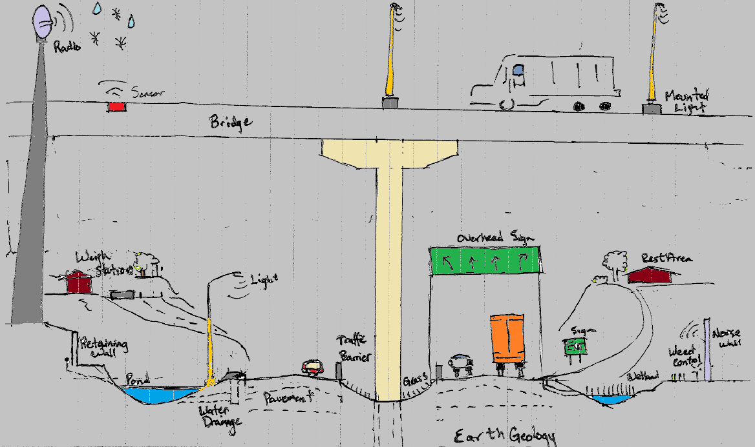

Slide 82
Active Efforts

Slide 83
Active Efforts to Update Baseline Inventory
Signals and Lighting Inventory Updates from 2018 LiDAR data
Pedestrian Infrastructure Sidewalk and Curb Ramps ($1M)
Mowing Inventory for Performance Measures

Slide 84
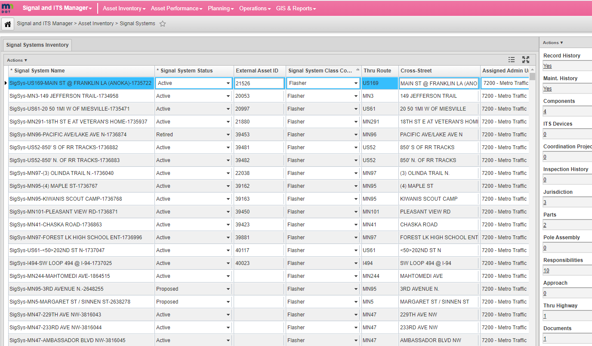
TAMS Phase 3
Build Window(s) for Snow Fence Inventory and Inspection
Build Window(s) for Entrance Monument Inventory
Pavement Long-Lines and Message Modifications and App
Lighting Inventory and Inspection Application
Signal Inventory and Inspection Application
Overhead Sign Structure Inspection Application

