Slide 1
AMSIP
(Asset Management Strategic Implementation Plan)
What are we going to do with all this asset management data?!
Dave Solsrud, PE
AMPO - Asset Management Program Office
Minnesota Department of Transportation

Slide 2
AMSIP Project
    Brief Recap – status, meetings since last ops div, decisions

Slide 3
Matrix 1
    List of Assets
    Recap of Management Approaches

Slide 4
Matrix 2
    List of Assets cont.
    Recap of Management Approaches

Slide 5
Matrix 3
    List of Actions proposed
    Stay the course
    Low hanging fruit
    Costly proposals – labor
    Costly proposals - $’s

Slide 6
Matrix 4
    List of Actions Proposed cont.

Slide 7
Sample Asset Responsibilities Example 1
    Who
    Acquires data
    Maintains data
      Maintenance (TAMS work, Inspections)
      Program delivery (As Builts, QA)
      Lidar (Cyclical)
    Uses the data

Slide 8
Sample Asset Responsibilities Example 2
    Who
    Acquires data
    Maintains data
      Maintenance (TAMS work, Inspections)
      Program delivery (As Builts, QA)
      Lidar (Cyclical)
    Uses the data

Slide 9
Sample Asset Responsibilities Example 3
    Who
    Acquires data
    Maintains data
      Maintenance (TAMS work, Inspections)
      Program delivery (As Builts, QA)
      Lidar (Cyclical)
    Uses the data

Slide 10
Who Uses Asset Data? Maintenance Measures
    Words – maintenance performance measures, 1 measure example, demand computation, resource needs
    Should we show the suite of maintenance measures?
    Can we show LOS prioritization somehow?
    List customers, analysts, skillsets

Slide 11
Who Uses Asset Data? Maintenance Planning
    Map based work planning support
    What level does this manifest best? Maintenance work planning vs future constuction projects?
    Inspection routing?
    Needs within a detoured corridor (IE metro)

Slide 12
Who Uses Asset Data? System Size
    General information requests?
    Number of signals
    How about a more sophisticated sort? Condition 4 culverts in reservation or similar?
    Josh?

Slide 13
Who Uses Asset Data? Cost/Productivity
    Cost models - $’s/patching mile by district
    Other productivity variations – guardrail repair vs ADT?
    Comparison of MnDOT to contactor costs? (crack sealing?)

Slide 14
Who Uses Asset Data? Spatial Analysis
    Heat maps of some kind – frequently hit guardrail? Other

Slide 15
Who Uses Asset Data? Dashboards
    What would be a good dashboard for a DE or Maintenance Engineer?

Slide 16
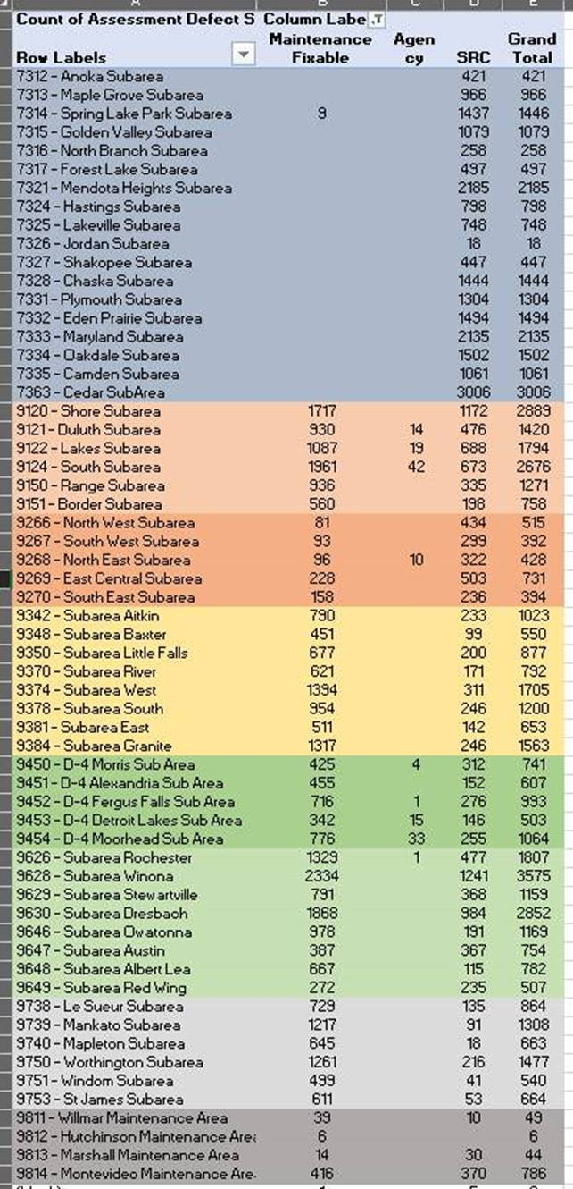
Who Uses Asset Data? Maint/Capital
    Maintenance and Capital coordination – CHIMES projects vs maintenance needs somehow?
    Guardrail by capital vs maintenance
    PM by Capital vs maintenance

Slide 17
Who Uses Asset Data? Scoping
    How can we best show this? Scoping Map? Or analysis?

Slide 18
Who Uses Asset Data? Procurement
    Mastic per mile of patching or sealing?
    Gaurdrail parts needed for
    Lin ft of liner using culvert decision tree?

Slide 19
Who Uses Asset Data?Consigned inventory
    Report of consumption vs SWIFT for cycle counts?

Slide 20
Who Uses Asset Data? Capital Planning Info
Roadside asset needs by request of district planners?

Slide 21
Who Uses Asset Data? Risk Mitigation
    Inspections performance?
    Poor condition assets?
    Location of hidden assets such as underground Geotech

Slide 22
Who Uses Asset Data? Regulatory
    GSOC Mapping
    MS4

Slide 23
Who Uses Asset Data? Sustainability
    Map of salt use in sensitive areas?
    Slope Vulnerability?

Slide 24
Who Uses Asset Data? Design
    Sign plans

Slide 25
Who Uses Asset Data? Financial
    Damage Restitution
    ER tracking
    TAMS plain language work types

Slide 26
Who Uses Asset Data? Asset Management
    PM work triggers (Cameron’s signal example)
    Drainage pond maintenance

Slide 27
End of 2/24 OPS Div Pres

Slide 28
agenda/outcomes
Thanks to OPS
Understanding of ASMIP
  Status
  Scope
  Implications
  Tradeoff Process
Dialog
Committment

Slide 29
Thanks!
Thanks to OPS for engagement
Team Members
  Matrix: Jay, Mike Barnes, Perry Collins, Paul Czech, Mike Ginnaty, Susann Karnowski, Bill Pirkl, Mark Schoenfelder, Todd Stevens, Mitch Webster.
  Geotech: Shiloh, Steve Kirsch, Pat Huston, Charlie Kremer, Doug Maki, Mary Safgren, Dustin Thomas, Amy Thorson
  PM: Greg Ous, Greg Paulson, Dave Van Deusen, Tom Meath, Ronda Allis, Jamie Hukriede, Mike Leegard
  Communications: JT, Jon Huseby, Jeff Perkins, Sheila Kauppi, Steve Lund, Jed Falgren, Jon Mason, Mike Dougherty
  TAMP: Duane Hill, Todd Campbell, Lindsey Bruer, Lynn Clarkowski, Sheila Johnson, Mark Panek
  39*1*9=351 Theoretical Hrs.

Slide 30
Background
“TAMP Implementation Workshop”
  Why some assets, not others? (TAMP, AM in general)
  What other assets do we want – how do we decide?
  What demands on district staff? What resource needs?
  What roles, responsibilities?
  PM barriers
  Maintenance Funding
  TAMP vs MnSHIP – how integrated?
  What data needs beyond AM, ex: 081, Restitution, Scoping, Design
  What’s our long-range goal for asset management? How do we know when we’re there?
  Decision making constraints
  Etc.

Slide 31
Outcomes of the Planning Process
“AMSIP” Components
  Strategic – Where (how far) are we going?
    MnDOT SOP => Tangible
    Shared Vision => Documented
  Implementation – Roles, Responsibilities, Processes/Practices, Data acquisition & maintenance etc.
    Emphasis on Actionable, Tangible outcomes
    Maximize number of decisions made during planning effort
    Emphasis on collaborative plan development

Slide 32
Project Status
Communications Team:
  Victory Declared!
  Final Meeting planned 11/30/20
  Comprehensive Plan
    Stakeholders
    Coms Needs
    Roadmap
    AMPO
  OPS Takeaways –
    Top-Down Messaging Expectations

Slide 33
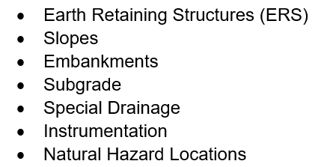
Project Status
Geotech Team:
  Victory Declared!
  Asset Taxonomy
  Desired Management Approach
  Near (& Mid, Long) Term Solution Recs.
    As-Built Specs for inventory (future)
    “Institutional Knowledge” interviews
    Plan extraction
    TAMS Configuration, Georilla Access
  Incorporated into “Matrix”
  Subject to “Matrix Trade-Off” decisions

Slide 34
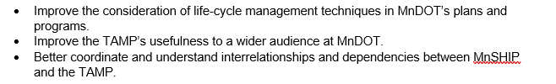
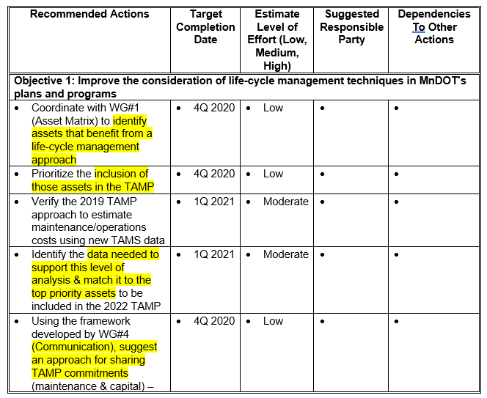
Project Status
TAMP Team:
  Implementation Plan Draft:
    Short, Long Term – 32 total
  OPS implications:
    Maintenance Costs/GAPS/TCO
    Data needs (See Matrix Team)
    Lifecycle Management
  Subject to “Matrix Trade-Off” decisions

Slide 35
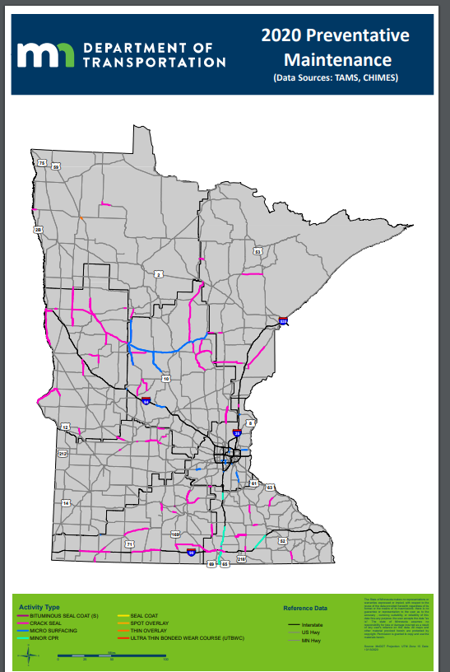
Project Status
PM Team:
Barriers => Solutions
Setasides, $$$’s Measures
Performance Measures (MBMT origin)
Programming Process
Reference Availability – Portal or similar
Vetting – Matls Engrs, Planners, Bridge, Traffic, DE’s, PCMG/CMG, MBMT - Underway
OPS Takeaways:
  Programming or Maint Plan to Meet Targets
  Tradeoffs
  Project Execution

Slide 36
Project Status
Matrix Team:
  Which assets should we attempt to develop inventory?
    How, Who, How to Sustain
  70 + Asset Classes
  Desired Maintenance Approach Determined (Aspirational)
    Tiers => Data Needs
  Numerous Other Drivers: Mandates, Data Consumers, Risk, Share of Spending (Cap & M&O), Maturity Gap
  Data Collection: Options, Relative Costs
  Subject to “Matrix Trade-Off” decisions

Slide 37
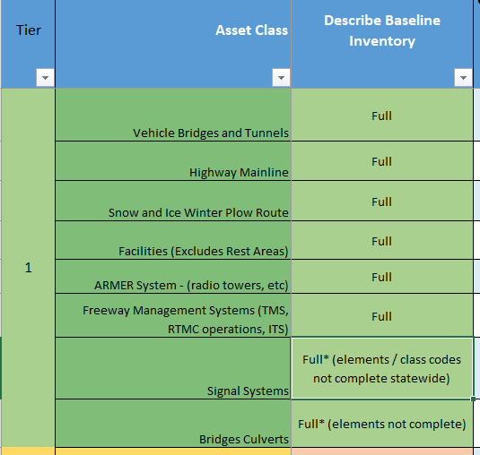
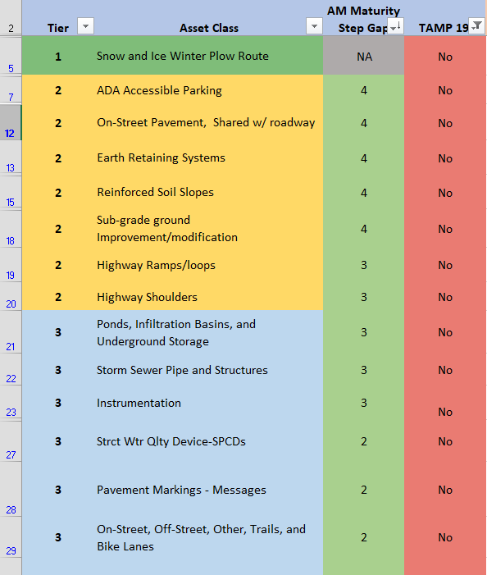
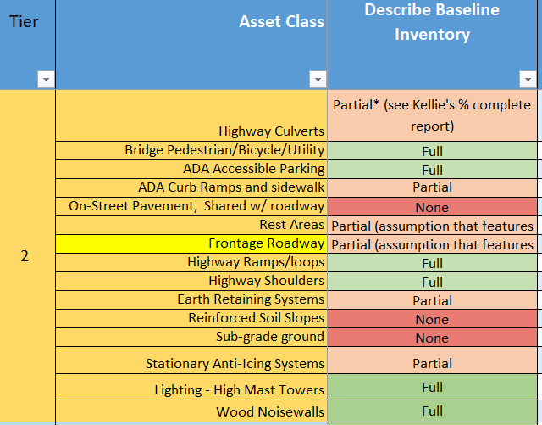
Matrix Data
Asset Maturity
Status of
Baseline
Inventory
TBD
Status of Baseline Condition

Slide 38
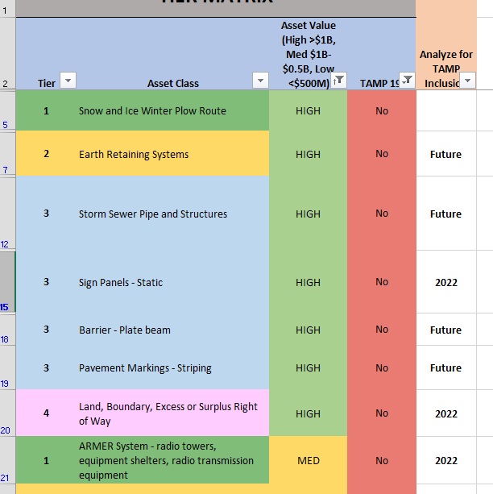
Matrix Data Results
High Value Assets
High Value Assets

Slide 39
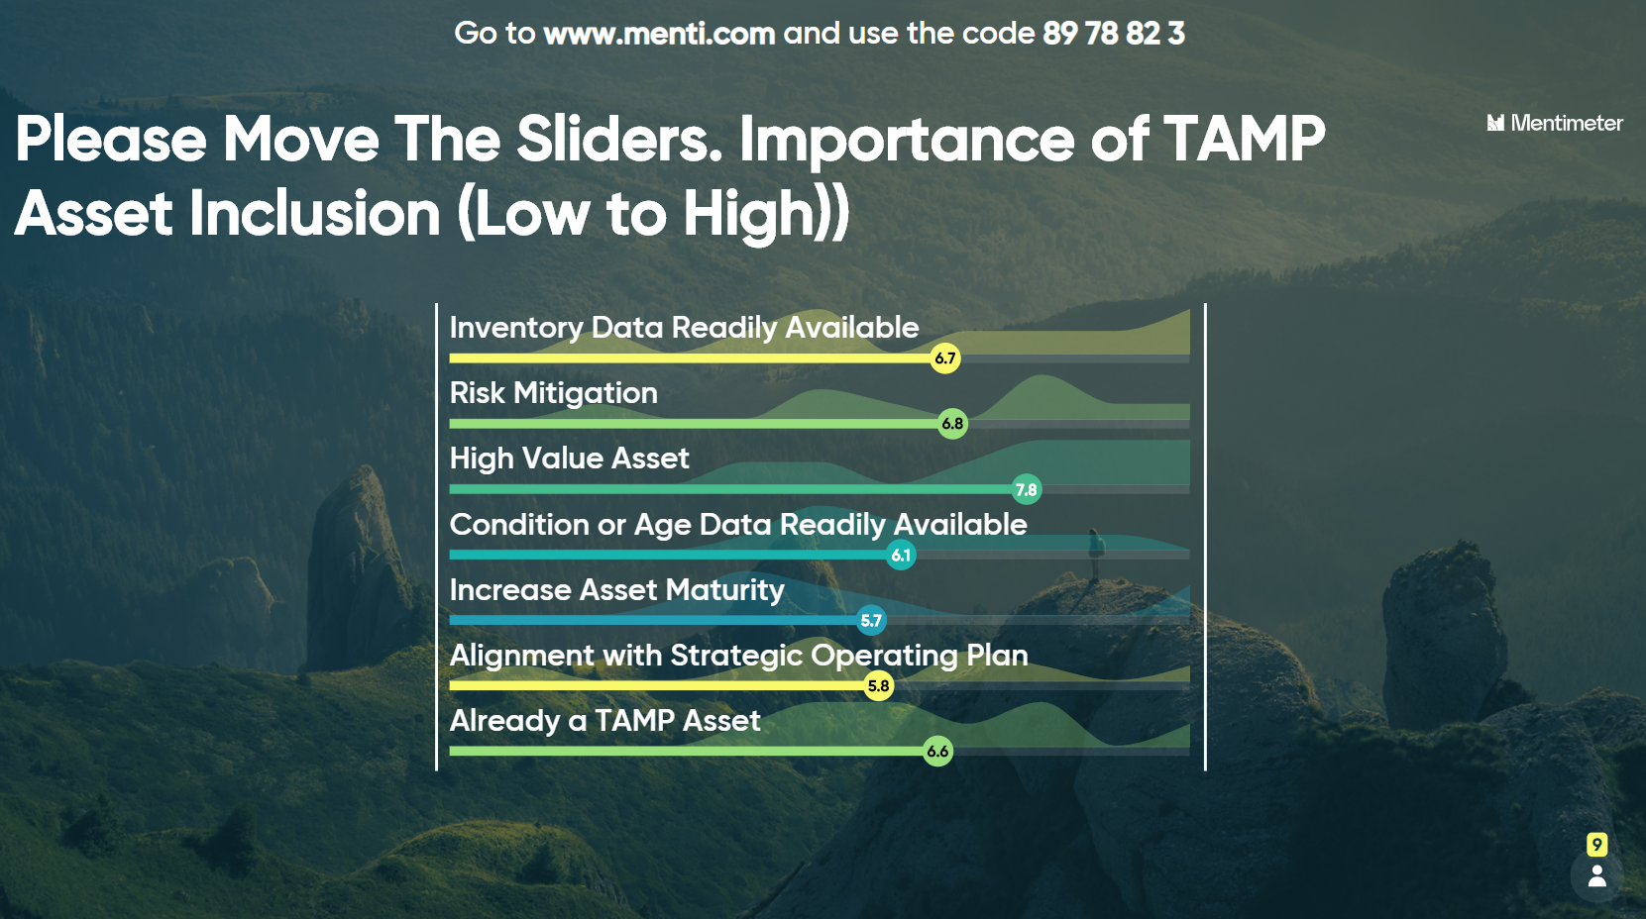
Team Matrix – Results of Menti.com

Slide 40
TIER 1
TAMP Assets RED
Tier 1 assets represent a combination of the highest monetary valued assets along with assets that are critical to public safety, mobility, and the economy. Failure of a single asset could lead to an immediate safety risk or impact the transportation network for an entire region Poor performance by a group of similar assets could result in regional or even statewide impacts. As a result, these assets receive the greatest level of scrutiny and resources dedicated to data collection, investment decision making, maintenance, and capital investments to provide the highest practical level of service and reliability.
Vehicle Bridges and Tunnels
Signal Systems
Intelligent Transportation Systems (ITS)
ARMER Radio System
Facilities
Highway Mainline Pavements
Winter Plow Routes (S&I)
Bridge Culverts

Slide 41
TIER 2
TAMP Assets RED
Tier 2 assets are typically not as high-value as tier 4 assets, but still represent a significant consequence to public safety upon failure for a corridor or municipality. As a result, MnDOT dedicates resources to pro-actively monitoring and subsequent interventions to prevent unacceptable performance. The agency collects and uses data on these assets to identify, prioritize, and deliver maintenance and repair actions to cost-effectively manage the assets throughout their service lives.
ADA Accessible Parking
Highway Culverts
Geotechnical Earth Retaining Structures
Highway Ramps/Loop Pavement
ADA Curb Ramps and Sidewalks
Rest Areas
Geotechnical Reinforced Soil Slopes
Highway Shoulder Pavement
Bike and Ped On-Street Pavement, Shared
Bridge Ped/Bike/
Utility
Anti-Icing Equipment
Geotechnical Subgrade Modifications
High Mast Lighting

Slide 42
TIER 3 - TAMP Assets RED
Tier 3 assets support safety and system performance at their specific locations. Individual failures of these assets can have significant local impacts but are of limited consequence to overall network performance. These assets typically benefit from routine or cyclical replacements, of components or whole assets, to ensure proper performance. Inventory data is collected to support the efficient scheduling and delivery of appropriate cyclical work. Additionally, condition data may be collected for some assets to comply with mandates (e.g., municipal separate storm sewer systems), optimize the maintenance and replacement cycles (e.g. sign panels), or both
c
Hydraulic Tunnels, Ponds, Side Culverts
Sign Panels (Static)
Geotechnical Instrumentation
Barrier Attenuators and End Treatments
Pavement Striping
Sign Structures Overheads and I-beams
Geotechnical Special Drainage
Plate Beam Barrier
Pavement Messages
High Tension Cable Barrier
Storm Sewer
Sign Structures Ground Mounted
Entrance Monuments
Wood Noise Walls
SPCD’s
On, Off-street, Other, Trails, and Bike Lanes
RWIS
Weigh Stations
Roadway Lighting

Slide 43
TIER 4 - TAMP Assets RED
Tier 4 assets represent limited risk to the transportation network. Failure of these assets generally impacts only the location served by that asset. To mitigate these risks, MnDOT has guidelines regarding maintenance response times to repair or replace assets within a certain period after being notified of the unacceptable condition to minimize the impact on safety and system performance. MnDOT collects and routinely updates inventory on these assets to ensure the agency has an accurate accounting of the current infrastructure and its needs. Work performed to maintain, improve, or replace these assets is tracked, specific to each individual asset or installation.
Snow Fence
Concrete Noise Walls
Mitigated Wetlands
Right-of-Way
Geotechnical Improved Subgrade
Rumble Strips and Stripes
Concrete Barrier
Targeted Trees
Geotechnical Natural Hazards

Slide 44
Responsibility Guide
Who is the Asset Owner?
Who is the Asset Program Manager?
Programming and Scoping
Field Inventory Data (Not Condition or Performance Data)
Inspection – Cyclical (Condition Data)
Maintenance and Operations (Performance/Accomplishment and Condition Data)
Design, Standards/Specification Provisions and Construction Inspection
Analysis and Reporting
63 Questions per Asset Type

Slide 45
Discussion
Questions, Comments, Recommendations, Requests…

Slide 46
Project Status
Complete
Consultant 12/20/19
Surveys 4/10/2019
Calls 5/26/2020
Visioning Meeting
Draft Outreach Plan
Remaining
Conduct Working Sessions Technical Work Teams (Short term issues - Thru Dec 2020)
Conduct Working Sessions Technical Work Teams (Longer term issues - Begin Early CY 2021)
Communications, Outreach, Engagement (ongoing)
Adopt Recommendations of PMT (AMSC)
Prepare Final Document
Prepare Communications Materials, Execute Communications Plan
Notes:
Visioning meeting by PMT and AMSC

Slide 47
Collaborative Emphasis
  Stakeholders
    “Planners” – Investment Planning, Specialty Functions/Offices, Department Leadership, etc.
    “Implementers” – Districts hold the bag! Make trade off decisions – “Feed the hungry mouths”.
      Make plans & execute, maintain data, record costs/utilize TAMS
  Seats at the table:
    Asset Management Surveys
    District follow-up calls (4 X 60 ee’s approx.)
    Project Management Team:
      JT Anderson, Mike Ginnaty, Lindsey Bruer, Steve Lund, Todd Stevens, Jed Falgren, Mitch Webster, Mike Dougherty
      Glenn Engstrom, Kevin Western
      Trisha Stefanski, Shannon Foss
      FHWA
    “Technical Work Teams” (6 +/- under development) (OPS and specialty personnel)
    AMSC
Notes:
Emphasis on districts/operations reps

Slide 48
Project Status
PMT: Long Term Topics
Knowledge Transfer
Technology and Tools
Further TAMP integration
Notes:
Longer term issues. AMSIP may be a roadmap rather than record of decision
Knowledge transfer – roles and responsibilities, other gaps? Ex OPS AM position each district?
Prioritized plan for implementation Ex: Bridge? Fleet? Georilla functions? Chimes? Etc.
TAMP – which assets? Tiering? How work done in TAMP can benefit planning, maintenance etc.

Slide 49
Project Status
PMT: Short Term Topics
Asset Matrix
  Develop a tiered structure based on robustness of management
  Determine (or validate) data needs (ROI if necessary) via tiers
  Determine, Document responsibilities
Geotechnical Assets
  May be sub-team of Asset Matrix
Preventive Maintenance
  Definitions
  Develop strategies for sustainability
  Input into MnSHIP process
Communications Plan and Execution
  Crucial to answer “Why”
  Stakeholders, Topics, Tactics
TAMP topics
  Integration between capital and maintenance
  Implementation topics
  Assets Included
Notes:
Matrix = substantive part of plan - Summarizing the asset information available and its location for each asset class.
Defining the asset characteristics most critical to forming asset tiers. (Performance, Condition, Reactive)
Establishing asset tiers and assigning asset classes to each tier.
Determining the types of data needed to manage each tier and the level of detail required (for instance, is as-built information needed)?
Conducting a Return on Investment (ROI) analysis where it would be beneficial to support the recommendations.
Establishing a schedule for addressing any gaps in data.
Compiling the relevant information into an asset matrix.

Slide 50
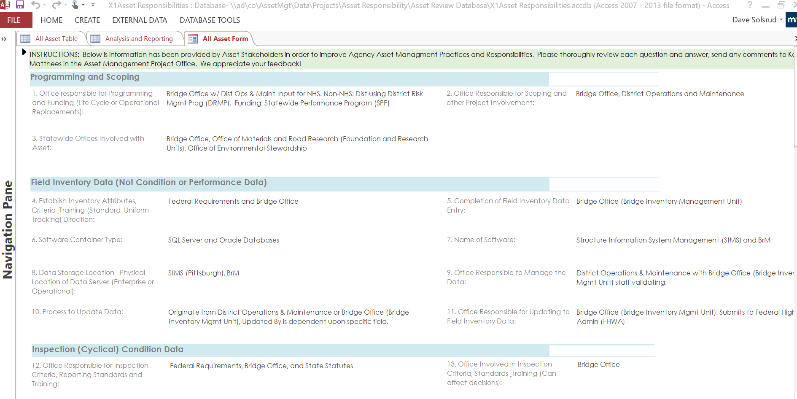
Asset Matrix
Notes:
Try for Live Demo
Responsibility Fields
Asset Inventory

Slide 51
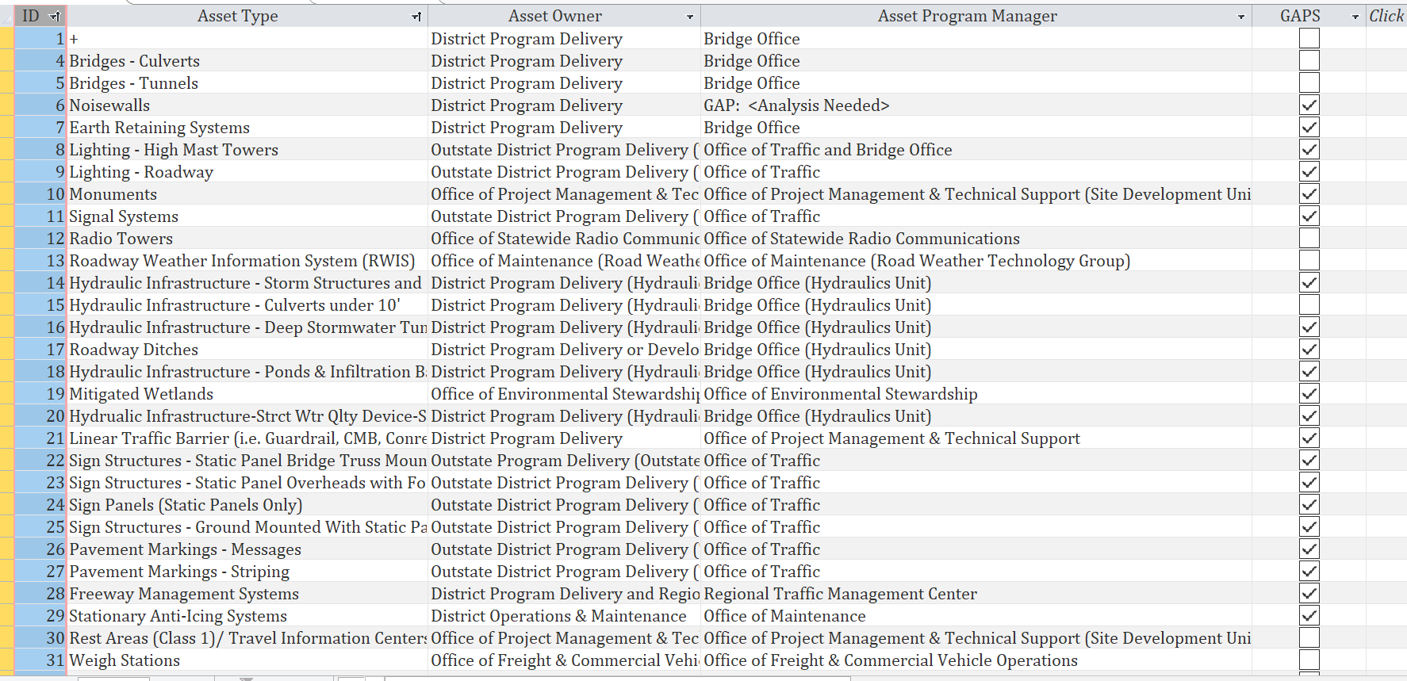
Asset Matrix
Notes:
Try for Live Demo
Responsibility Fields
Asset Inventory

Slide 52
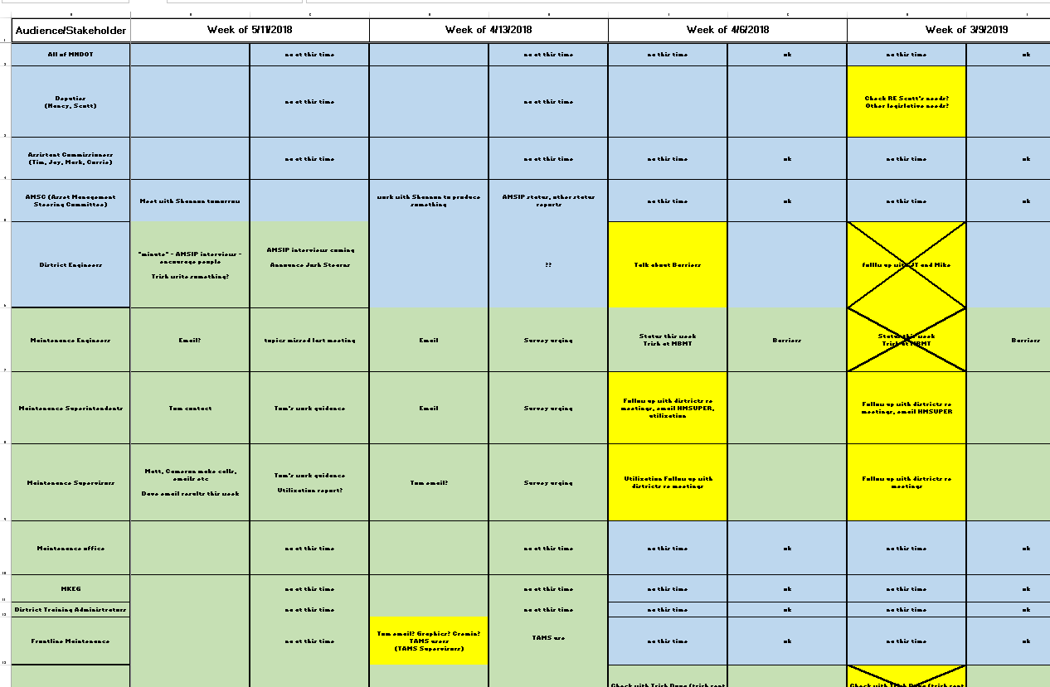
Communications Plan
Notes:
Stakeholders
Message needed
Tactics
Timeframes

Slide 53
OPS Help Needed
col·lab·o·ra·tion : collaboration; the action of working with someone to produce or create something.
Active Participation needed – Primarily Technical Work Teams
5 – 6 teams needed soon
Heavy lift – people who can represent these issues are busy
Important to generate good decisions
Notes:
A key is balancing wants with consequences….. (we saw in surveys and on calls – people desire good info and tool…at what cost?)

Slide 54
OPS Help Needed
Communications
  How can we effectively share what’s happening?
  How can we share results?
  What people need to know…
Notes:
My challenge! Email – who reads? Meetings? Work team members have a communications assignment

Slide 55
Mike & JT
Mike Ginnaty, JT - prep for Thursday:
Background how we got here - not much.
Update on how we are thinking about tiering assets
What that may mean
Number of assets
Level of effort
Tie back to 081
Commitments to maintaining data
General agreement this is good
Resources
Dave's interest in district engagement.
TAMS - value in this? Who see's the benefit.
Damage restitution - department gains
Show a benefit, even if not to individuals
PMT members
Communications ask - How- minimal email reading

Slide 56

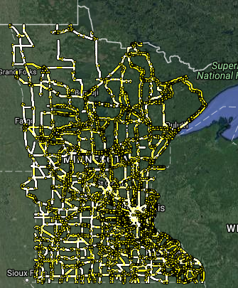
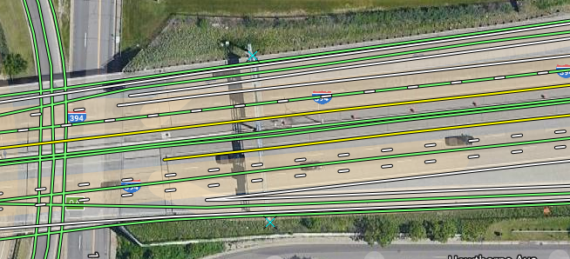
Traffic Barrier Project
Sharing of Data
Utilizing Georilla a GeoMoose OpenLayer 3 Mapserver for Windows Open Source GIS Based Viewer
  700 Unique Visitors Per Month

Slide 57
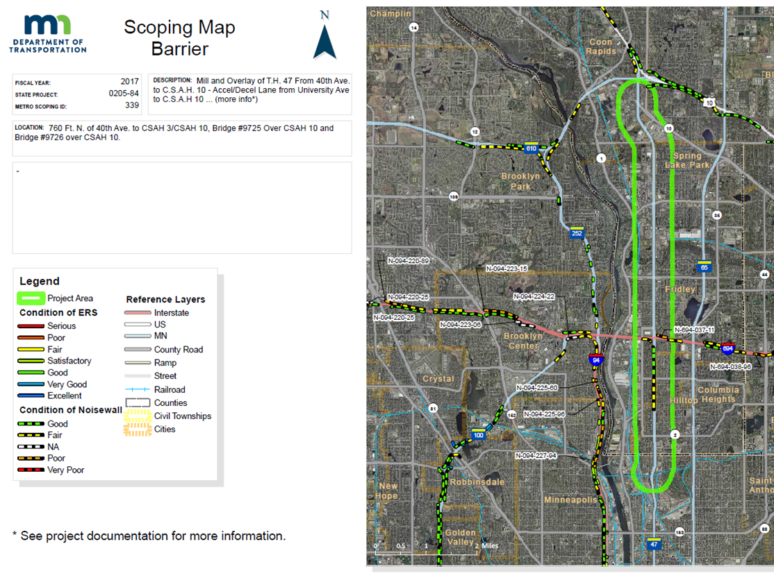
Traffic Barrier Project
Sharing of Data

Slide 58
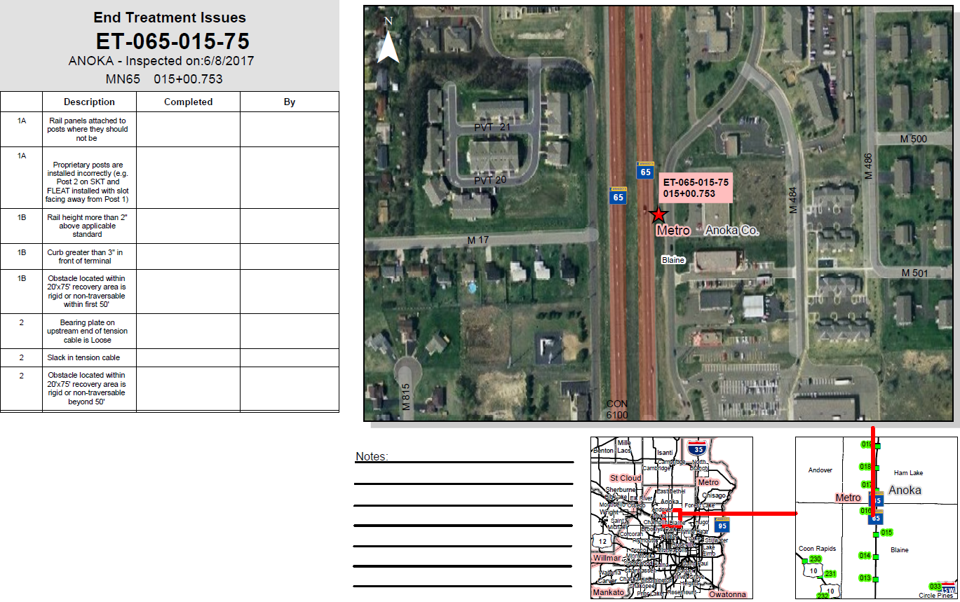
Traffic Barrier Project
Sharing of Data

