Slide 1
AMSIP Communication Priorities
Friday, April 30, 2021

Slide 2
Information Needs
General Asset Management Knowledge – Messaging that builds general knowledge & support for AM
TAMS Data – Conveying the importance of quality data & its benefits
Decision Making – Demonstrating the importance of using TAMS data & AM principles to make decisions
TAMP Implementation – Ensuring the implementation of the TAMP
Coordination With External Stakeholders

Slide 3
Target Audiences

Slide 4
1. Communicate Roles & Develop Initial Resources – Complete by June 30,2021
Add communication needs generated by the AMSIP work groups to messaging needs
Establish an on-going Work Group to provide feedback
Prepare initial materials
Include general information about AM & its importance
Provide examples showing benefits to MnDOT
Establish a shared portal
Present the communication plan to Senior Leadership

Slide 5
2. District Rollout – Complete by December 2021
Develop materials targeted to Districts focused on the importance of TAMS data to decision making.
Customize examples to be relevant to each District
Include a variety of formats, including PowerPoints, handouts, posters, how-to-training, & videos
Post materials on the portal
Meet with District Management to explain objectives & provide the materials available
Share the information with Districts

Slide 6
3. Central Office Rollout – Complete by March 2022
Meet with Central Office Management personnel to explain objectives & information available
Develop additional materials in collaboration with the Communication Work Group
Share the additional information

Slide 7
4. MnSHIP/TAMP Rollout – Complete by December 2022
Identify communication topics that need to be shared
Develop the material & a plan for its distribution
Share the material
Monitor activities & support as needed

Slide 8
5. On-Going Communication Efforts – Complete by December 2025
Monitor activities to promote AM & support when necessary
Present results to Executive & Senior Leadership to maintain support for AM
Annually review the plan & make necessary adjustments
Update the materials & put on the shared portal

Slide 9
What Initial Materials Are Needed?
PowerPoint Slides
Handouts/Flyers
Videos
Other Materials

Slide 10
PowerPoints – First Priorities
General TAM Information
TAMS Data
Implementation of TAMS may impact/change the way you do your job
Information specific to TAMS data collection
Information on why TAMS is important & how it’s used

Slide 11
PowerPoints – Later Priorities
Decision Making to Support Project & Treatment Selection
Why program goals should match TAMP commitments
Understanding trade-offs
Considering future maintenance costs when programming projects
TAMP implementation
Coordination with stakeholders

Slide 12
Handouts & Flyers
TAMS is Making a Different
Quality Data Matters!
The Data You Collect Makes a Difference!
What Asset Management Means at MnDOT

Slide 13
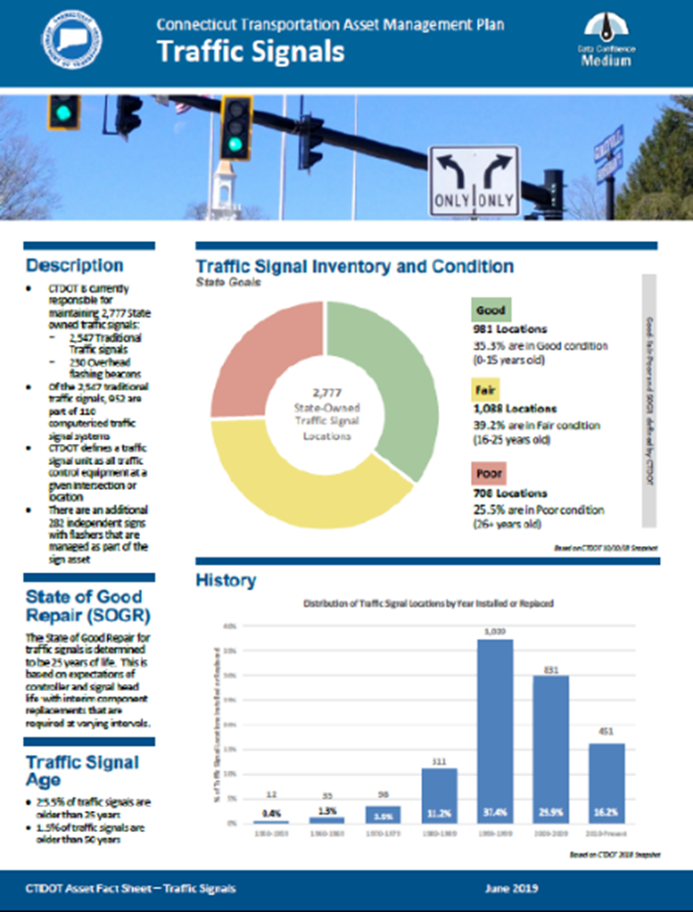
Questions
How does the work from the Asset Matrix & Pavement Preservation work groups fit into the plan?
How urgent is the development of a short, animated video on asset management?
How urgent are online training videos related to TAMS?
Is it reasonable to develop Asset Folios after the TAMP is developed?

Slide 14
What Other Priorities Are There?
This Photo by Unknown Author is licensed under CC BY-ND

